Slide 1
CIS143 Class 01
Spring 2019

Slide 2
Blackboard site
Syllabus
Class schedule
Software to install

Slide 3
The nature of development suites
MAMP is an example of a “stack” – a web server (Apache), a database server (MySQL), and php, a programming environment used to send instructions to the servers
Mobile and web development suites often have layers of tools
The advantages and challenges of using these tools
How to fix an implementation/coding problem

Slide 4
First assignment
Reading: Introduction, chapters 1, 2, 3
Install MAMP
Install text editor (TextMate for Mac, Notepad++ for Windows)
Take screen shots of installed software
Upload screenshots to Blackboard assignment link
Due Monday, February 4th at 10 am

Slide 5
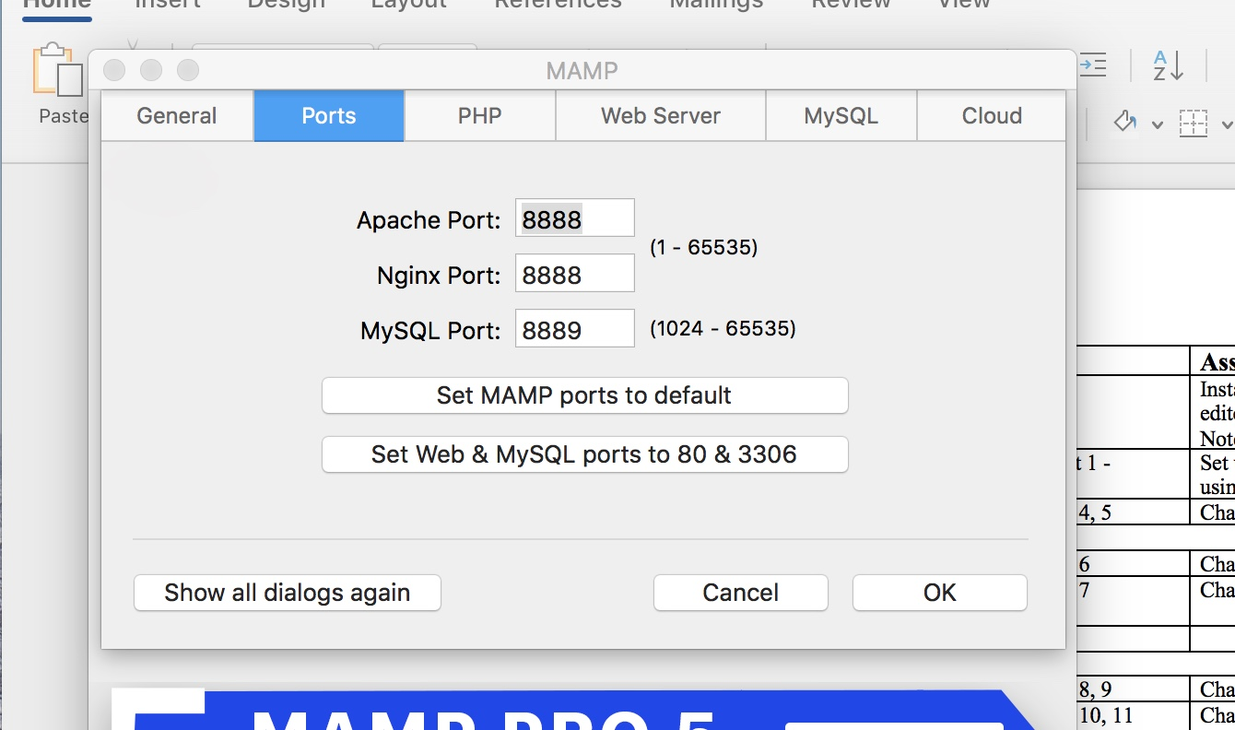
If you want to keep going with MAMP …
Confirm that ports are set to default
This prevents a port conflict (especially an issue with Windows implementation)
Watch tutorial on getting started with MAMP (Lynda.com course or on Youtube)
Try out the MAMP software

