Slide 1
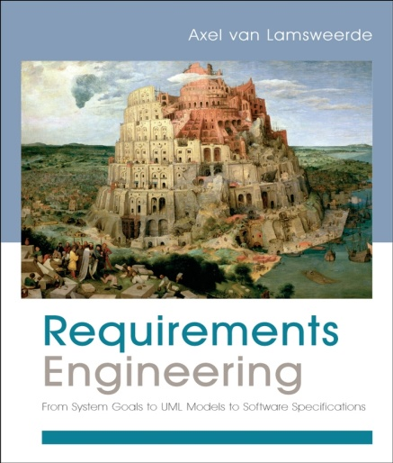
Building System Models for RE
Chapter 8
Modeling System Objectives with Goal Diagrams

Slide 2
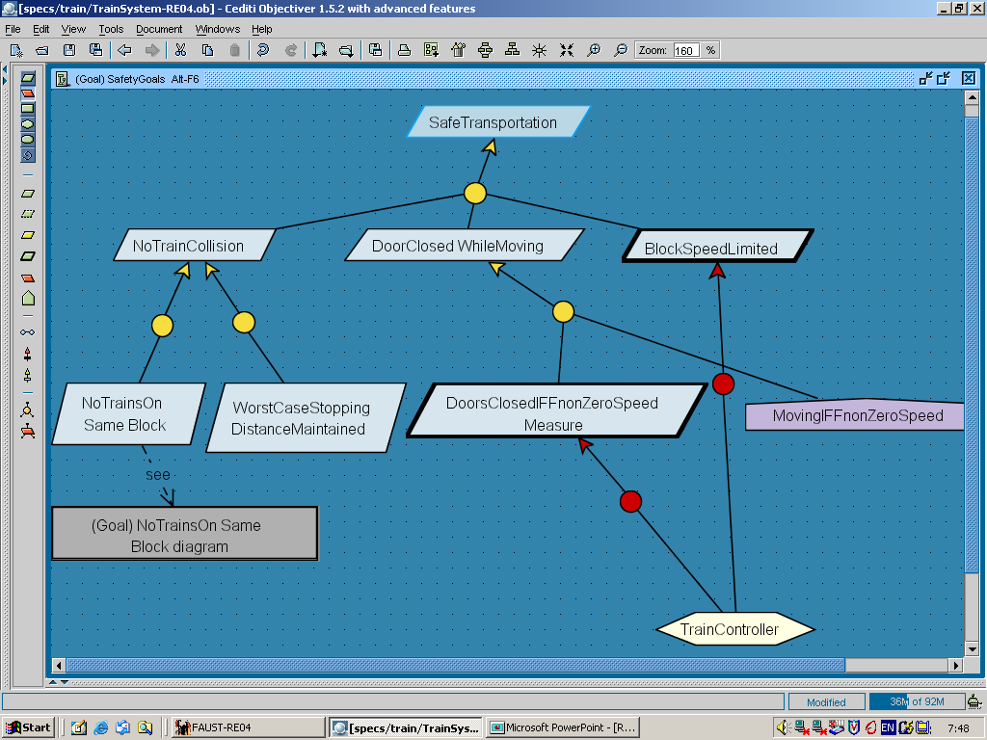
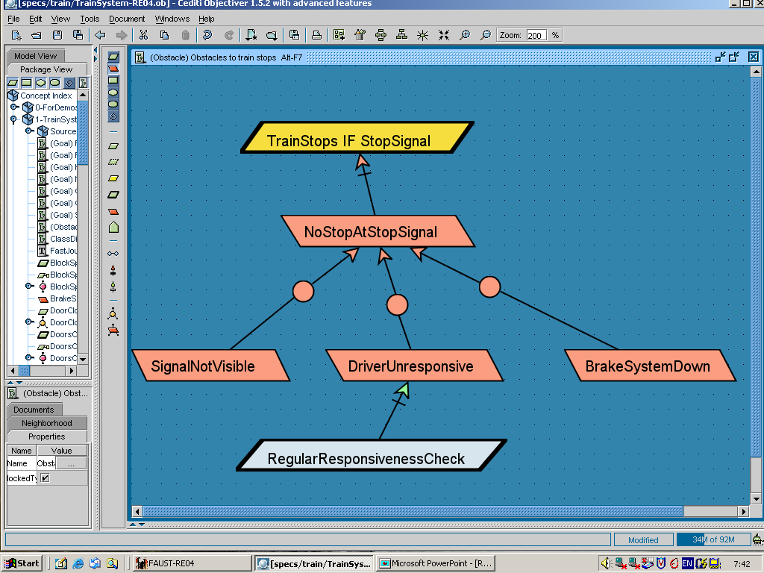
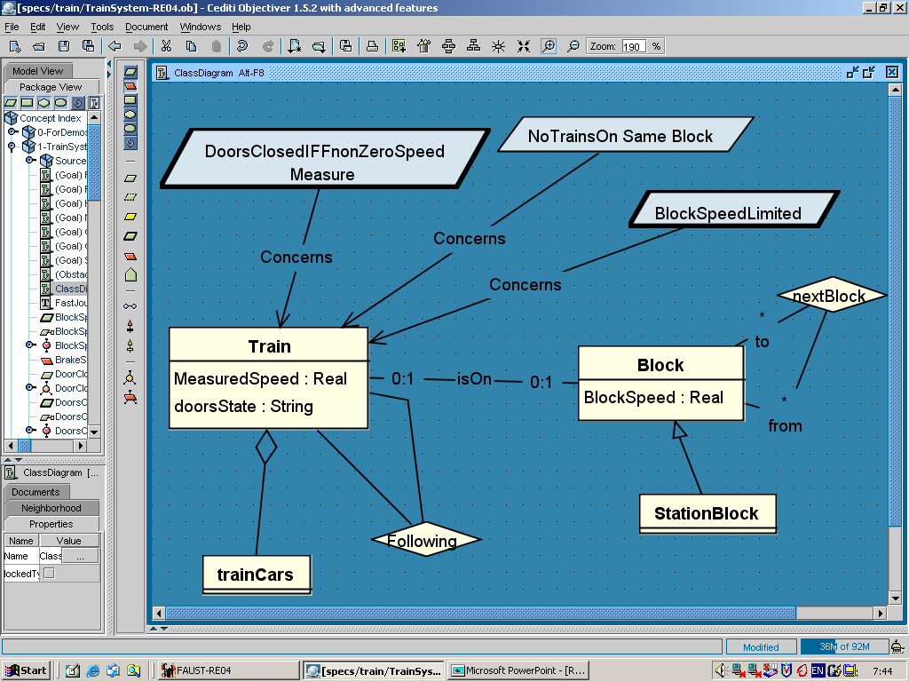
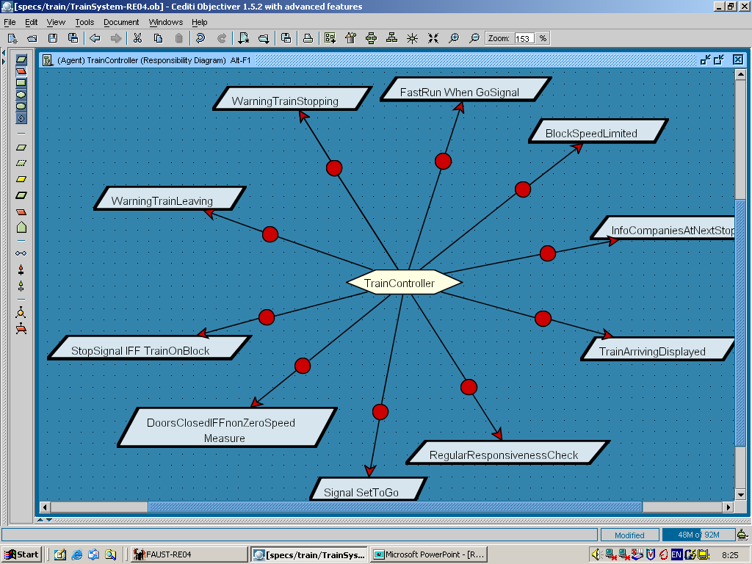
Intentional view of the modeled system
Chap.8: Goals
Chap.9: Risks
why ?
Chap.10: Conceptual objects
Chap.11: Agents
on what?
who ?

Slide 3
Goals as seen in Chapter 7
Prescriptive statements of intent the system should satisfy through cooperation of its agents
  formulated in terms of problem world phenomena
  at various levels of abstraction/granularity
Can be negotiated, weakened, prioritized (unlike domain props)
The finer-grained a goal, the fewer agents required for its satisfaction
  requirements, expectations: single-agent goals
Behavioral (Achieve/Maintain) goals, soft goals
Functional, quality, development goals

Slide 4
A goal model shows contribution links and leafgoal assignments
AND-refinement
OR-
refinement

Slide 5
Goal modeling: outline
Goal features as model annotations
Goal refinement
Capturing conflicts among goals
Connecting the goal model with other system views
Capturing alternative options
Goal diagrams as AND/OR graphs
Documenting goal refinements & assignments with annotations
Building goal models: heuristic rules & reusable patterns

Slide 6
Goal features are specified in model annotations
goal
DoorsClosedWhileMoving
Goal Maintain [DoorsClosedWhileMoving]
Def All train doors shall be kept closed at any time
when the train is moving
[ FormalSpec ... in temporal logic for analysis, not in this chapter ... ]
[ Category Safety ]
[ Priority Highest ]
[ Source From interview with railway engineer X ... ]
annotation
precise definition
features

Slide 7
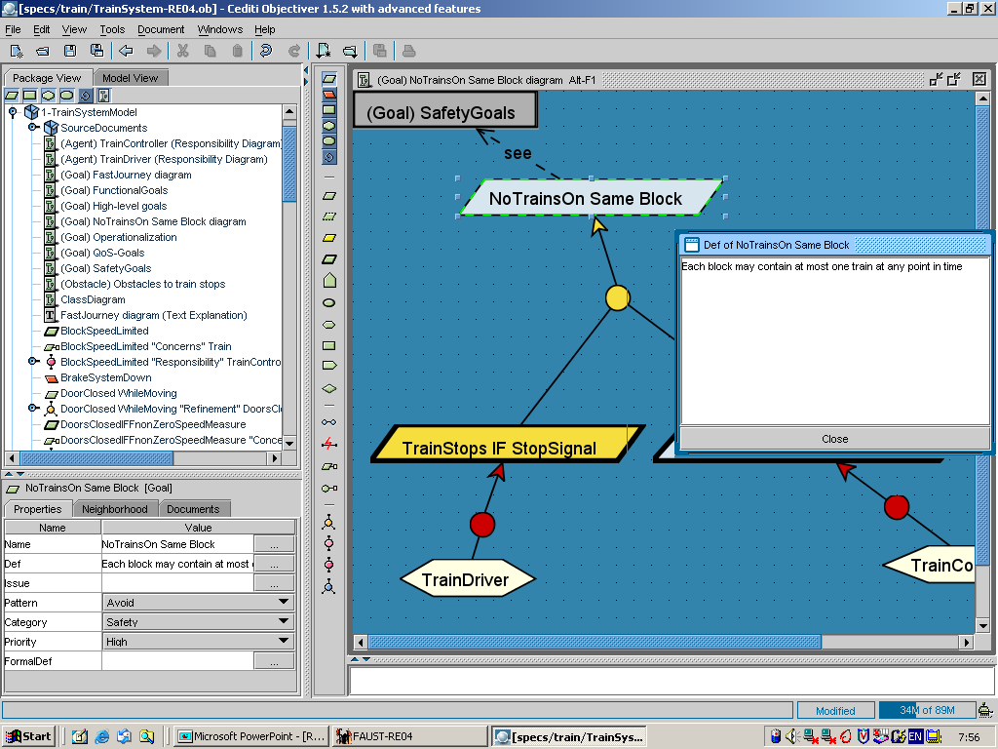

Slide 8
Goal refinement
An AND-refinement of goal G into subgoals G₁, ..., G_{n} states that G can be satisfied by satisfying G₁, ..., G_{n}
The set {G₁, ..., G_{n}} is called refinement of G
  Subgoal G_{i} is said to contribute positively to G
goal
Achieve [BookRequestSatisfied]
AND-refinement
Achieve [ CopyBorrowed
If Available]
Achieve [CopyDueSoon
If Not Available]
Def In case a requested book has no copy available for check out,
a copy of that book shall be made available within 2 weeks
for check out by the requesting patron.

Slide 9
AND-refinements should be complete
{G₁, ..., G_{n}} is a complete AND-refinement of G iff satisfying G₁, ..., G_{n} is sufficient for satisfying G in view of known domain properties
    {G₁, ..., G_{n}, Dom} |= G
Achieve [BookRequestSatisfied]
complete AND-refinement (claim)
Achieve [ CopyBorrowed
If Available]
Achieve [CopyDueSoon
If Not Available]
Achieve[ CopyReserved]
Maintain[AvailabilityEnforced]
Achieve[AvailabilityNotified]

Slide 10
Complete AND-refinements
Getting complete refinements of behavioral goals is essential for requirements completeness
Domain properties are often used for arguing about complete refinements
  classified as ...
    domain invariants: known to hold in every state
    "train doors are either open or closed"
    domain hypotheses: assumed to hold in specific states
    "railway tracks are in good conditions ..."
  attached to conceptual objects in the object model

Slide 11
Domain properties in AND-refinements
DoorsClosedWhileMoving
domain
invariant
DoorsClosedWhileNonZeroSpeed
Moving Iff
NonZeroSpeed

Slide 12
AND-refinements should also be consistent and minimal
Consistent: subgoals G₁, ..., G_{n} and domain properties in Dom may not contradict each other:
    {G₁, ..., G_{n}, Dom} |≠ false
    (any behavior would be permitted from false)
Minimal: if one subgoal G_{j} is missing, the parent goal is no longer necessarily satisfied:
  {G₁, ..., G_{j-1}, G_{j+1}, ..., G_{n}, Dom} |≠ G
  (to avoid unnecessarily restrictive requirements or expectations)

Slide 13
Refinement trees
Goals are recursively refinable
Leaf nodes = goals assignable to single system agents

Slide 14
Refinement trees visualize satisfaction arguments

Slide 15
Chaining satisfaction arguments into argumentation trees
To show how requirements ensure higher-level concerns, and recursively
MotorRaising ®
HandBrakeReleased
req
motor.Regime = ‘up’ ®
handBrakeCtrl = ‘off’
motor.Regime = ‘up’ « MotorRaising
handBrakeCtrl = ‘off’
«HandBrakeReleased

Slide 16
Chaining satisfaction arguments into argumentation trees
To show how requirements ensure higher-level concerns, and recursively
HandBrakeReleased
« MotorRaising
HandBrakeReleased
® MotorRaising
MotorRaising ®
HandBrakeReleased
req
motor.Regime = ‘up’ ®
handBrakeCtrl = ‘off’
motor.Regime = ‘up’ « MotorRaising
handBrakeCtrl = ‘off’
«HandBrakeReleased

Slide 17
Chaining satisfaction arguments into argumentation trees
To show how requirements ensure higher-level concerns, and recursively
HandBrakeReleased « DriverWantsToStart
HandBrakeReleased
« MotorRaising
MotorRaising «
AccelerPedalPressed
AccelerPedalPressed
« DriverWantsToStart
HandBrakeReleased
® MotorRaising
MotorRaising ®
HandBrakeReleased
req
motor.Regime = ‘up’ ®
handBrakeCtrl = ‘off’
motor.Regime = ‘up’ « MotorRaising
handBrakeCtrl = ‘off’
«HandBrakeReleased

Slide 18
Capturing potential conflicts among goals
Goals G₁, ..., G_{n} are divergent in Dom if boundary condition B can be found making them unsatisfiable together:
    {B, G₁, ..., G_{n}, Dom} |= false
Can be captured for later analysis (cf. Chap. 3, 16, 18)

Slide 19
Connecting the goal model with other system views
Interface links relate goals to other sub-models ⇒ traceability
Responsibility: instances of Agent are the only ones to restrict behaviors to satisfy Goal
Obstruction: satisfaction of Obstacle inhibits satisfaction of Goal
Concern: specification of Goal refers to Object
0perationalization: spec of Operations ensures satisfaction of Goal
Coverage: behaviors prescribed by Goal cover Scenario
Goal
Agent
Obstacle
Goal
Goal
Object
Goal
Oper1
Oper2
Goal

Slide 20
Goal modeling: outline
Goal features as model annotations
Goal refinement
Capturing conflicts among goals
Connecting the goal model with other system views
Capturing alternative options
Goal diagrams as AND/OR graphs
Documenting goal refinements & assignments with annotations
Building goal models: heuristic rules & reusable patterns

Slide 21
Capturing options: alternative refinements
An OR-refinement of goal G into refinements R₁, ..., R_{m} states that G can be satisfied by satisfying all subgoals from any of the alternative refinements R_{i}
Alternative goal refinements yield different system proposals (variants)
Pros/cons to be evaluated against soft goals for selection of best option

Slide 22
Capturing options: alternative assignments
An OR-assignment of goal G to agents A₁, ..., A_{m} states that G can be satisfied by behavioral restrictions of any of the alternative agents A_{i}
Alternative assignments yield different system proposals
(e.g. different degrees of automation)
Pros/cons to be evaluated against soft goals for selection of best option

Slide 23
Goal diagrams as AND/OR graphs
AND/OR graph shows how goal nodes contribute to each other
  roots = high-level system goals
    functional or non-functional
    behavioral or soft
  leaves = requirements or expectations
    assignable to single agents
  an AND-refinement links a parent goal to set of conjoined subgoals
  an OR-refinement links a parent goal to a set of alternative AND-refinements => alternative system options
    soft goals in the graph are used to select preferred options
Generally a directed acyclic graph, not a tree
  multiple roots (e.g. functional, non-functional goals)
  a goal may contribute to multiple parent goals

Slide 24
Goal diagrams as AND/OR graphs (2)
EffectivePassengersTransportation
RapidTransportation
SafeTransportation
AND-refinement
FastJourney
HighFrequency
NoTrainCollision
DoorsClosed
WhileMoving
BlockSpeed
Limited
to-be
system-as-is
OR-refinement
FastRunWhen
GoSignal
SignalSetToGoPromptly
WorstCaseStopping
DistanceMaintained
NoTrainsOn
SameBlock

Slide 25
Goal diagrams as AND/OR graphs (3)
EffectiveAccessToStateOfTheArt
EffectiveLoanSystem
EffectiveBiblioSearchSystem
...
BookRequestSatisfied
Extensive
Coverage
Accurate
Classification
physLib
E-Lib
CopyBorrowed
WhenAvailable
CopyDueSoon
WhenNotAvailable
Effective
BookSupply
E-bookAccess
Copy
Reserved
Availability
Notified
Availability
Enforced
LimitedLoan
Amount
LimitedLoan
Periods

Slide 26
Annotating goal refinements & assignments
Optional features
  Name: for unambiguous reference
  SysRef: for associating alternatives to system versions
  Tactic: for documenting refinement tactic (cf. ref. patterns)

Slide 27
Goal modeling: outline
Goal features as model annotations
Goal refinement
Capturing conflicts among goals
Connecting the goal model with other system views
Capturing alternative options
Goal diagrams as AND/OR graphs
Documenting goal refinements & assignments with annotations
Building goal models: heuristic rules & reusable patterns

Slide 28
Heuristic rules for early discovery of goals
Analyze current objectives & problems in system-as-is ...
  preserve strategic, organization-specific objectives & policies
    ⇒ high-level goals for system-to-be
    e.g. Effective access to state-of-the-art knowledge
  preserve application-specific objectives to be found in any system version
    e.g. Accurate book classification
  analyze problems & deficiencies in system-as-is
    ⇒ goals of system-to-be: Avoid / Reduce / Improve them
    e.g. Anywhere anytime biblio search

Slide 29
Heuristic rules for early discovery of goals (2)
Search for goal-related keywords in elicitation material (documents available, interview transcripts, etc.)
  intentional: in order to, so as to, so that, purpose, objective, aim, achieve, maintain, avoid, ensure, guarantee, want, motivate, expect,...
  prescriptive: shall, should, must, has to, to be, may not, may never,...
  amelioration: improve, increase, decrease, reduce, enhance, enable, support, provide, ...
  + refinement links: “in order to X the system has to Y “, ...
  (to be checked against false positives)
X
...
Y

Slide 30
Heuristic rules for early discovery of goals (3)
Instantiate goal categories
  Browse leaves of taxonomies of functional & non-functional goals, looking for system-specific instances
  e.g. Any Information goal concerning train passengers?
  Any Accuracy goal about train information?
  Any Confidentiality goal about meeting participants?

Slide 31
Heuristic rules for later discovery of goals
By abstraction (bottom-up): ask WHY? questions about...
- lower-level goals
- interaction scenarios being elicited
- other operational material available
=> parent goals
By refinement (top-down): ask HOW? questions about ...
    - higher-level-goals
=> subgoals
Frequent questioning patterns
  WHY? directly followed by HOW? on parent goal, to elicit missing “brothers”
  HOW ELSE? to explore alternatives

Slide 32
Building goal models:
HOW and WHY questions
BookRequestSatisfied
HOW?
CopyBorrowed
WhenAvailable
CopyDueSoon
WhenNotAvailable
Copy
Reserved
Availability
Notified
Availability
Enforced
WHY?
LimitedLoan
Amount
LimitedLoan
Periods

Slide 33
Building goal models:
HOW and WHY questions
EffectivePassengersTransportation
HOW?
RapidTransportation
SafeTransportation
FastJourney
HighFrequency
NoTrainCollision
DoorsClosed
WhileMoving
BlockSpeed
Limited
S2B
current
WHY?
FastRunWhen
GoSignal
SignalSetToGoPromptly
WorstCaseStopping
DistanceMaintained
NoTrainsOn
SameBlock

Slide 34
Identifying goals from WHY questions about scenario episodes

Slide 35
Heuristic rules for later discovery of goals (2)
Split responsibilities among agents
  to get subgoals involving fewer agents
  and move towards requirements and expectations

Slide 36
Heuristic rules for later discovery of goals (3)
Identify soft goals from pros & cons of alternative options
  pro => refinement link to missing parent soft goal ?
  con => conflict link to missing parent soft goal ?

Slide 37
Heuristic rules for later discovery of goals (4)
Identify wishes of human agents
  e.g. MinimalRequirementsOnParticipants
Check the converse of Achieve goal for missing Maintain goal
    Achieve [Target If Condition]:
    if Condition then sooner-or-later Target
    ? ↓ ?
    Maintain [Target OnlyIf Condition]:
    always (if Target then Condition)
    e.g. Achieve [ItemSent If Paid] → Maintain [ItemSent OnlyIf Paid]
    Achieve [reverseThrustEnabled If PlaneOnGround]
    → Maintain [reverseThrust OnlyIf PlaneOnGround]

Slide 38
Building goal models: delimiting their scope
Refine goals … until when ?
  ... until assignable to single agents as ...
  requirement (software agent)
  expectation (environment agent)
Abstract goals … until when ?
  ... until boundary of system capabilities is reached:
  goals that cannot be satisfied solely by system agents
  e.g. EliminateGreenhouseEffect
  is beyond capabilities of train system

Slide 39
Goal refinement … until when ?
Maintain[WC-SafeDistanceBetwTrains]
Maintain [Safe
Speed/AccelCom'ed]
Maintain [Safe
TrainRespToComd]
...

Slide 40
Goal refinement … until when ?
Maintain[WC-SafeDistanceBetwTrains]
Maintain[Safe
Speed/AccelCom'ed]
Maintain[Safe
TrainRespToComd]
...
OnBoard
TrainControl

Slide 41
Goal refinement … until when ?
Maintain[WC-SafeDistanceBetwTrains]
Maintain[Safe
Speed/AccelCom'ed]
Maintain[Safe
TrainRespToComd]
...
OnBoard
TrainControl
Mt[AccurateEstimate
OfSpeed/Position]
Mt[SafeComdTo
NextTrainFromEstim]

Slide 42
Goal refinement … until when ?
Maintain[WC-SafeDistanceBetwTrains]
Maintain[Safe
Speed/AccelCom'ed]
Maintain[Safe
TrainRespToComd]
...
OnBoard
TrainControl
Mt[AccurateEstimate
OfSpeed/Position]
Mt[SafeComdTo
NextTrainFromEstim]
Tracking
System

Slide 43
Goal refinement … until when ?
Maintain[WC-SafeDistanceBetwTrains]
Maintain[Safe
Speed/AccelCom'ed]
Maintain[Safe
TrainRespToComd]
...
OnBoard
TrainControl
Mt[AccurateEstimate
OfSpeed/Position]
Mt[SafeComdTo
NextTrainFromEstim]
Tracking
System
Achv[ComdMsg
SentInTime]
Mt[Safe
ComdMsg]
Achv[SentMsg
DeliveredInTime]
Mt[Msg
Implem]

Slide 44
Goal refinement … until when ?
Maintain[WC-SafeDistanceBetwTrains]
Maintain[Safe
Speed/AccelCom'ed]
Maintain[Safe
TrainRespToComd]
...
OnBoard
TrainControl
Mt[AccurateEstimate
OfSpeed/Position]
Mt[SafeComdTo
NextTrainFromEstim]
Tracking
System
Achv[ComdMsg
SentInTime]
Mt[Safe
ComdMsg]
Achv[SentMsg
DeliveredInTime]
Mt[Msg
Implem]
Speed/Accel
Control

Slide 45
Goal refinement … until when ?
Maintain[WC-SafeDistanceBetwTrains]
Maintain[Safe
Speed/AccelCom'ed]
Maintain[Safe
TrainRespToComd]
...
OnBoard
TrainControl
Mt[AccurateEstimate
OfSpeed/Position]
Mt[SafeComdTo
NextTrainFromEstim]
Tracking
System
Achv[ComdMsg
SentInTime]
Mt[Safe
ComdMsg]
Achv[SentMsg
DeliveredInTime]
Mt[Msg
Implem]
Speed/Accel
Control
Communic
Infrastruct

Slide 46
Goal refinement … until when ?
Maintain[WC-SafeDistanceBetwTrains]
Maintain[Safe
Speed/AccelCom'ed]
Maintain[Safe
TrainRespToComd]
...
OnBoard
TrainControl
Mt[AccurateEstimate
OfSpeed/Position]
Mt[SafeComdTo
NextTrainFromEstim]
Tracking
System
Achv[ComdMsg
SentInTime]
Mt[Safe
ComdMsg]
Achv[SentMsg
DeliveredInTime]
Mt[Msg
Implem]
Speed/Accel
Control
Communic
Infrastruct

Slide 47
Building goal models: bad smells
N
Do not confuse ...
  goal ...
  operation ...
  Goal ≠ service from functional model (e.g. use case)
  Services operationalize functional, leaf goals in refinement graph
    a goal is often operationalized through multiple operations
    an operation often operationalizes multiple goals
  Soft goals are often not operationalized in functional model but used to select among alternatives
CopyBorrowed
IfAvailable
DoorsOpen
OnlyIf TrainStopped
Open
Doors
BorrowCopy

Slide 48
Behavioral goals vs. operations
N
Semantic difference
  Behavioral goals constrain entire sequences of state transitions
  Operations constrain single state transitions
Tip: use past participle for goal name
(state to be reached/maintained, quantity to be reduced/increased, ...)
use infinitive for operation name
(action to reach/maintain that state)

Slide 49
Building goal models: bad smells (2)
N
Do not confuse ...
  OR-refinement ...
  AND-refinement by case ...
  cf. case analysis:
  (Case1 or Case2) ⇒ X equiv (Case1 ⇒ X) and (Case2 ⇒ X)
  OR-refinement introduces alternative systems to reach parent goal
  AND-refinement by cases introduces complementary, conjoined subgoals within same system
Extensive
Coverage
physLib
E-Lib
Effective
BookSupply
E-bookAccess
BookRequestSatisfied
CopyBorrowed
If Available
CopyDueSoon
If Not Available

Slide 50
Building goal models: bad smells (3)
N
Avoid ambiguities in goal specification & interpretation ...
  a precise & complete goal definition is essential
  grounded on shared system phenomena, and agreed upon by all stakeholders
Def A train shall never get so close to a train in front so that if the train stops suddenly (e.g., derailment) the next train would hit it
WorstCaseStopping
DistanceMaintained
BookRequestSatisfied
Def A book without any copy available for loan shall have a copy available within 15 days for the requesting borrower
CopyDueSoon
WhenNotAvailable

Slide 51
Building goal models: reuse refinement patterns
From a catalogue of generic, complete AND-refinements ...
encode refinement tactics, codify modeller’s experience
guide modeling process by suggesting refinements to be instantiated
  instantiated pattern may sometimes require adaptation
provide satisfaction argument for free
  (formal) correctness proof done once for all, kept hidden
support model documentation & understanding
can also be used for ...
  completing partial refinements
  exploring alternative options (multiple applicable patterns)

Slide 52
A sample of refinement patterns
Refinement by milestone
  Applicable when milestone states can be identified on the way to the goal's target condition
Example of use:
milestone-driven refinement

Slide 53
Refinement by milestone: variant for Maintain goals
milestone-driven refinement
SafeTrainAccelerationGuaranteed
ReceivedCommand
ExecutedByTrain
SafeAcceleration
Computed
AccelerationSent
InTimeToTrain
SentCommand
ReceivedByTrain

Slide 54
A sample of refinement patterns (2)
Refinement by case
  Applicable when the goal satisfaction space can be partitioned into cases (disjoint, covering all possibilities)
Achieve [Target]
Case1 or Case2
not (Case1 and Case2)
Achieve [Target1
If Case1]
Achieve [Target2
If Case2]
if Target1
or Target2
then Target
Example of use:
(Similar pattern for Maintain goals)
BookRequestSatisfied
case-driven refinement
CopyBorrowed
If Available
CopyDueSoon
If Not Available

Slide 55
A sample of refinement patterns (3)
Guard introduction
  Applicable to Achieve goals where a guard condition must be set for reaching the target
Example of use:
guard introduction

Slide 56
A sample of refinement patterns (4)
Divide-and-Conquer
  Applicable to Maintain goals where GoodCondition is a conjunction
Example of use:
divide-and-conquer

Slide 57
A sample of refinement patterns (5)
Refinement towards goal realizability
  Applicable when the goal refers to quantities not monitorable or not controllable by candidate agent
GoalOnUnMonitorableCondition
resolve lack of monitorability
GoalOnMonitorable
Condition
MonitorableCondition Iff
UnMonitorableCondition
GoalOnUnControllableCondition
resolve lack of controllability
GoalOnControllable
Condition
ControllableCondition Iff
UnControllableCondition
Child node may be goal (incl. requirement, expectation)
or domain property (invariant/hypothesis)

Slide 58
Refinement towards goal realizability: examples of use
DoorsClosedWhileMoving
resolve lack of monitorability
DoorsClosedWhileNonZeroSpeed
NonZeroSpeed
Iff Moving
domain invariant
NurseIntervention If CriticalPuseRate
resolve lack of controllability
NurseIntervention
If Alarm
Alarm Iff
CriticalPulseRate
expectation
requirement

Slide 59
Refinement towards goal realizability: examples of use (2)
GoalOnUnMonitorableCondition
GoalOnMonitorable
Condition
MonitorableCondition «
UnmonitorableCondition
instantiation
MotorRaising ® HandBrakeReleased
motor.Regime = ‘up’ ®
HandBrakeReleased
motor.Regime = ‘up’
« MotorRaising

Slide 60
Refinement towards goal realizability: examples of use (3)
GoalOnUnControllableCondition
GoalOnControllable
Condition
ControllableCondition «
UncontrollableCondition
instantiation
motor.Regime = ‘up’ ® HandBrakeReleased
motor.Regime = ‘up’ ®
handBrakeCtrl = ‘off’
handBrakeCtrl = ‘off’
« HandBrakeReleased
req

