Slide 1
Data Visualization

Slide 2
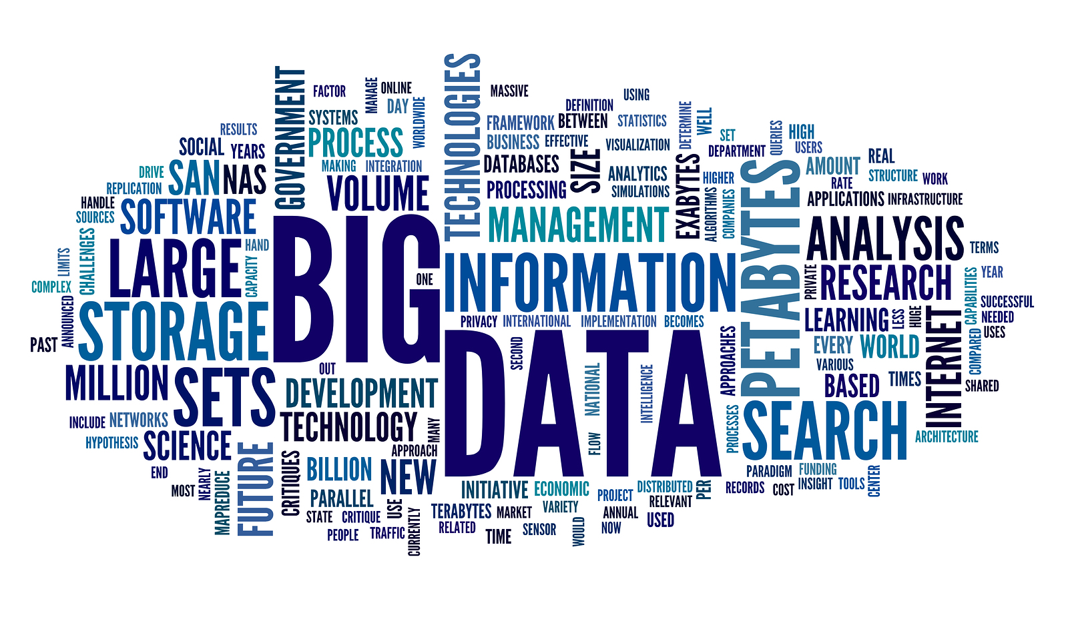
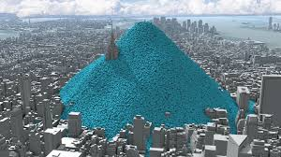
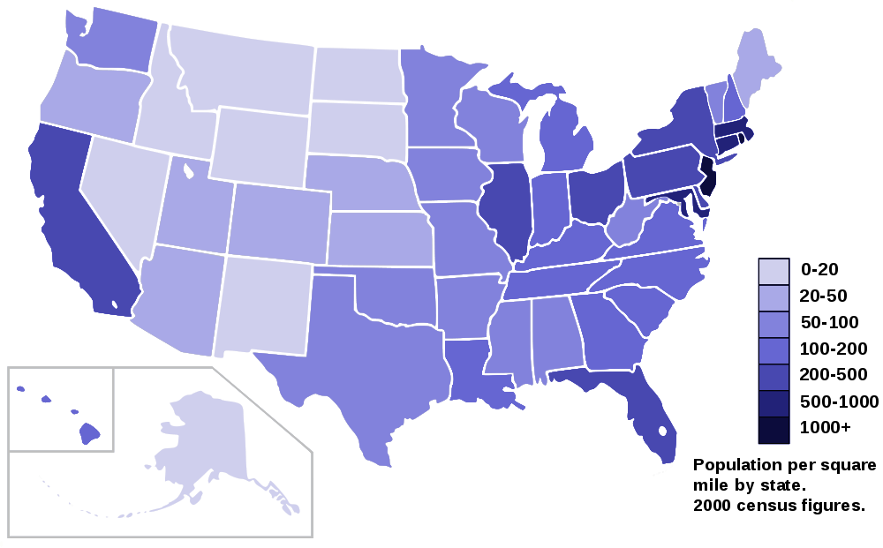
Data Visualization

Slide 3
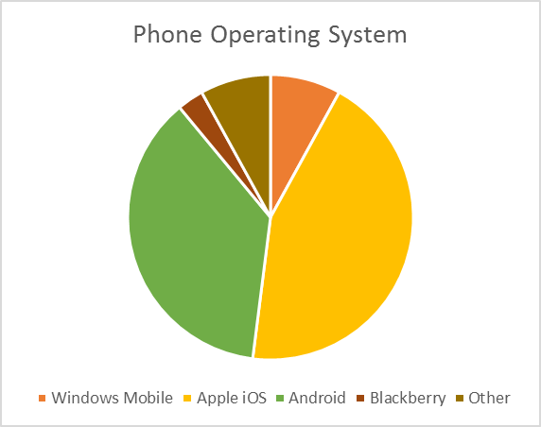
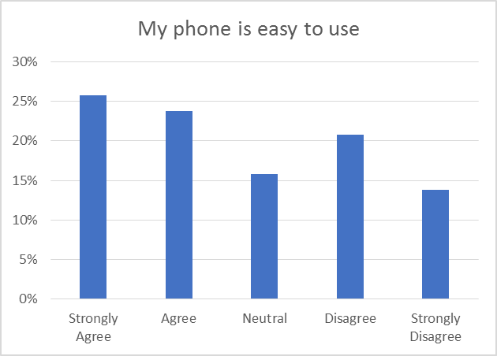
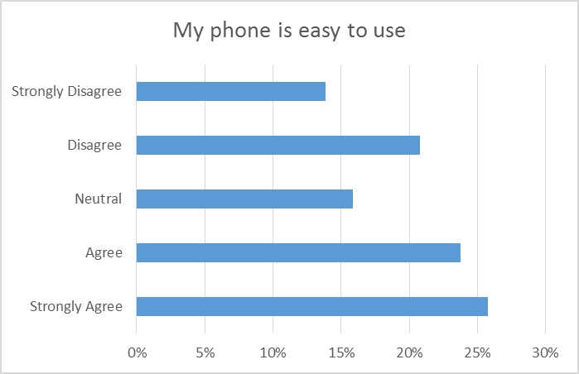
Chart Types
Pie Chart
Column Chart
BAR CHART

Slide 4
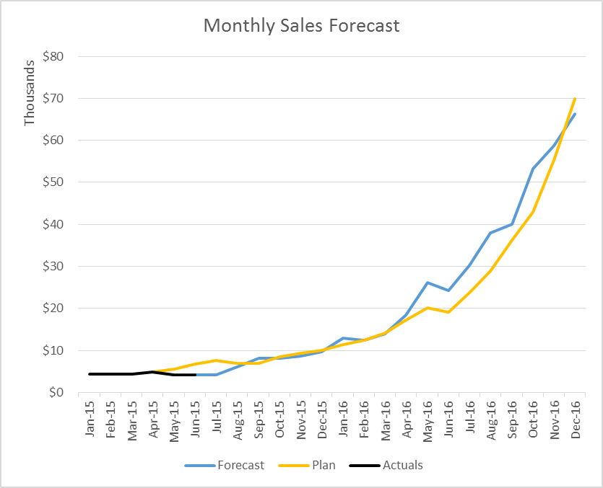
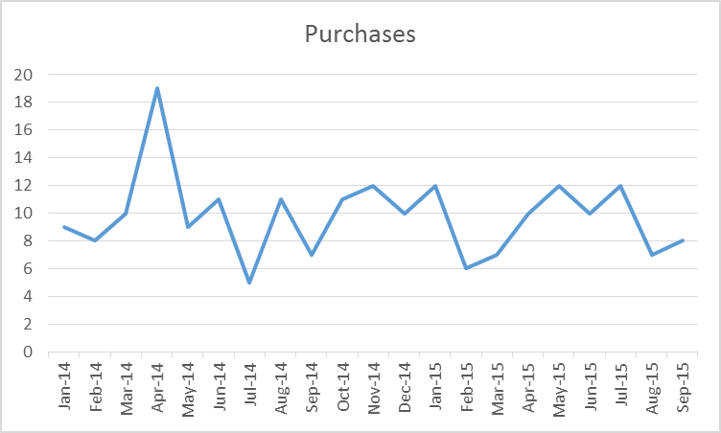
Line graphs and Time Series Data
https://www.captechconsulting.com/blogs/data-scientist-vs-data-analyst

Slide 5
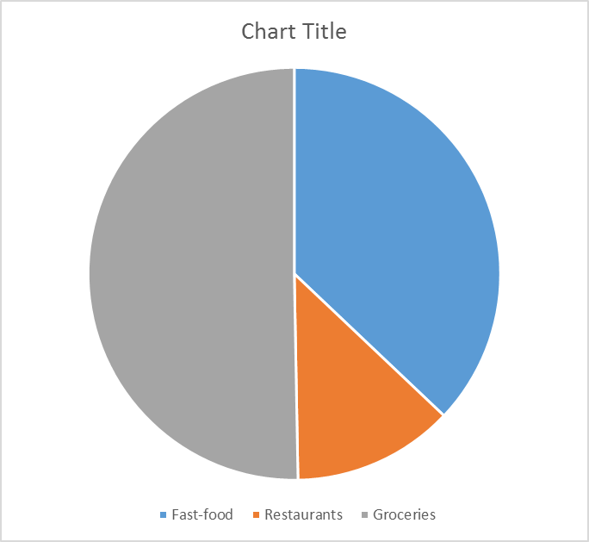
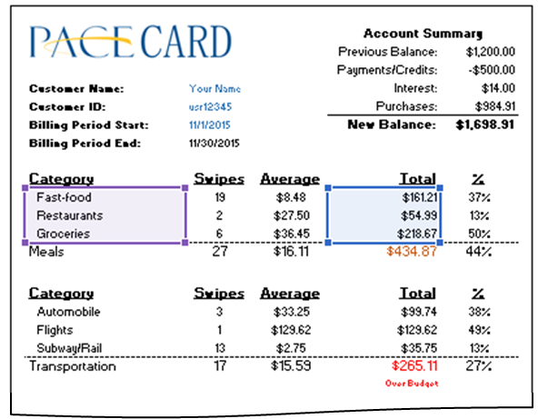
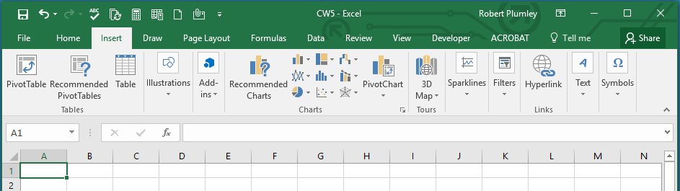
Selecting your Data Source
Axis Labels
Series Values

Slide 6
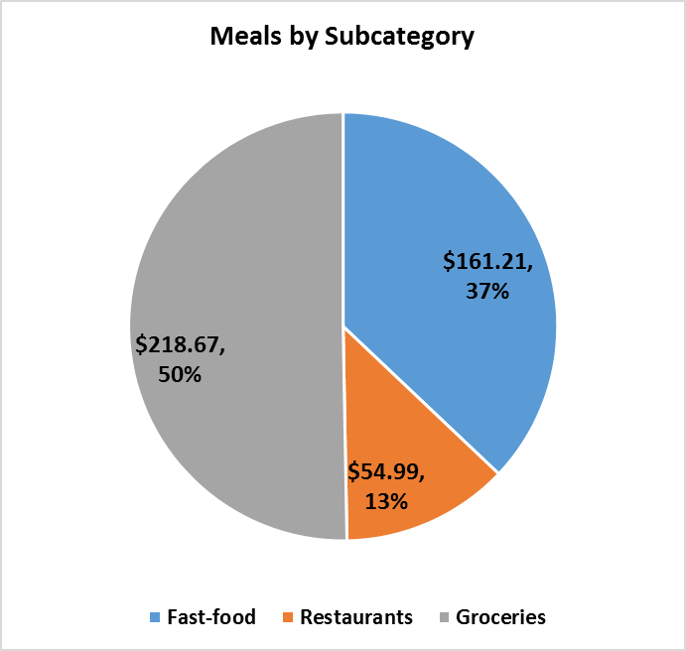
Elements of a Chart
Chart Title
Data Labels
Legend

Slide 7
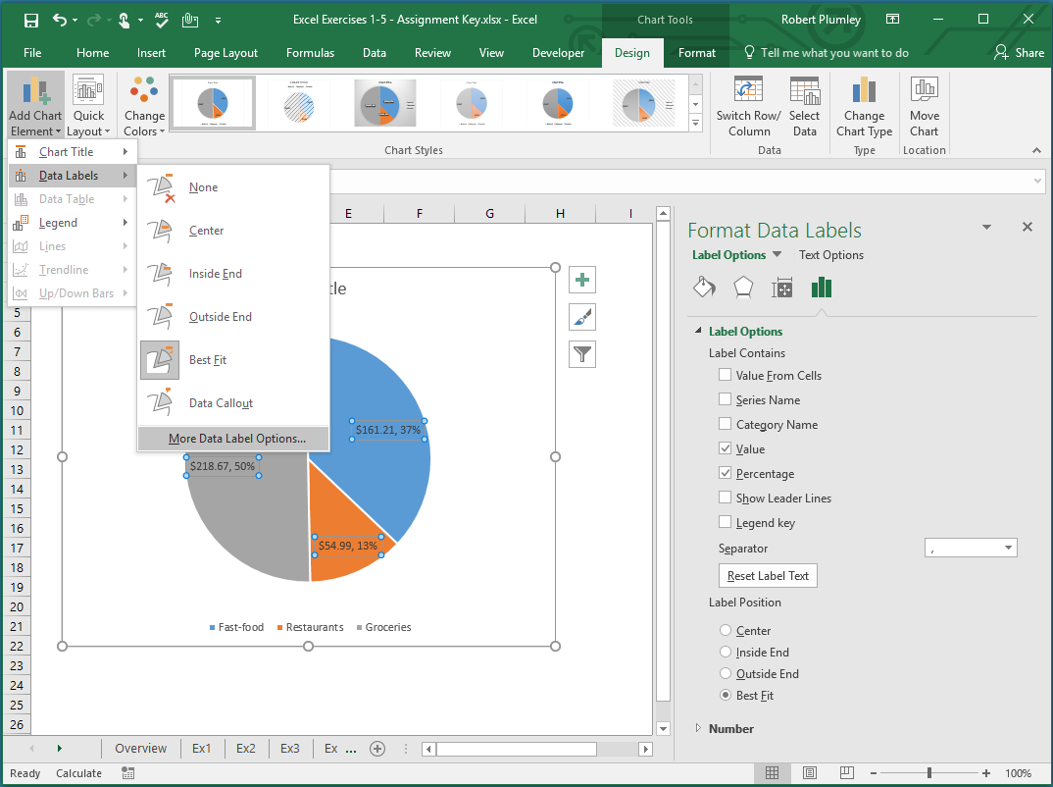
Elements of a Chart

Slide 8
Pivot Tables

Slide 9
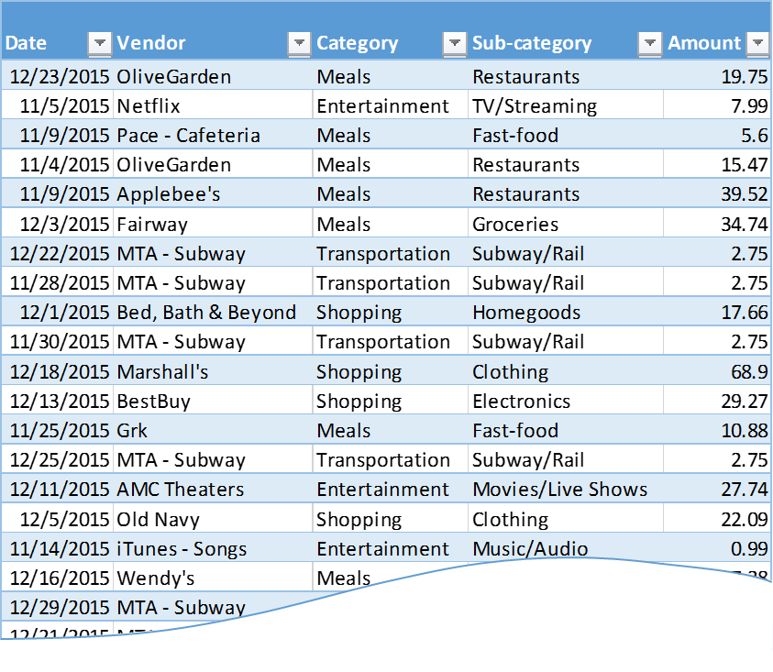
From Data Table to Pivot Table

Slide 10
Creating a PivotTable
Select a cell in source table

Slide 11
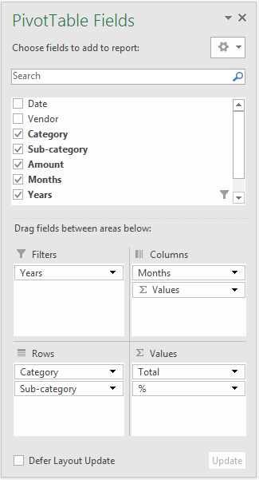
Using the Fields List

