Slide 1
Cloud Computing

Slide 2
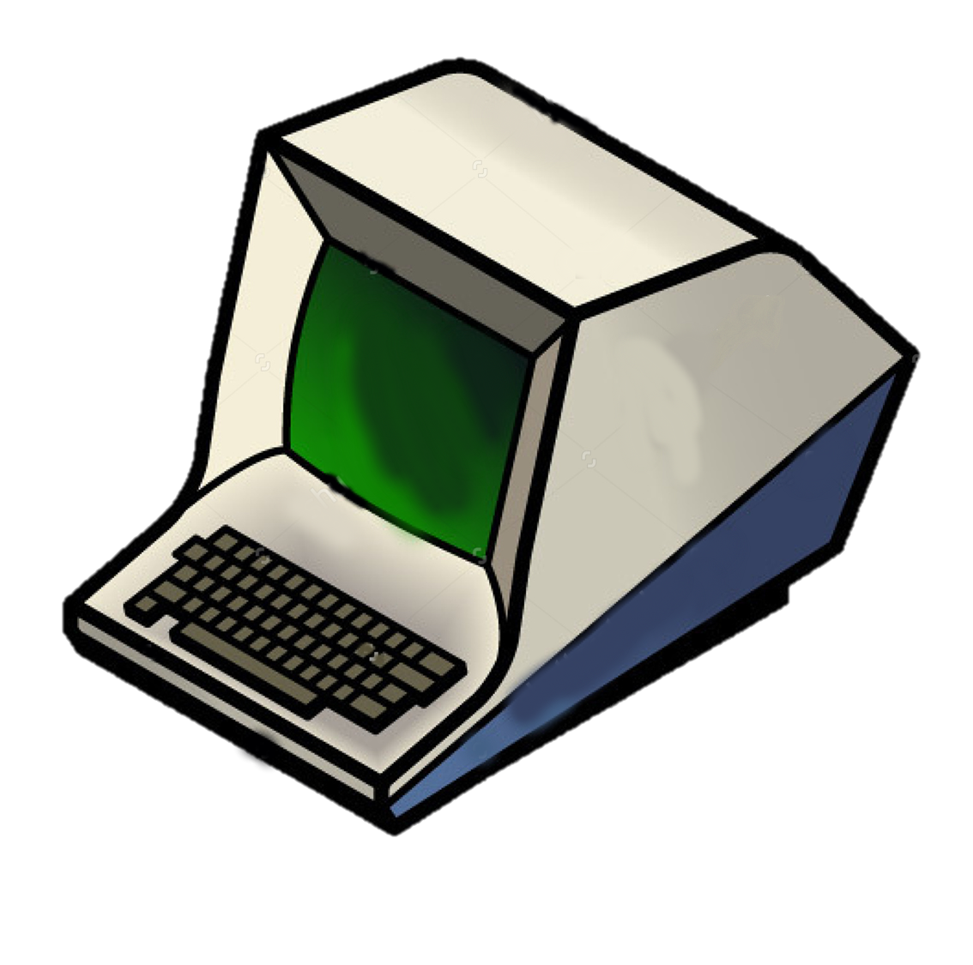
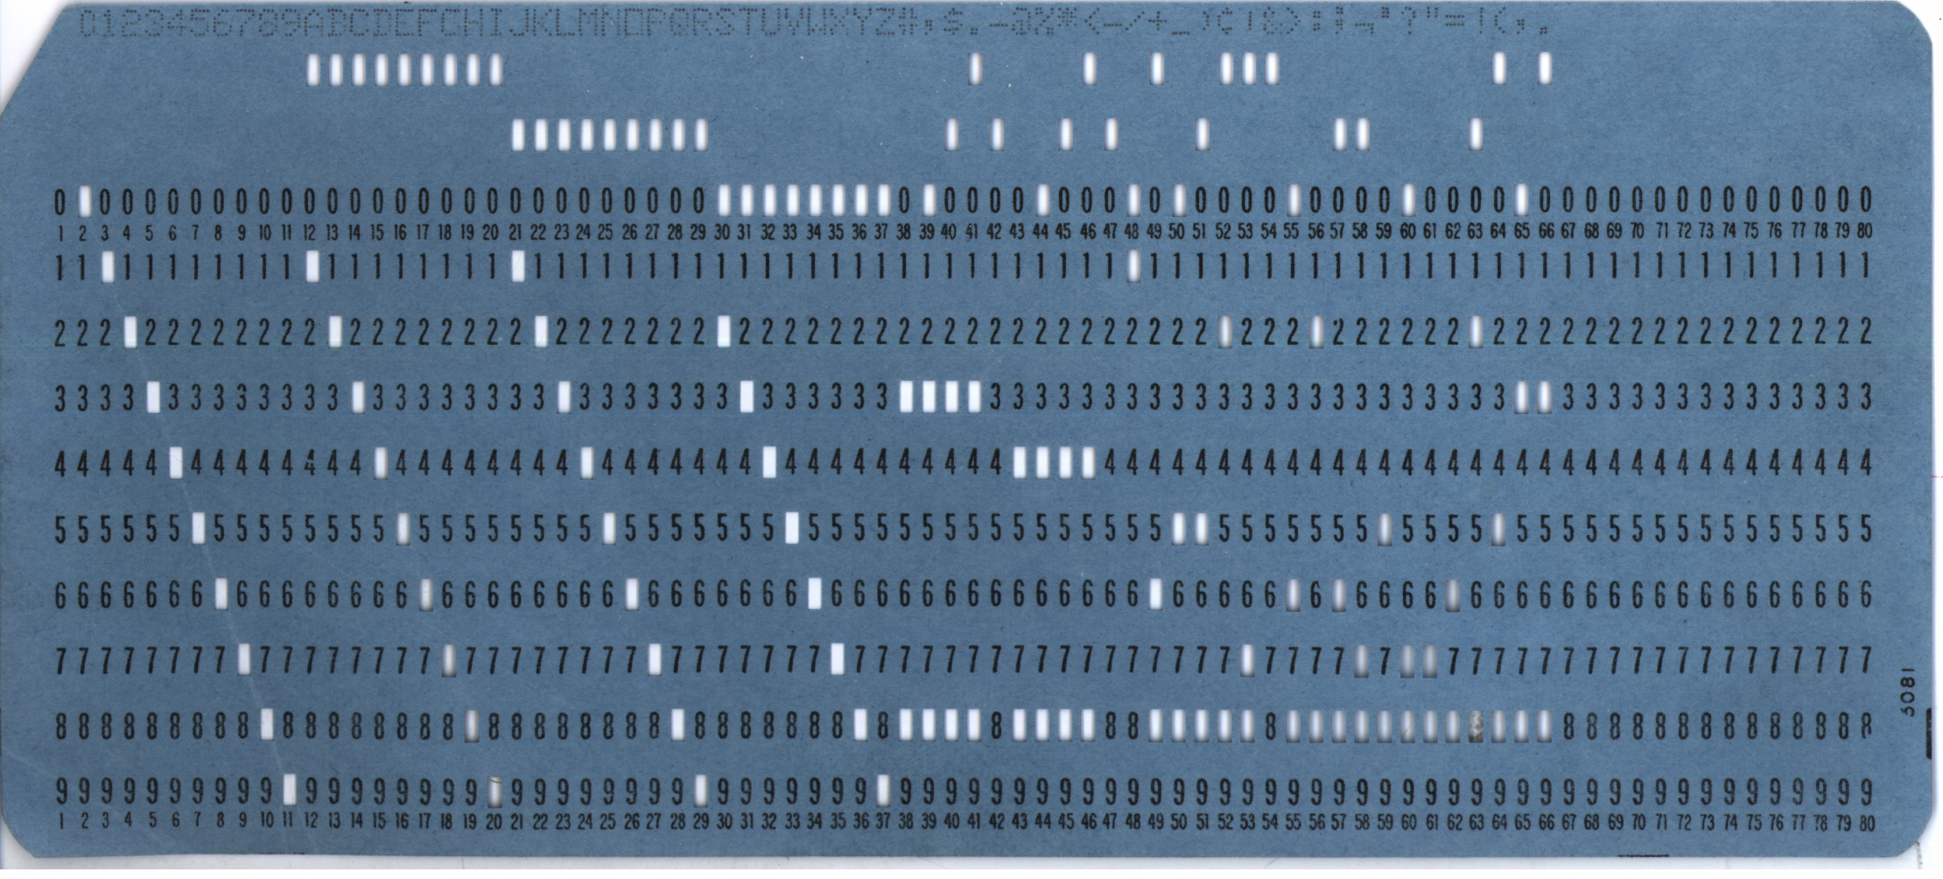
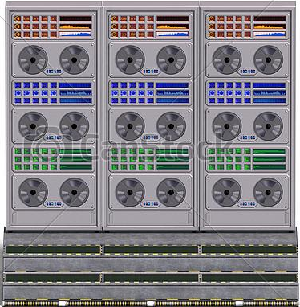
Old School Computer Terminals
Notes:
Mainframe computers
Punchcards were where programs were created and stored
Then we came the terminal & mainframe model
Essentially a private network of dumb terminals with very little processing power that are
Used for data input and accessing programs on a
Mainframe computer where all the processing power and data storage is.

Slide 3
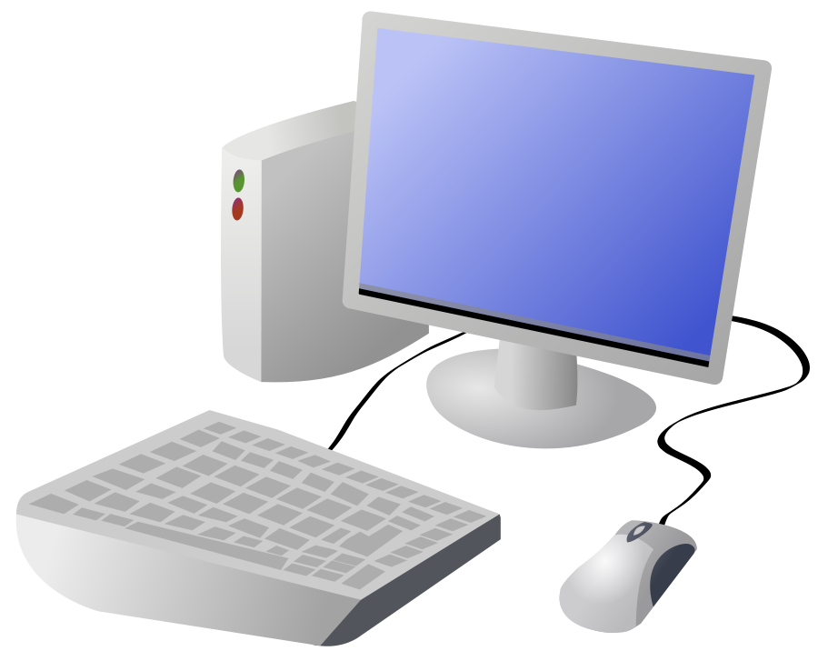
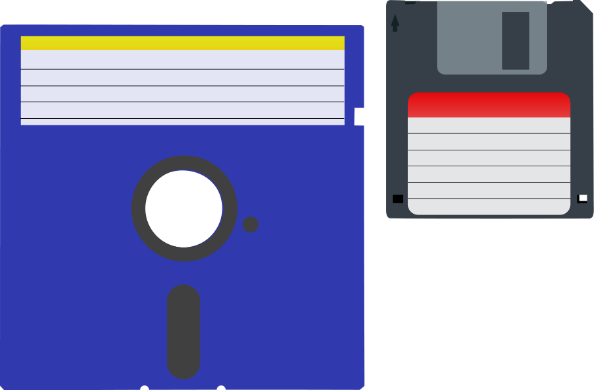
Personal Computers
Notes:
Then personal computers came along.
They had more processing power than terminals but minimal storage so programs weren’t installed directly on them.
Instead programs and files were mostly kept on floppy disks (the flashdrive of their age),
Programs very often required multiple disks and had built in pauses to allow you to switch them out.
But personal computers evolved, particularly with respect to the amount of storage available,
so floppy disks were replaced with compact disks and more of the program’s code would be downloaded to the computers hard drive
And now as, you’ve all experienced, storage on personal computers is less of an issue so software installations are almost exclusively downloaded from the internet.

Slide 4
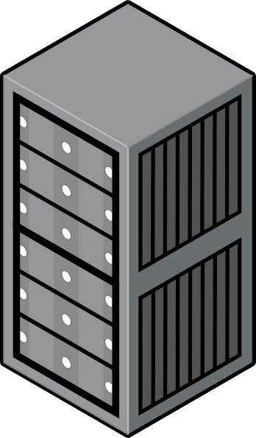
The Cloud
Notes:
But now with the internet so readily available, why install the software at all?
Enter the concept of the cloud.
Basically, “the cloud” is the same concept of the terminal & mainframe set up of the earlier days of computers but instead of
Dumb terminals, we have really smart ones.

Slide 5
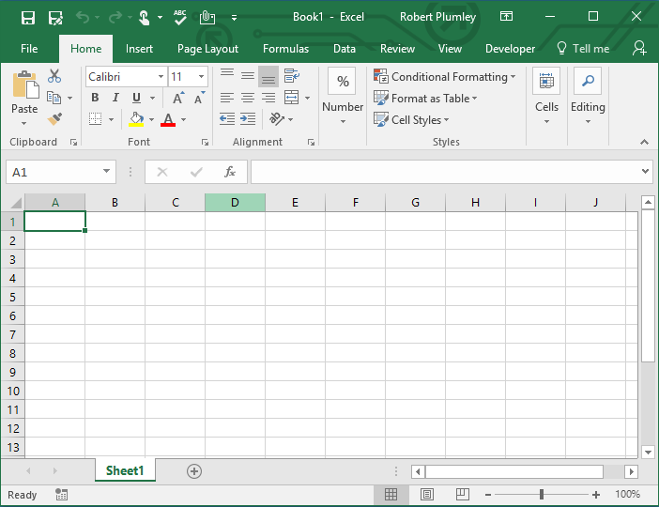
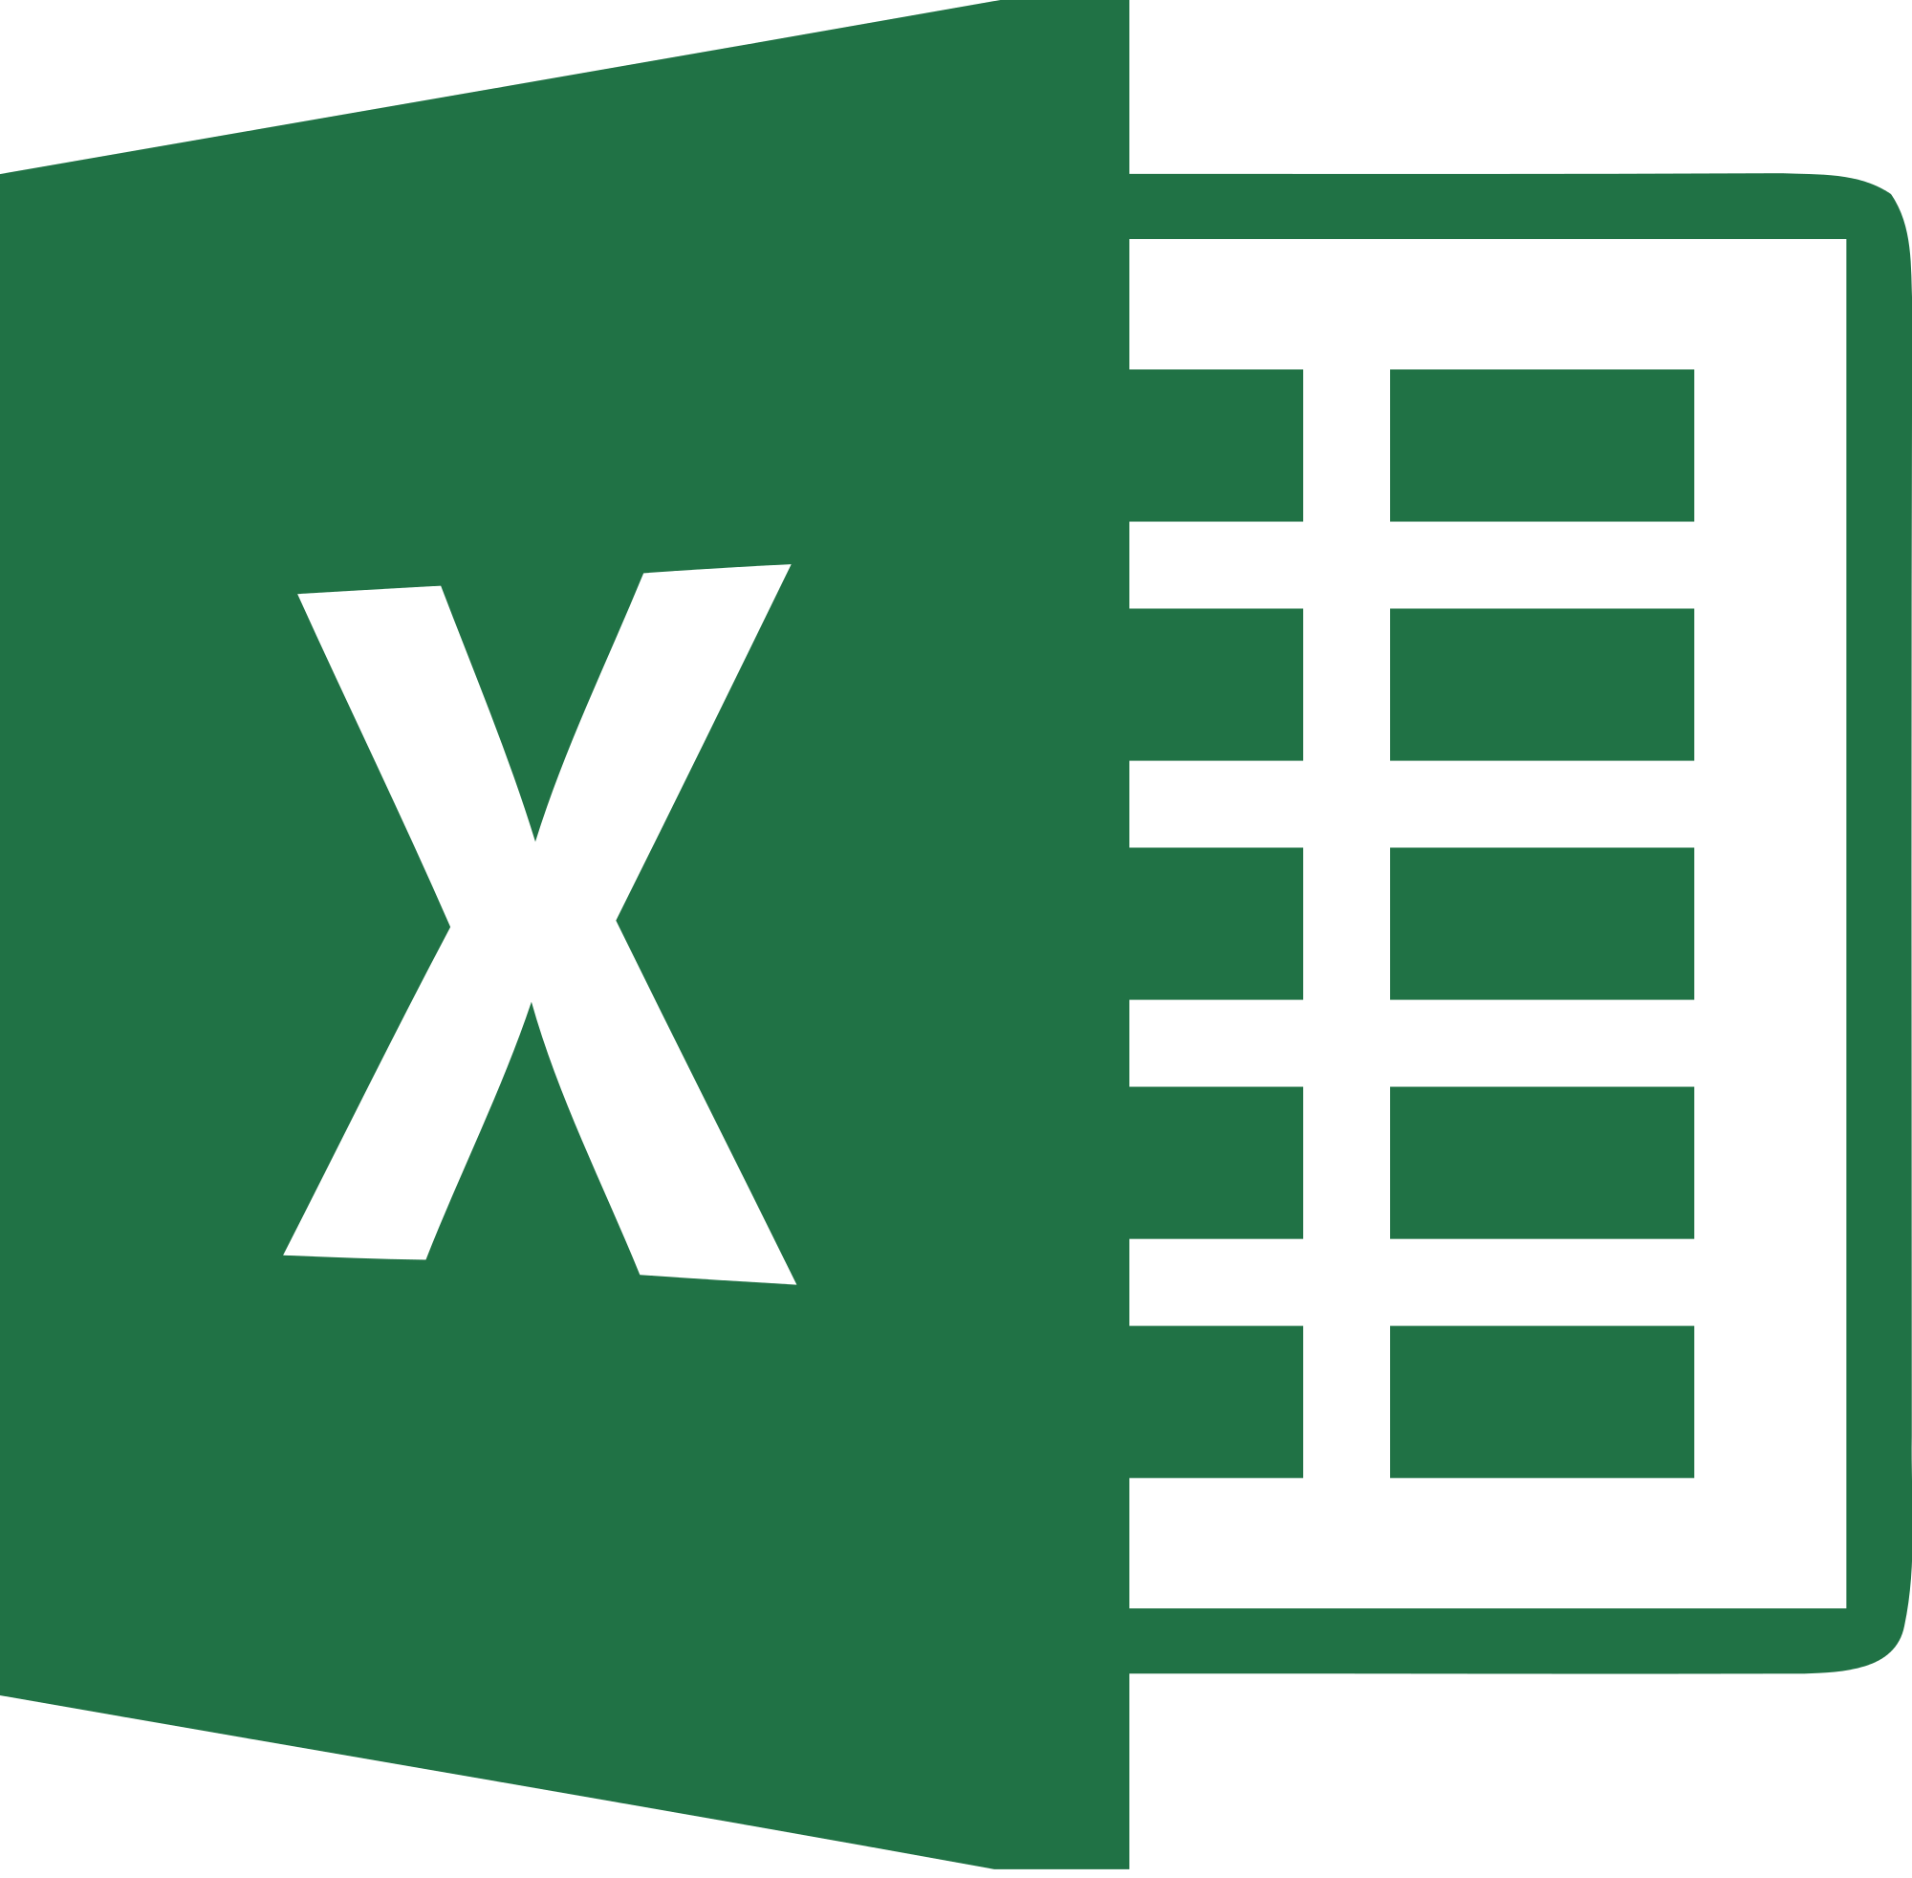
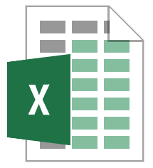
Installed Software
Software code is copied to the device’s hard drive
Software is run on directly on the device
Speed is limited to the CPU’s abilities
Files are saved locally to the device’s hard drive
C:\Users\Me\Documents\Book1.xlsx
Book1.xlsx
Notes:
When you visit sites like amazon they store small files call cookies that allow you to be identified when you visit the site again or visit other sites in their ad network

Slide 6
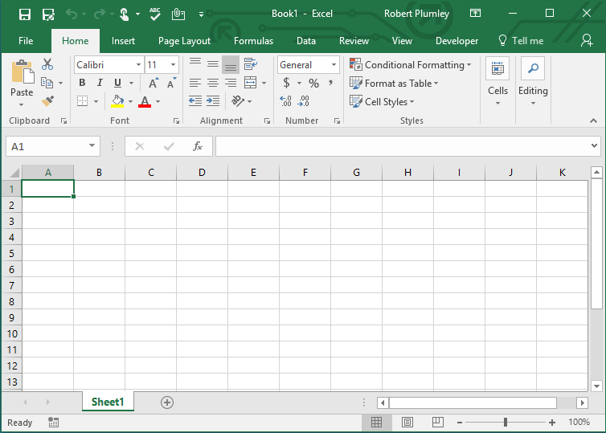
Web-based Software
Application is accessed through a web browser or app
Calculations and processing are done on the providers servers, not your machine.
Files are saved to the providers servers and must be downloaded to get your own copy.
https:office.Microsoft.com\....\....\Book1.xlsx
Notes:
When you visit sites like amazon they store small files call cookies that allow you to be identified when you visit the site again or visit other sites in their ad network

Slide 7
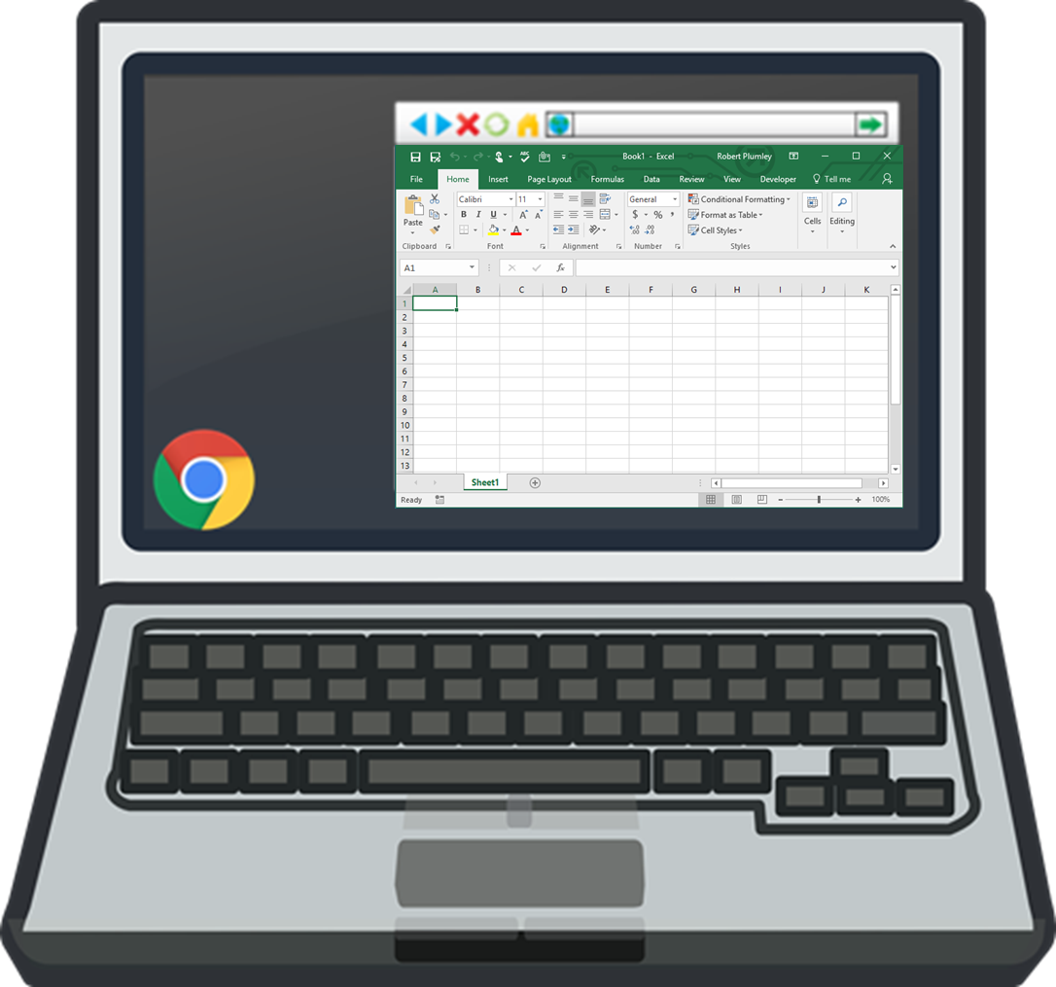
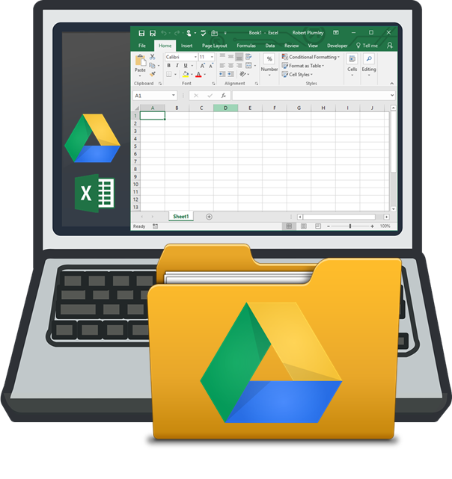
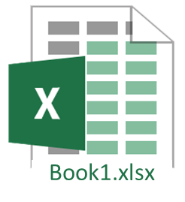
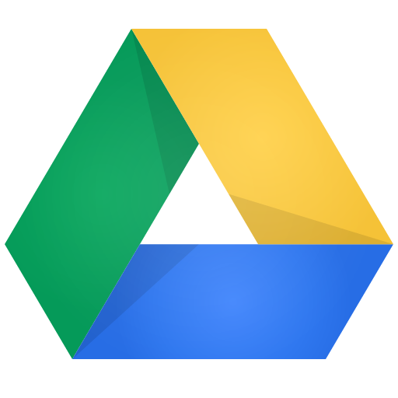
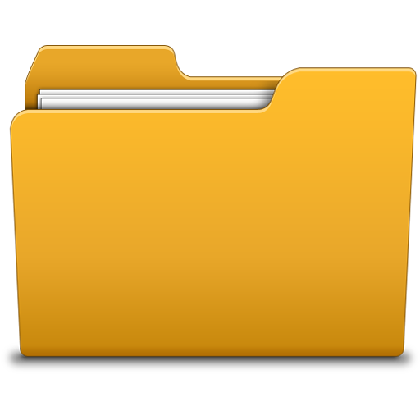
Cloud Storage – “Syncing”

Slide 8
Business & Cloud Computing

Slide 9
… As A Service
SaaS
PaaS
IaaS
Software as a Service
Platform as a Service
Infrastructure as a Service

Slide 10
PaaS – Platform as a Service
CIS 101 Web Application
Platform Options
Password
Protection
&
User Management
Video Hosting and Tracking
Password
Protection
&
User Management
In Application Notices
In Application Notices
Group Chat and Forums
Group Chat and Forums
Video Hosting and Tracking

Slide 11
IaaS - Infrastructure as a Service
Virtual server hosting services delivered via the internet from a large pool of servers physically housed and maintained by the service provider.
Physical Hosting – Servers, building, power, connectivity, etc.
Maintenance - Upgrades to server hardware and software

Slide 12
IaaS - Infrastructure as a Service
Facebook - Year 1 (2005)
Snapchat – Year 1 (2011)

Slide 13
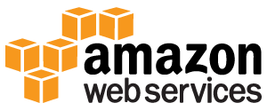
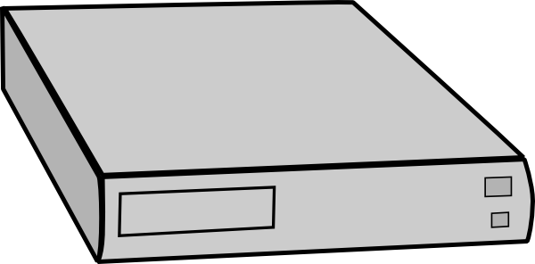
Virtual Servers

Slide 14
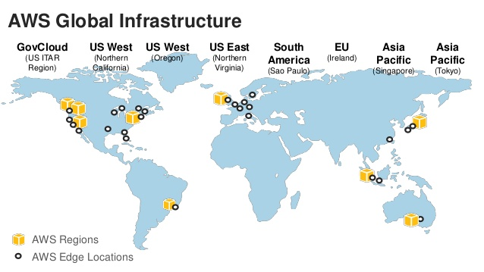
Redundancy and Co-Location

