Slide 1
Computers & Internet

Slide 2
Primary Parts of a Computer
Display – Monitor, etc.
CPU: Central Processing Unit
Hard Drive
RAM
Input Devices
Keyboard
Mouse
Touch screen

Slide 3
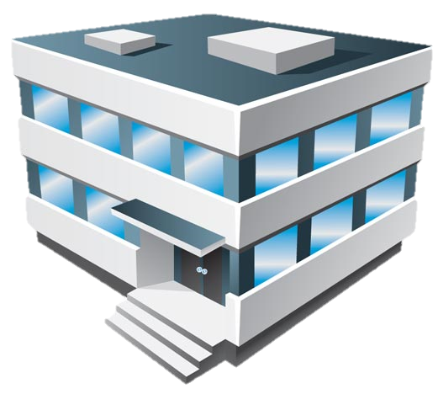
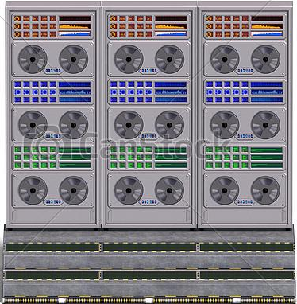
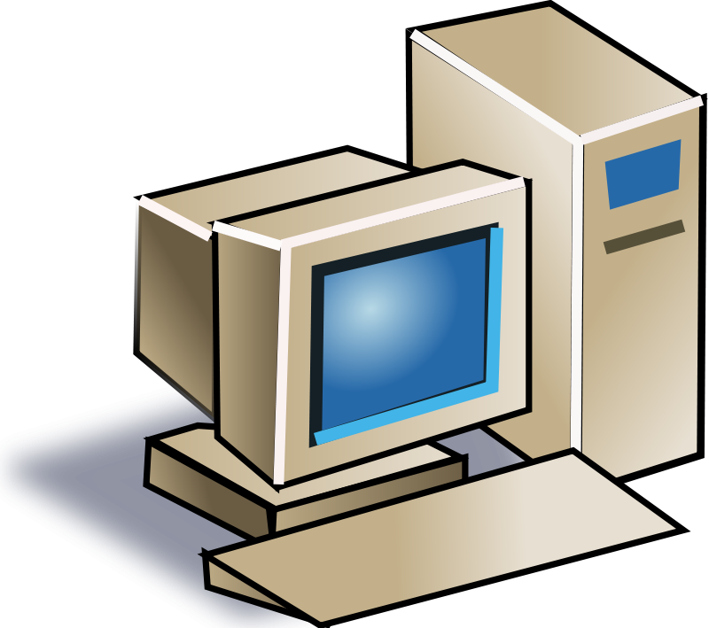
Moore’s Law
The observation made in 1965 by Gordon Moore, co-founder of Intel, that the number of transistors per square inch on integrated circuits had doubled every year since the integrated circuit was invented.

Slide 4
The Internet

Slide 5
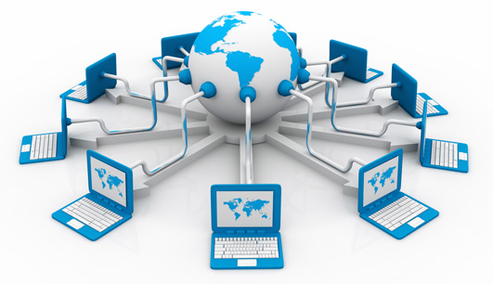
What is Internet?
Worldwide system of computer networks - a network of networks in which users at any one computer can, if they have permission, get information from any other computer

Slide 6
History of Internet
Internet started over 50 years ago
Scientist and researchers used to communicate during cold war
1962: JCR Licklider proposed the idea of a network of computer that can talk to each other
In 1969 :First message was sent from one computer to another through a network called ARPANET which was governments computer network at that time.
ARPNET consisted of 2 computers, One was located in UCLA and the other at Stanford labs
LOGIN was the first word sent and it did not fail or crash the network but could send only “LO”
In 1971 at the university of Hawaii ALOHA network was added followed by various other networks in London and Norway.
1991: Programmer named Tim Berner's Lee invented WWW
Notes:
By the end of the year 1969 only 4 computers were connected to the ARPNET network.
During the same time Ray TomLinson was developing first system to send mails back and forth between the users of ARPNet which was called Email person’sname@
After 1991 it was not for just scientist and military anymore but Network of information was accessible to anyone within the internet connection

Slide 7
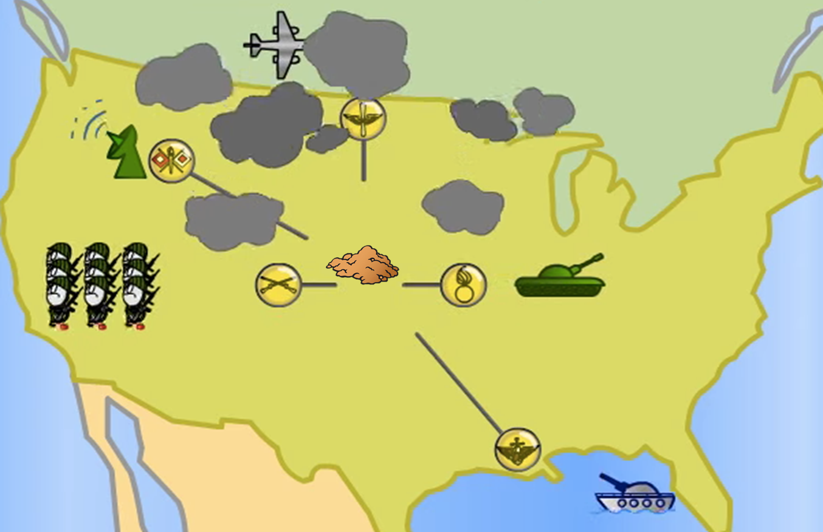
Centralized Military Command

Slide 8
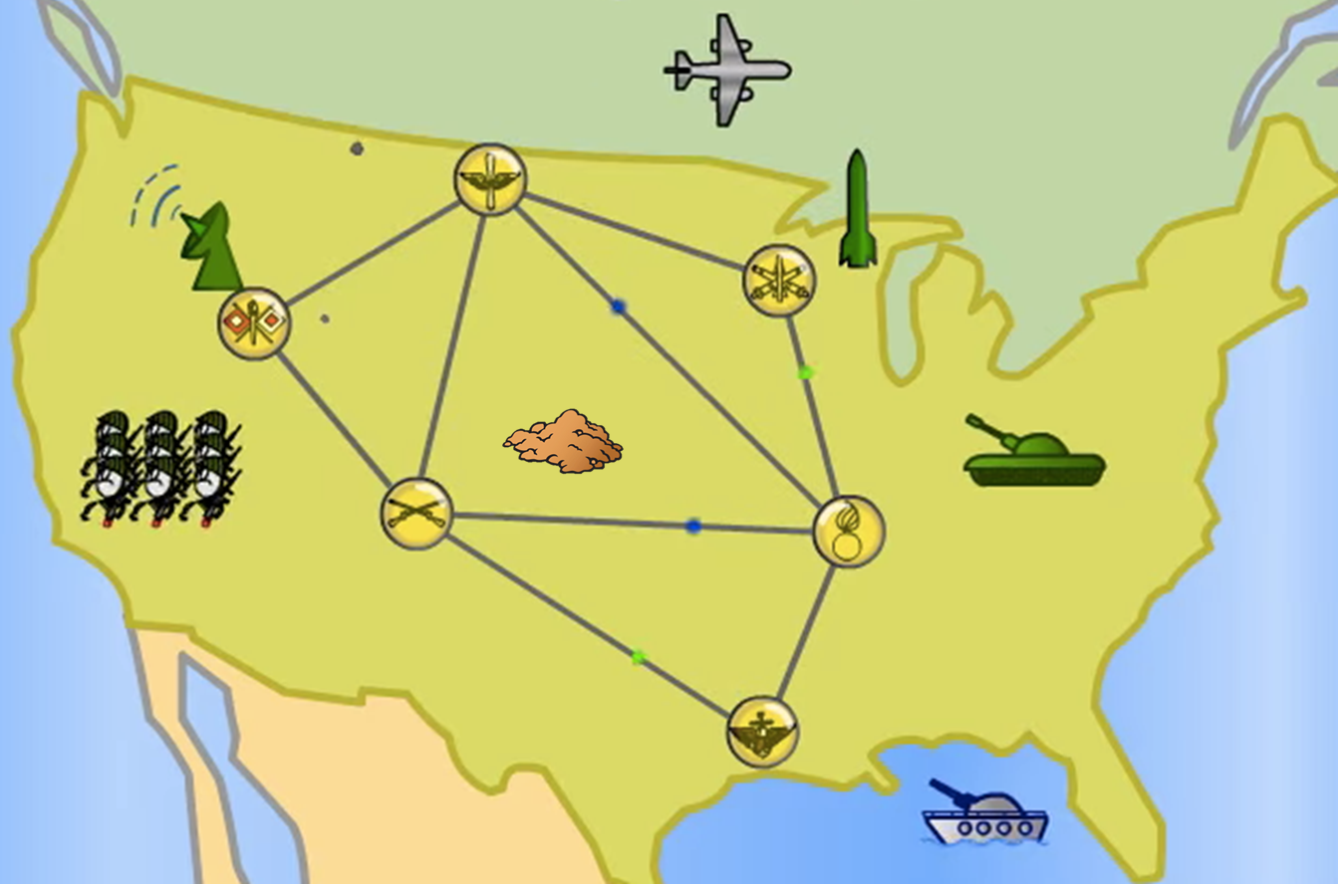
Decentralized Military Command

Slide 9
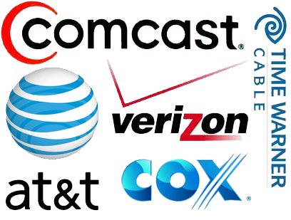
ISP : Internet service provider

Slide 10
IP Address: Internet Protocol Address
Internet protocol address is a unique number assigned to every device on the internet
It is mostly 11 digit number; It can also be 18 combinations of both digits and letter

Slide 11
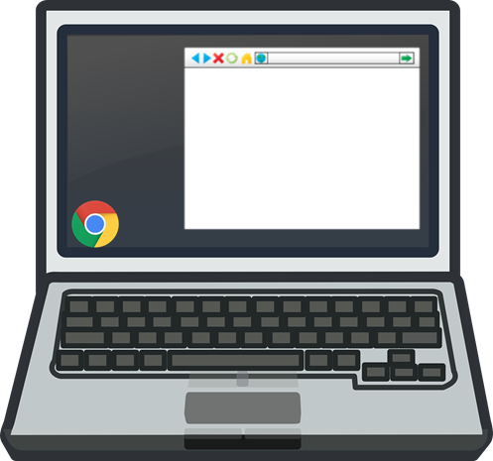
DNS: Domain Name System
The Internet's equivalent of a phone book. They maintain a directory of domain names and translate them to Internet Protocol (IP) addresses. This is necessary because, although domain names are easy for people to remember, computers or machines, access websites based on IP addresses
www.pace.edu
Domain Name | IP Address
www.google.com | 216.58.194.132
www.pace.edu | 198.105.44.27
www.starbucks.com | 107.162.135.91
198.105.44.27

Slide 12
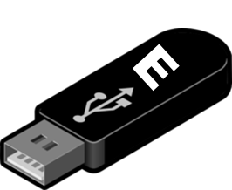
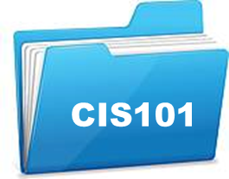
File Paths on Your Computer
E:\CIS101\Resume.doc

Slide 13
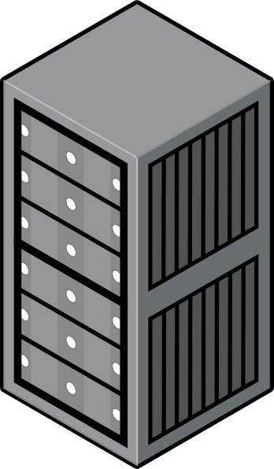
File Paths on the Internet
http://webpage.pace.edu/cis101/resume.doc

Slide 14
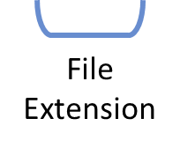
URL : Uniform Resource locator
A reference to the name of a file on the internet
http://webpage.pace.edu/cis101/resume.doc

Slide 15
The Good, the Bad, & the Ugly
What are some ways that you use the internet?
How has always being connected changed the way we live our lives?
What are some of the global implications of the existence of the internet?

