Slide 1
CIS101 Intro to Computing
Week 1

Slide 2
Agenda: First Day of Class
Websites
Blackboard.pace.edu
CIS101 Portal
Course Overview
Syllabus & One-Pager
Excel
Web Development
Group Project
Gantt Chart
First Assignments
SS1: Skills Survey
DB1: Introduce Yourself
Icebreaker

Slide 3
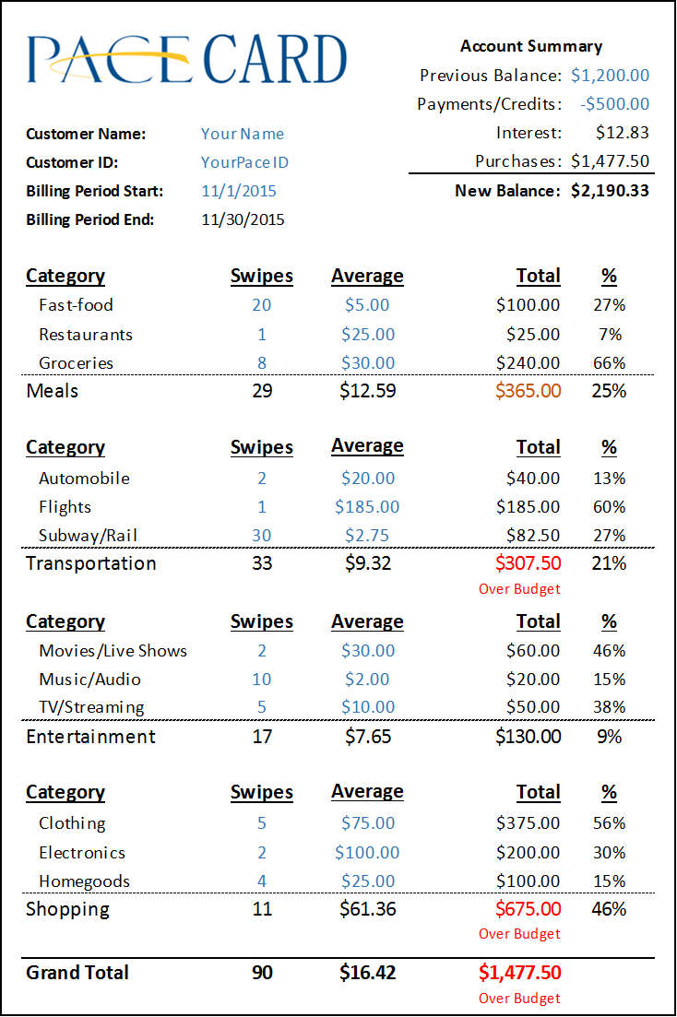
Excel
Ex1: Estimated Credit Card Statement
Formatting, Formulas, and Functions
Ex2: Estimated Credit Card Statement vs Budget
IF statements and Conditional Formatting
Ex3: Credit Card Statement using a data table
Data Tables and IF functions
Ex4: Data Visualization
Creating and formatting charts
Ex5: Pivot Tables
Creating and filtering Pivot Tables
EX6: Major Specific Data Analysis
Analyze the dataset that matches your major

Slide 4
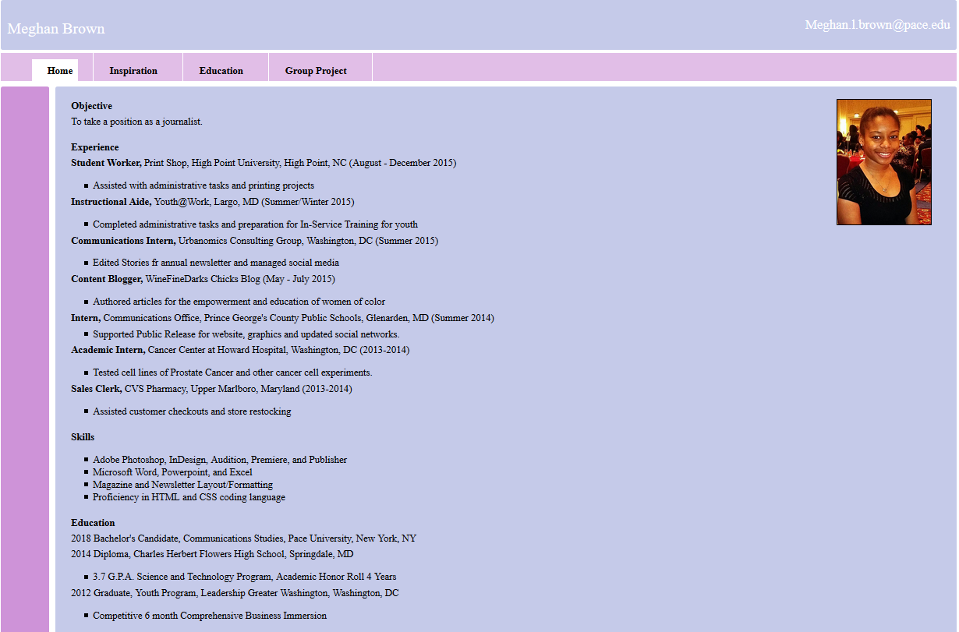
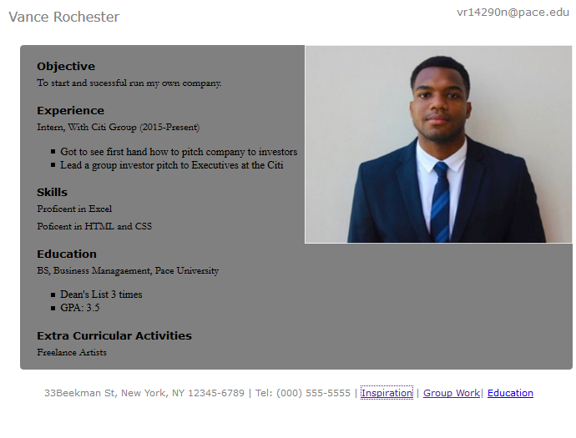
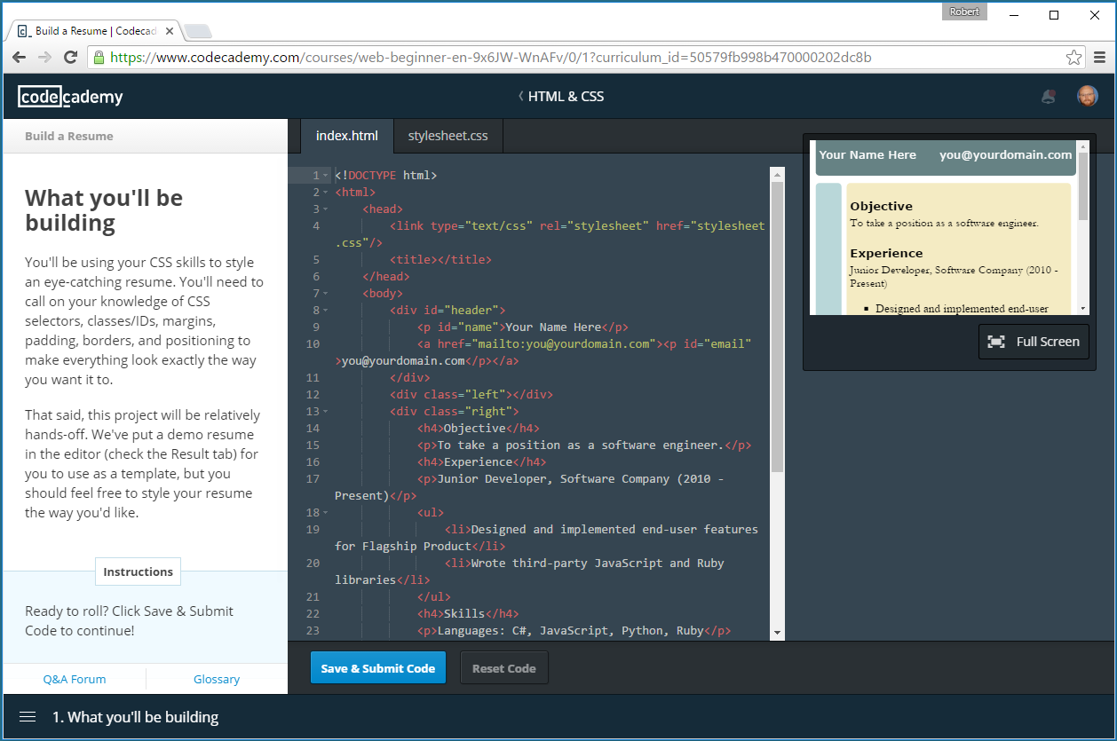
Web Development
WD1 - 3: Codecademy.com
Hands-On HTML and CSS Training
WD4 - 5: Codecademy.com
Hands-On JavaScript Training
WD6: Create your own Resume Site
Webpage.Pace.edu
CodeAnyWhere.com

Slide 5
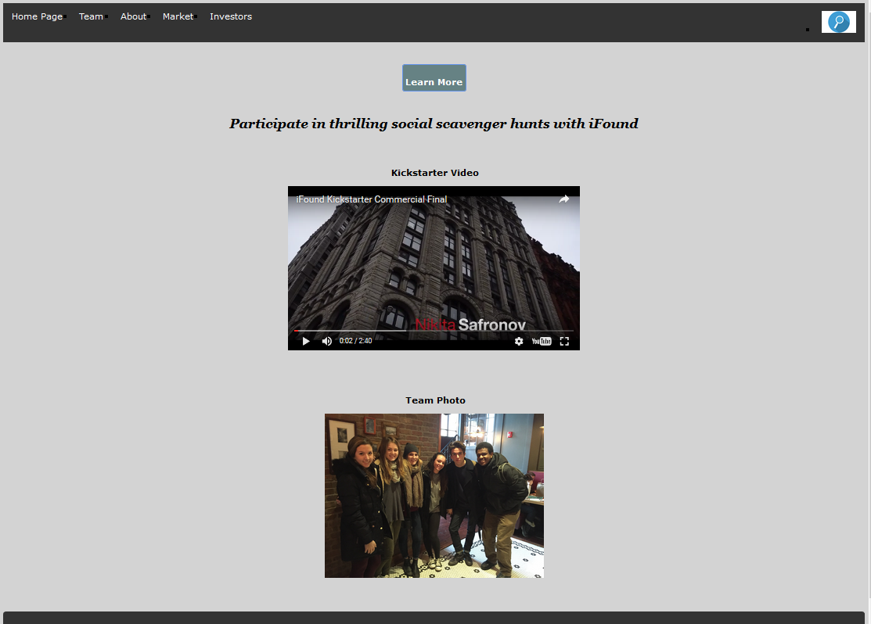
Group Project
Teams of 5 to 6 members will develop an investors pitch for a new app
Deliverables:
GP1: Wireframes - Website and App
GP2: KickStarter Video
GP3: Market Research Survey
GP4: 5 Year Business Plan
GP5: Website
GP6: Final Presentation

Slide 6
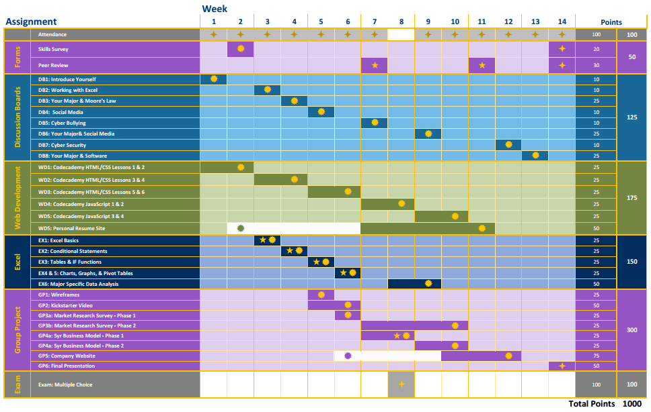
Schedule

