Slide 1
Cybersecurity

Slide 2
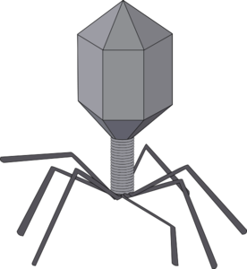
Malware
Short for malicious software, is any software used to disrupt computer or mobile device operations.
Technical Classifications
Virus
Code that self-replicates by infecting a devices existing programs and files, and then spreading to other computers via shared files.
Worm
Standalone program that spreads by utilizing network vulnerabilities to reach and install itself on other devices connected to that network.
Trojan
Standalone program that typically doesn’t self-replicate and instead spreads by tricking users into voluntarily installing it for an intended purpose without knowing it is malware.

Slide 3
Malware Objectives
Spyware
Open virtual doors to or control devices on private computer systems
Collect and transmit sensitive information
Vandalize systems by slowing down, manipulating or deleting its data
Adware
Display unwanted advertising, often in un-closable windows
Scareware
Threaten users to make them take a desired action

Slide 4
Social Engineering
How likely are you to pick it up?
40% of Millennials
22% of Gen X
9% of Baby Boomers.
At least 20% will be plugged in
Payroll Backup

Slide 5
Social Engineering
Scareware
Software engineered to cause shock, anxiety, or the perception of a threat in order to manipulate users into paying for access to their device unwanted software.
Rogue security software
Non-functional or Trojan horse malware purchased to resolve the detection of a fake virus
Ransomware
Malware that encrypts a users files and then requires payment to have them decrypted.

Slide 6
Social Engineering
Phishing
Attempt to obtain sensitive information such as usernames, passwords, and credit card details by masquerading as a trustworthy entity in an electronic communication, often executed on a large-scale.
Email
Spam messages such as The Nigerian Prince
Texts
“Reply with Stop” messages used to confirm validity of phone numbers
Phone Calls
Simply answering or voicemail prompt confirms the validity of the number and often the owner’s name
Websites
Fake discounts or software offers used to trick users into providing registration/login information likely used on other sites as well.
Social Media – Catfishing
Creation of a fake social network profile to engage with other users, often with romantic undertones, for nefarious purposes.
Notes:
Video about Email Phishing

Slide 7
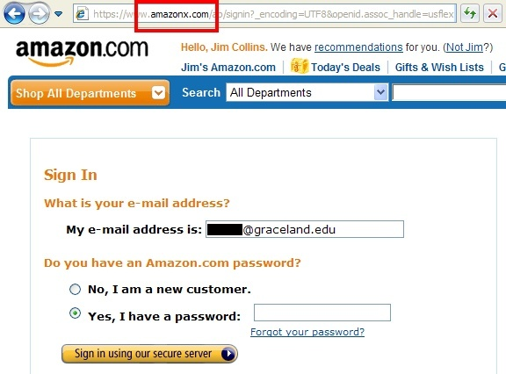
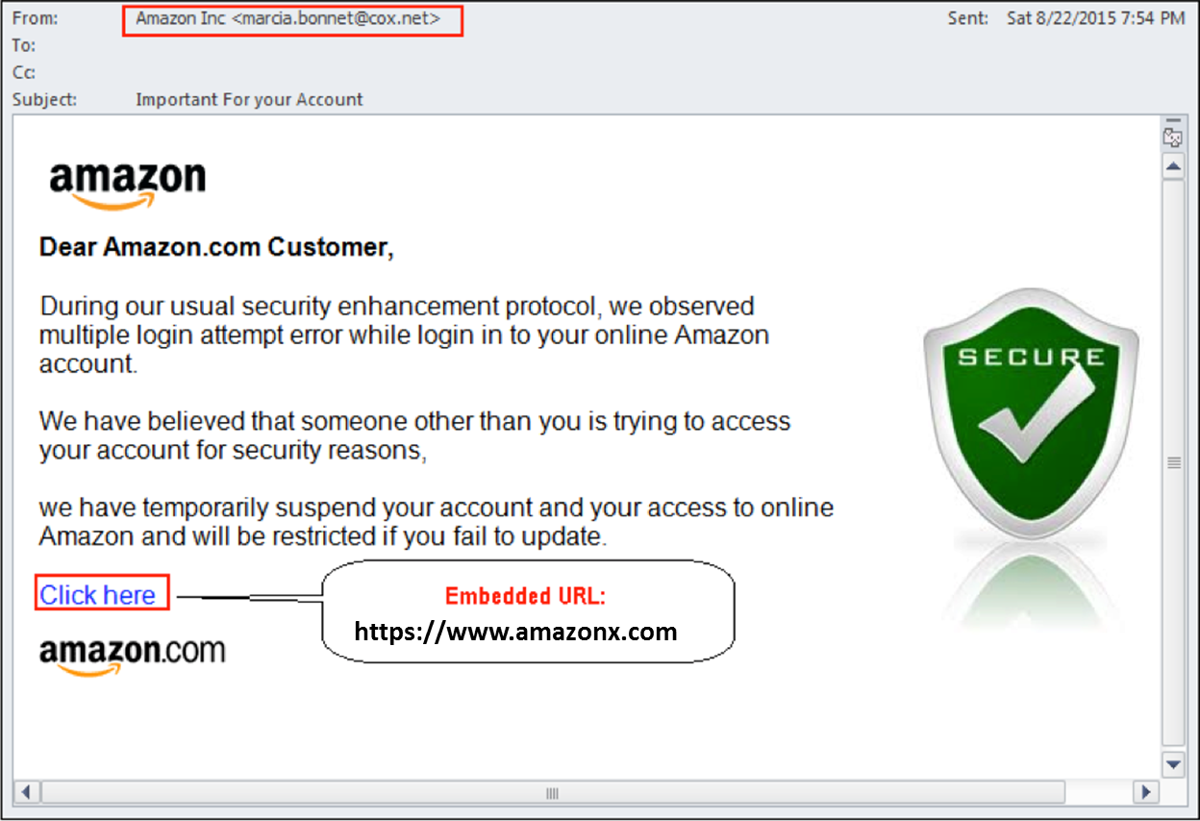
Social Engineering
Spoofing
A situation in which a person or program successfully masquerades as another by falsifying data
Email Spoofing
Technique commonly used by spammers to hide the origin of their e-mails by faking an emails “From” information to make it appear to be from a trusted source
Website Spoofing
A hoax site designed to mislead visitors into thinking it is a known, trusted site to collect user information, particularly login credentials for the mimicked site.
Notes:
A specific form of phishing

Slide 8
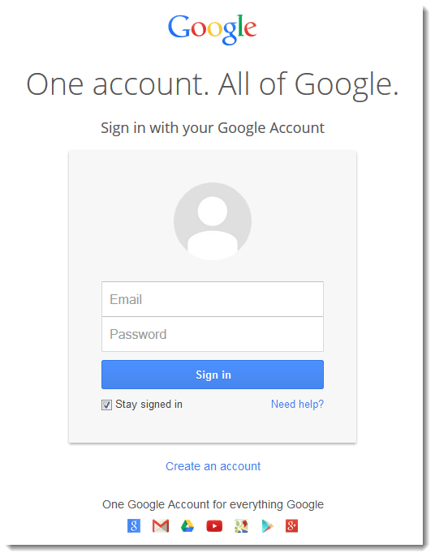
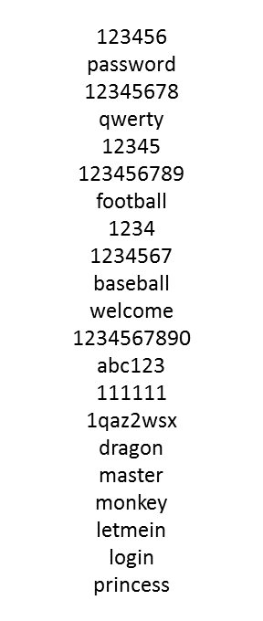
Password Cracking
Dictionaries
A list of common passwords or passwords know to be used by a specific user, that are cycled through to attempt to gain access to a users account on a new site.
Security Questions
Using security questions to reset a user’s password and gain access to their account.
How may of these can be answered by all of your Facebook friends?
Who is your favorite actor, musician, or artist?
What is the name of your favorite pet?
In what city were you born?
What high school did you attend?
What is your mother's maiden name?
When is your anniversary?
What was your high school mascot?
Brute-force
Attempting every alpha-numeric combination possible to guess a user’s password. Time consuming and easily stopped by most sites.
Just lowercase letters for a 7 character password is 26⁷, 8,031,810,176 possible combinations
email@gmail.com
baseball
✓
1234567
1234
Notes:
Dictionaries - Think what would happen if a spoofing victim used the same email and password for multiple accounts.

Slide 9
Who and Why
Cybercrimes
Criminal acts perpetrated by individuals or groups using computers and networks, typically for financial gain.
Piracy – Copyright Infringement
Bank & Credit Card Fraud
Identity Theft
Blackmail
Corporate Espionage
Cyberterrorism
Organized, large-scale use of computers, networks, and public internet to cause destruction and harm by disrupting use of networks and infrastructure systems.
Cyberwarfare
Actions by a nation-state to penetrate another nation's computers or networks for the purposes of causing damage or disruption
Notes:
Video about Cyberwarefare Stuxnet

Slide 10
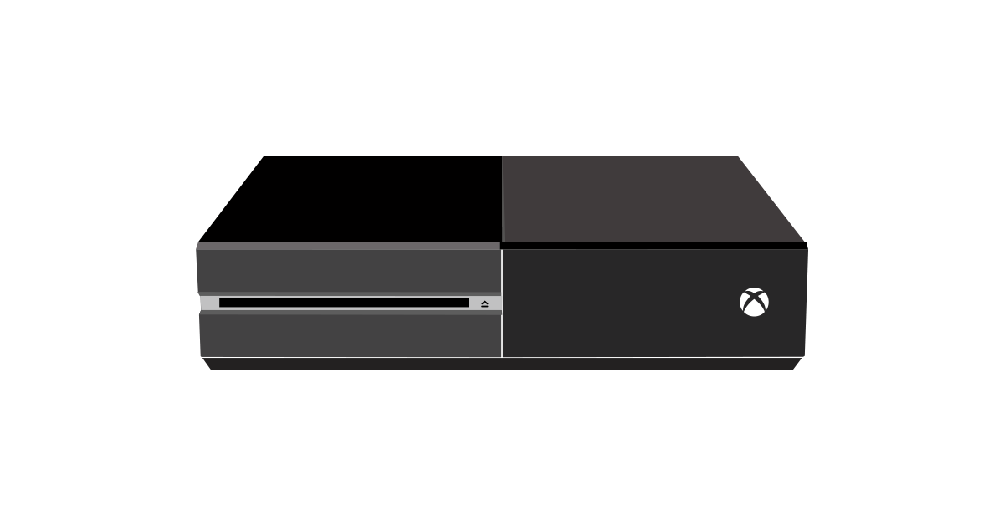
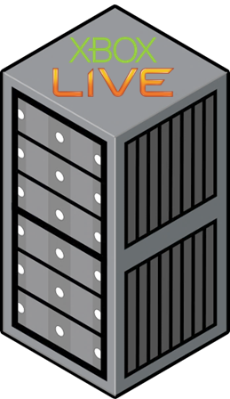
Distributed Denial-of-Service (DDoS)

Slide 11
What can you do?
Use Secure Passwords
Use strong passwords with at least 8 characters, including numbers and special characters
Don’t use the same password for your primary email and any other website
Enable two-step verification on primary email accounts, so you receive a verification code via text in addition to using your password.
Use a Password manager, such as LastPass or Keepass to remember your passwords
Anti-Virus Software
Popular Options: AVG, Norton, & McAfee
Make sure it is always up-to-date and running full system scans automatically on a regular basis
Firewall Software
Blocks unwanted network activity
Most operating systems come equipped with software to block inbound traffic from external sources
Blocking outbound spyware transmissions may require addition software, often an add-on offering of anti-virus software packages.
Be Smart and Pay Close Attention

