Slide 1
Data Types & Analysis

Slide 2
Types of Data
Quantitative Data
Qualitative Data
Deals with numbers.
Data which can be measured or quantified.
Length, height, area, weight, costs, members, ages, etc.
25 units, $300, 4ft, 18 hours
Quantitative → Quantities
Deals with descriptions.
Data can be observed but not measured.
Colors, textures, smells, tastes, appearance, beauty, etc.
Good, Bad, Horrible
Qualitative → Qualities
http://regentsprep.org/regents/math/algebra/ad1/qualquant.htm

Slide 3
Quantitative Data
Quantitative → Quantities → numbers
Discrete Data – quantitative data with distinct values / observations.
For example: 5 customers, 17 points, 12 steps etc.
Continuous Data – quantitative data with any value / observation within a finite or infinite interval.
For example: conversion rate, height, weight etc.
http://www.optimizesmart.com/how-to-select-best-excel-charts-for-your-data-analysis-reporting/

Slide 4
Qualitative Data
Qualitative → Qualities → descriptions
Nominal data – qualitative data that can NOT be put into a meaningful order.
For example: {Blue, Yellow, Green, Red, Black}
Ordinal data – qualitative data that can be put into a meaningful order (i.e. ranked).
For example: {Very Satisfied, Satisfied, Unsatisfied, very unsatisfied}
http://www.optimizesmart.com/how-to-select-best-excel-charts-for-your-data-analysis-reporting/

Slide 5
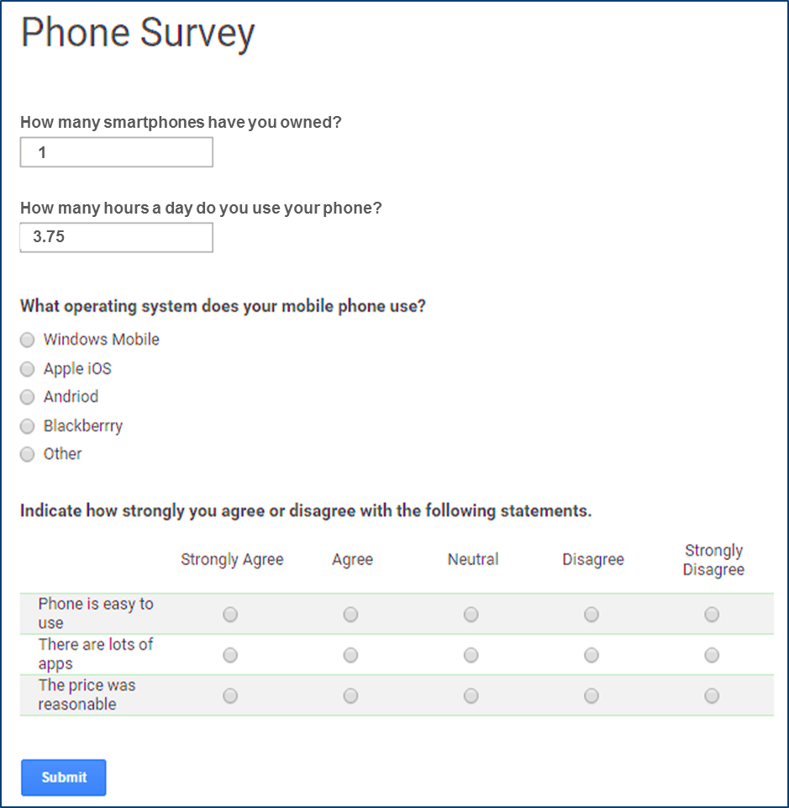
Data Collection
Discrete
Quantitative
Continuous
Nominal
Qualitative
Ordinal

Slide 6
Data Translation
2
1
0
-1
-2
2
1
0
-1
-2
2
1
0
-1
-2

Slide 7
Data Related Roles

Slide 8
Roles within the Data Lifecycle
https://www.captechconsulting.com/blogs/data-scientist-vs-data-analyst

Slide 9
Data Analysts
How do I solve reporting performance problems?
How do I solve data quality and sourcing problems?
What tools and reports are contextually appropriate?
How will my analysis be used by my clients?
How can I learn more about my clients’ business?
https://www.captechconsulting.com/blogs/data-scientist-vs-data-analyst

Slide 10
Data Scientists
How do I balance model robustness with the simplicity of the message?
How do I detect and quantify changing relationships?
How can I correct for biased and incomplete data?
How do I effectively communicate model uncertainty?
How do I help my client trust the model?
https://www.captechconsulting.com/blogs/data-scientist-vs-data-analyst

