Slide 1
Excel Basics
Week 3

Slide 2
Applications for this Course
Numbers for Mac
Google Sheets

Slide 3
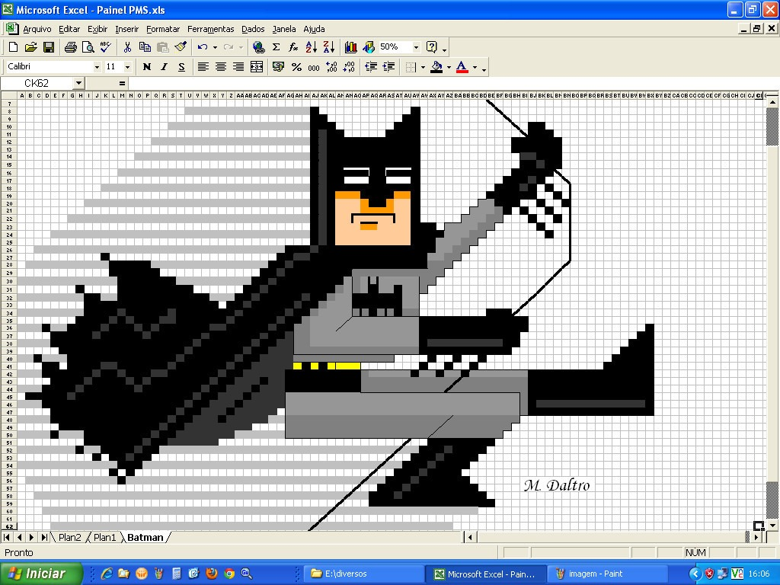
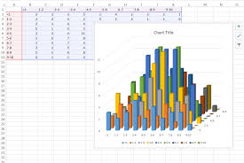
Excel in the Real World
Personal Budgets
Project Planning/Budgeting
Financial Forecasts
Graphing Data
Mail Merge for Marketing Campaigns
To-Do Lists

Slide 4
Excel Terminology
https://exceljet.net/keyboard-shortcuts

Slide 5
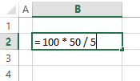
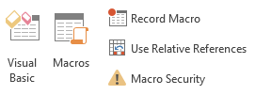
Excel Terminology
Formula - User defined equation using numbers and/or cell references
Function - Predefined equations in Excel that perform various operations on the inputs they are provided
Macro – Custom user created functions using Visual Basic coding language
https://exceljet.net/keyboard-shortcuts

Slide 6
Formulas Use Operators
Arithmetic Operators
Logic Operators
+ Add
= 10 + 5 Result = 15
- Subtract
= 10 – 5 Result = 5
* Multiply
= 10 * 5 Result = 50
/ Divide
= 10 / 5 Result = 2
^ Power
= 10 ^ 5 Result = 100,000
( ) Order of Operations
= ((5 + 5) ^ 5) Result = 100,000
> Greater than
= 10 > 5 Result = TRUE
>= Greater than or Equal to
= 10 >= 5 Result = TRUE
= Equal to
= 10 = 5 Result = FALSE
<= Less than or Equal to
= 10 <= 5 Result = FALSE
< Less than
= 10 < 5 Result = FALSE
<> Not Equal to
= 10 <> 5 Result = TRUE

Slide 7
Functions to Know
Math Functions
Logic/Conditional Functions
=Sum(B1:B20)
Adds together all numbers in range
=Count(B1:B20)
Counts all numeric values in range
=CountA(B1:B20)
Counts all non-empty cells in range
=Average(B1:B20)
Calculates average of numbers in range
=SumProduct(B1:B20, C1:C20)
Calculates sum of the range members multiplied
=If ( 10 > 5, “Good”, “Bad”)
Result = “Good”
=And ( 10 >= 5, 4 > 10)
Result = FALSE
=Or ( 10 = 5, 4 = 4)
Result = TRUE
=CountIfs(Criteria Range, Criteria)
=SumIfs(Numeric Range, Criteria Range, Criteria)
=AverageIfs(Numeric Range, Criteria Range, Criteria)

Slide 8
Popular Keyboard Shortcuts

Slide 9
The Ribbon: Home

Slide 10
The Ribbon: Insert

Slide 11
The Ribbon: PivotTable Tools

Slide 12
Great Reference Sites
https://www.google.com/
Honestly, if you havent googled it you arent trying very hard
http://spreadsheets.about.com/od/a/
This site is a great source for Excel terminology
https://exceljet.net/keyboard-shortcuts
Over 200 keyboard shortcuts for both PC and Mac

