Slide 1
HTML basics
http://www.w3schools.com/

Slide 2
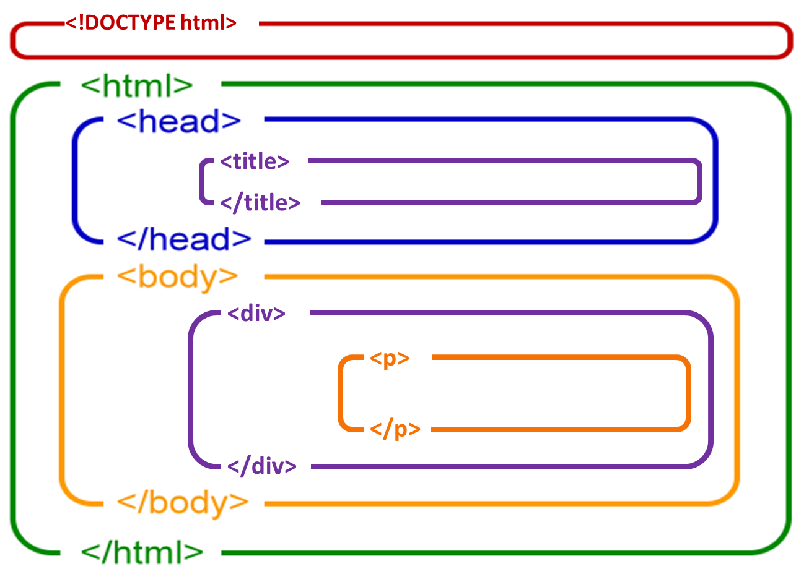
HTML: Hyper Text Markup Language

Slide 3
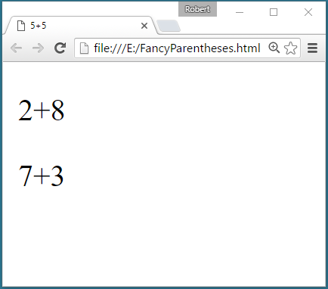
Think of HTML Tags as Fancy Parentheses
X = ( ( ( 5+5 ) ) ( ( ( 2+8 ) ( 7+3 ) ) ) )
X = ( ( ( 5+5 ) ) ( ( ( 2+8 ) ( 7+3 ) ) ) )
5+5
2+8
7+3
</div>
<!DOCTYPE html>
<html>
<head>
<title>
</title>
</head>
<body>
<div>
<p>
</p>
<p>
</p>
</body>
</html>
<!DOCTYPE html>
<html>
<head>
<title>5+5</title>
</head>
<body>
<div>
<p>2+8</p>
<p>7+3</p>
</div>
</body>
</html>
<!DOCTYPE html>
<html>
<head>
<title>5+5</title>
</head>
<body>
<div>
<p>2+8</p>
<p>7+3</p>
</div>
</body>
</html>
<!DOCTYPE html>
<html>
<head>
<title>5+5</title>
</head>
<body>
<div>
<p>2+8</p>
<p>7+3</p>
</div>
</body>
</html>

Slide 4
Structure of HTML files
The text between <html> and </html> describes an HTML document
The text between <head> and </head> provides information about the document
The text between <title> and </title> appears in the browser tab
The text between <body> and </body> describes the visible page content
HTML tags normally come in pairs
The first tag in a pair is the start tag, the second tag is the end tag
The end tag is written like the start tag, but with a slash before the tag name
The start tag is often called the opening tag. The end tag is often called the closing tag.

Slide 5
Commonly used tags
HTML headings are defined with the <h1> to <h6> tags H1 being the largest
HTML paragraphs are defined with the <p> tag
Text font modifiers
<b> bold </b>
<u> underline </u>
<i> italicize </i>
HTML links are defined with the <a> tag: The link's destination is specified in the href attribute. Attributes are used to provide additional information about HTML elements.
<a href="http://www.w3schools.com">This is a link</a>
HTML images are defined with the <img> tag.
The source file (src), alternative text (alt), and size (width and height) are provided as attributes: <img src="w3schools.jpg" alt="W3Schools.com" width="104" height="142">

