Slide 1
Midterm Review

Slide 2
Primary Parts of a Computer
Display – Monitor, etc.
CPU: Central Processing Unit – The Brain
Hard Drive – Long Term Memory
RAM – Short Term Memory
Input Devices
Keyboard
Mouse
Touch screen

Slide 3
Key Internet Terms
ISP : Internet Service Provider
IP Address: Internet Protocol Address
DNS: Domain Name System
Primary reason military invested in developing the internet?
Decentralized Military Command

Slide 4
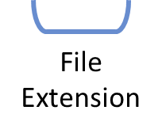
URL : Uniform Resource locator
A reference to the name of a file on the internet
http://webpage.pace.edu/cis101/resume.doc

Slide 5
HTML
http://www.w3schools.com/

Slide 6
HTML: Hyper Text Markup Language
<!DOCTYPE html>
<html>
<head>
<title>
</title>
</head>
<body>
<div>
<p>
</p>
</div>
</body>
</html>

Slide 7
Commonly used tags
HTML headings are defined with the <h1> to <h6> tags H1 being the largest
Text font modifiers
<b> bold </b> <strong> strong </strong>
<u> underline </u>
<i> italicize </i> <em> emphasize </em>
HTML links are defined with the <a> tag: The link's destination is specified in the href attribute. Attributes are used to provide additional information about HTML elements.
<a href="http://www.w3schools.com">This is a link</a>
HTML images are defined with the <img> tag.
The source file (src), alternative text (alt), and size (width and height) are provided as attributes: <img src="w3schools.jpg" alt="W3Schools.com" width="104" height="142">

Slide 8
HTML Tables
<table>
<thead>
<tr>
<th>
</th>
<th>
</th>
<th>
</th>
</tr>
</thead>
<tbody>
<tr>
<td>
</td>
<td>
</td>
</tr>
<td>
</td>
<tr>
<td>
</td>
<td>
</td>
<td>
</td>
</tr>
</tbody>
</table>

Slide 9
Excel

Slide 10
Types of Data
Quantitative Data
Qualitative Data
Quantitative → Quantities
Data which can be measured/numbers.
Discrete Data – distinct values.
Continuous Data - divisible values.
Qualitative → Qualities
Descriptions/observations, but not measured.
Nominal Data – can not be ordered.
Ordinal Data – observations with a logical rank.
http://regentsprep.org/regents/math/algebra/ad1/qualquant.htm

Slide 11
Excel Terminology
https://exceljet.net/keyboard-shortcuts

Slide 12
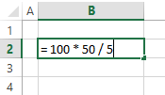
Excel Terminology
Formula - User defined equation using numbers and/or cell references
Function - Predefined equations in Excel that perform various operations on the inputs they are provided
Macro – Custom user created functions using Visual Basic coding language
https://exceljet.net/keyboard-shortcuts

Slide 13
Formulas Use Operators
Arithmetic Operators
Logic Operators
+ Add
= 10 + 5 Result = 15
- Subtract
= 10 – 5 Result = 5
* Multiply
= 10 * 5 Result = 50
/ Divide
= 10 / 5 Result = 2
^ Power
= 10 ^ 5 Result = 100,000
( ) Order of Operations
= ((5 + 5) ^ 5) Result = 100,000
> Greater than
= 10 > 5 Result = TRUE
>= Greater than or Equal to
= 10 >= 5 Result = TRUE
= Equal to
= 10 = 5 Result = FALSE
<= Less than or Equal to
= 10 <= 5 Result = FALSE
< Less than
= 10 < 5 Result = FALSE
<> Not Equal to
= 10 <> 5 Result = TRUE

Slide 14
Functions to Know
Math Functions
Logic/Conditional Functions
=Sum(B1:B20)
Adds together all numbers in range
=Count(B1:B20)
Counts all numeric values in range
=CountA(B1:B20)
Counts all non-empty cells in range
=Average(B1:B20)
Calculates average of numbers in range
=SumProduct(B1:B20, C1:C20)
Calculates sum of the range members multiplied
=If ( 10 > 5, “Good”, “Bad”)
Result = “Good”
=And ( 10 >= 5, 4 > 10)
Result = FALSE
=Or ( 10 = 5, 4 = 4)
Result = TRUE
=CountIfs(Criteria Range, Criteria)
=SumIfs(Numeric Range, Criteria Range, Criteria)
=AverageIfs(Numeric Range, Criteria Range, Criteria)

Slide 15
IF Statements in Excel
IF
Then
-
Else
-
-
=IF(
Logic_Test
,
[Value if True]
,
[Value if False]
)
5 > 2
7
5 + 2
=IF(
x > y
,
x + y
,
10
5 * 2
x * y
)
x = 5
Y = 2

Slide 16
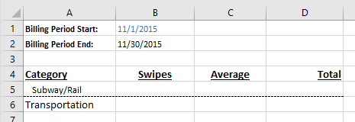
COUNTIFS
3
=CountIfs( Criteria Range, Criteria, Criteria Range , Criteria , Criteria Range , Criteria )
A5,
data[Date] ,
“>=“ & B1 ,
data[Date] ,
data[Sub-category] ,
=CountIfs( )
“<=“ & B2 )

Slide 17
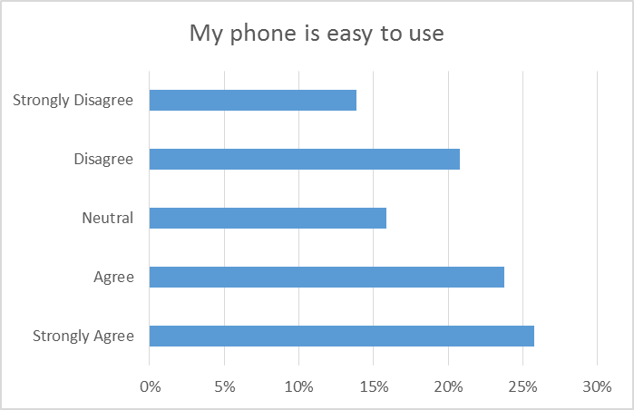
Chart Types
Pie Chart
Column Chart
BAR CHART

Slide 18
Line graphs and Time Series Data
https://www.captechconsulting.com/blogs/data-scientist-vs-data-analyst

Slide 19
Midterm Format

Slide 20
Midterm Format
Open Notes & Web, but do not communicate with another human being
Cheating will result in a zero for both parties even if they are in another section
50 Questions in 60 Minutes
Q1 – 5 True/False Internet Vocabulary & HTML
Q6 – 10 True/False Data types & Excel
Q11 - 30 Multiple Choice HTML
Q31 - 37 Calculated Response Excel Formulas
Q38 – 45 Calculated Response Excel Functions & IF Statements
Q46 – 50 Multiple Choice IF Functions

Slide 21
Calculated Questions
= B1 * B1
same as = 3 * 3
answer is 9
= Sum(A1:C1)
same as = 13 + 3 + 5
answer is 21
= if(B1 > B1, A3, A1)
same as if(3 > 3, 4, 13)
answer is 13

