Slide 1
Economics of Social Media

Slide 2
Social Media

Slide 3
20,000 People Watch a Puddle

Slide 4
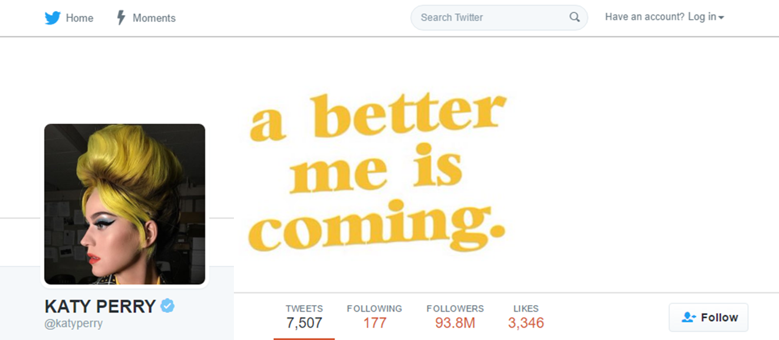
Facebook User Growth
93.8 Million People

Slide 5
Top 25 Populous Countries
Notes:
Equal to being the 15th largest country on earth
219 of 233 Presidents and Prime Ministers speak to few people during a national address than Kate Perry does with a Tweet

Slide 6
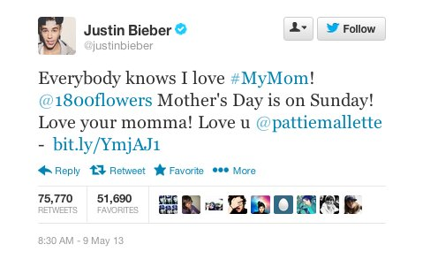
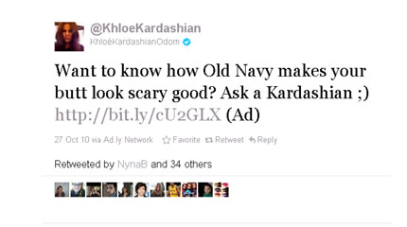
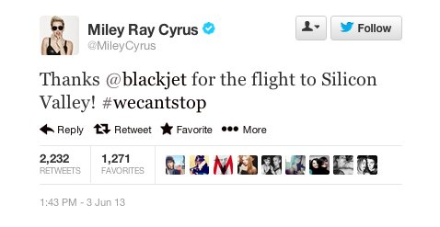
Endorsements

Slide 7
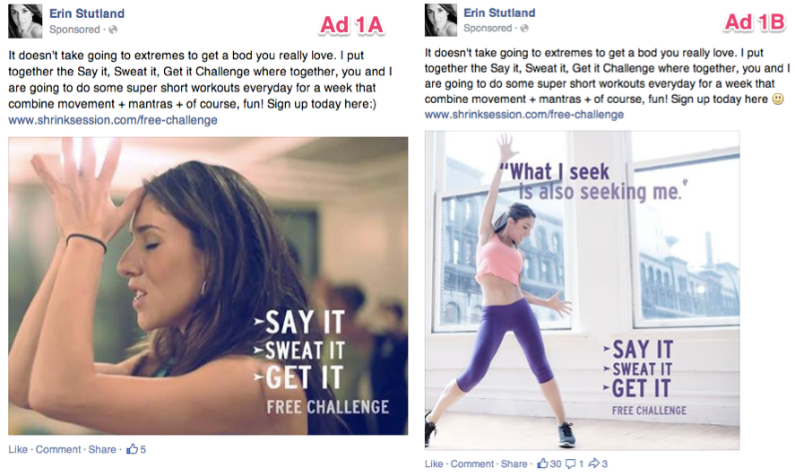
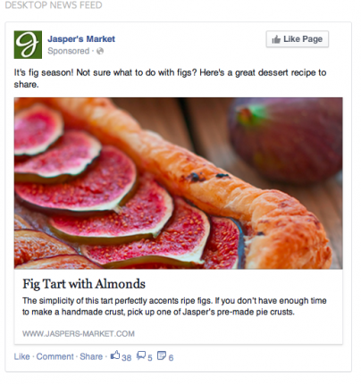
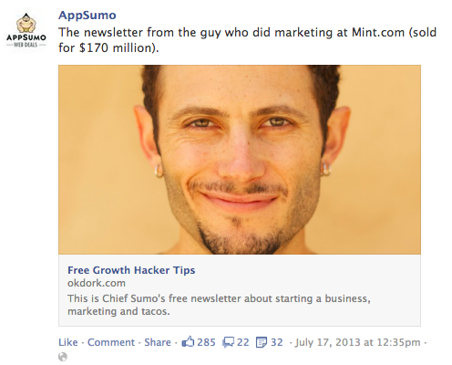
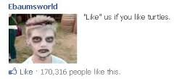
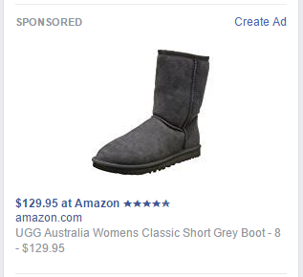
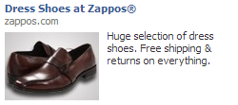
How do they make money?

Slide 8
$35 Billion Industry

Slide 9
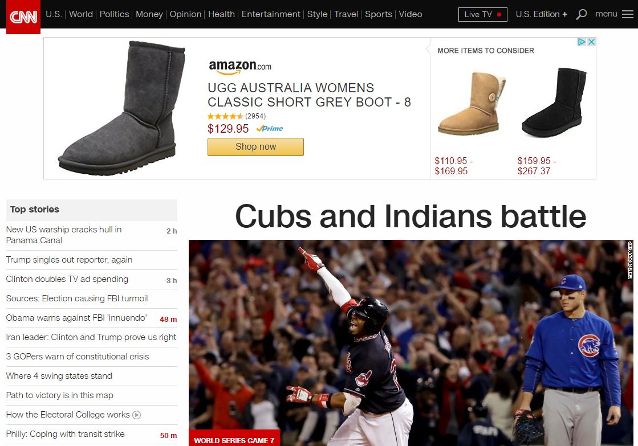
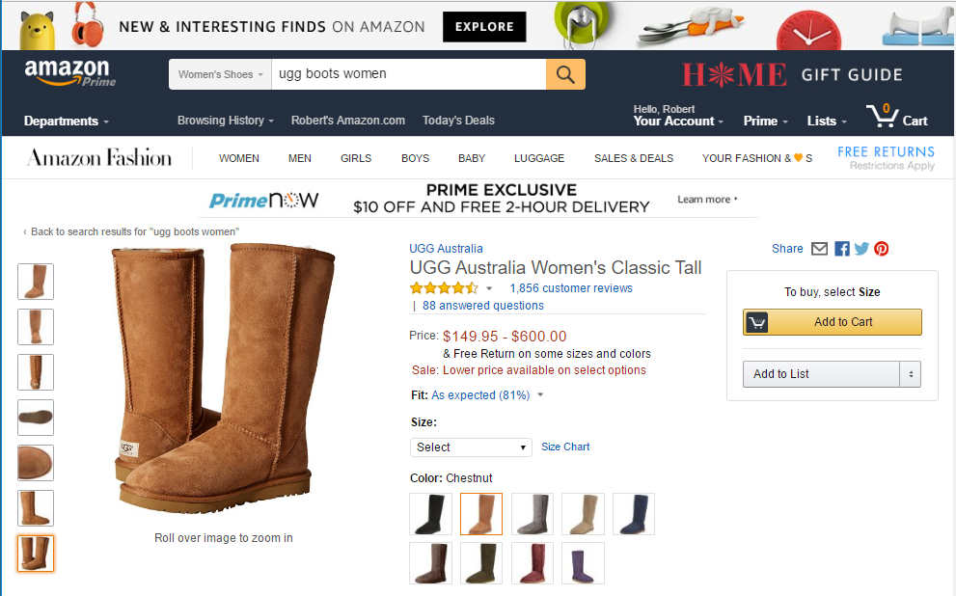
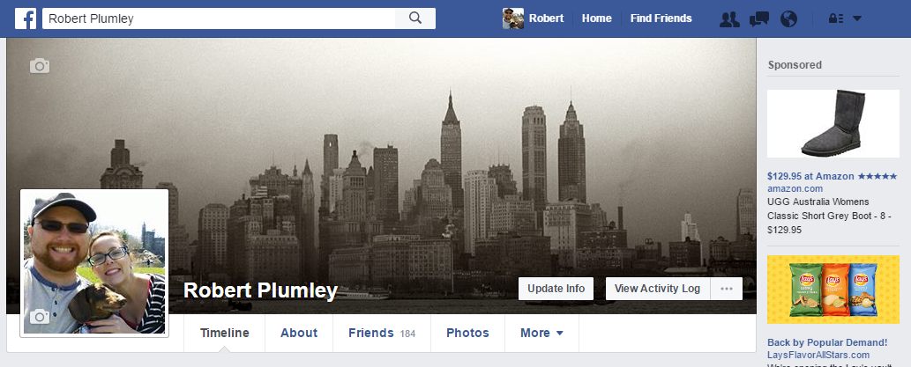
$35 Billion Industry, Why?
John Doe
John
John Doe
Notes:
$35 Billion Industry, Why?
Profile information
Your age
Gender
Things you’ve liked
Where you check-in
Virtually everything you share
Have you ever looked at a product on a site like amazon, and had that product follow you around the net?

Slide 10
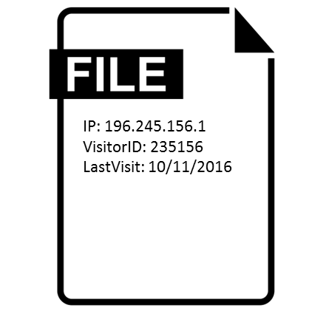
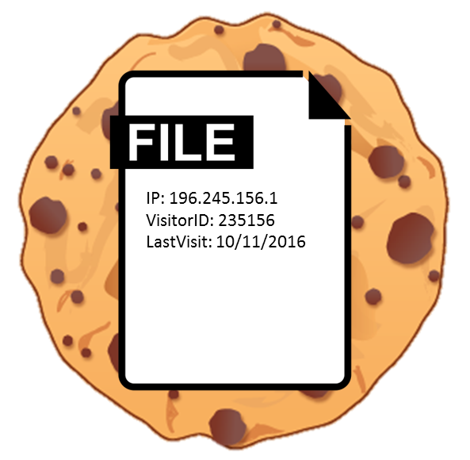
Cookies
Notes:
When you visit sites like amazon they store small files call cookies that allow you to be identified when you visit the site again or visit other sites in their ad network

Slide 11
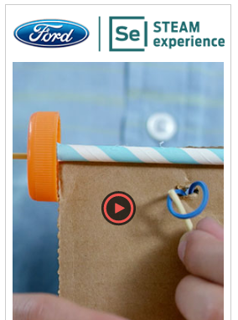
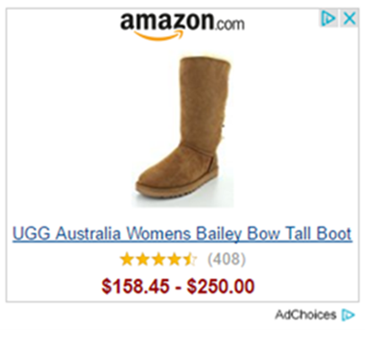
Cookies
Ad Network
Load Ad Here
Notes:
Spaces where ads will go are added to sites and that block is connected to ad networks, just like you connected your site to youtube when your embedded video
When a website is loaded the cookie information is provided to the ad network to identify you
The ad network goes through the various ad options based on how well they match your profile info and highest bidder
And then loads the best match in the block on the site.

Slide 12
What do you think of Social Media?

