Slide 1
Excel Tables

Slide 2
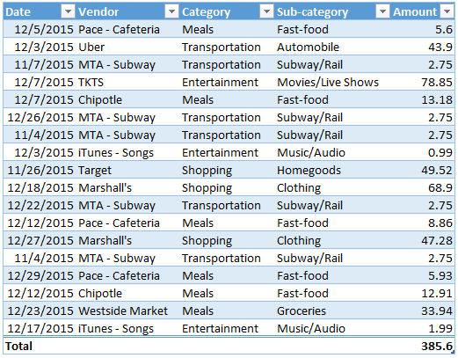
Elements of an Excel Table
Header Row
Data Rows
Total Row

Slide 3
Data Row
Each Row is a single entity that is described by the data in its columns

Slide 4
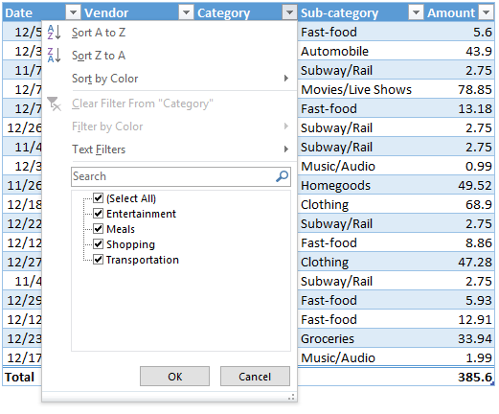
Header Row
Quick Filter and Sort Options

Slide 5
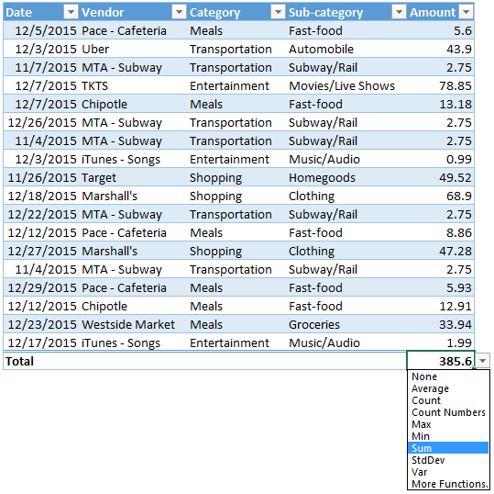
Total Row
Total Row Options

Slide 6
IF Functions

Slide 7
IF Functions
=CountIfs( Criteria Range , Criteria)
=SumIfs( Numeric Range , Criteria Range , Criteria)
=AverageIfs( Numeric Range , Criteria Range , Criteria)

Slide 8
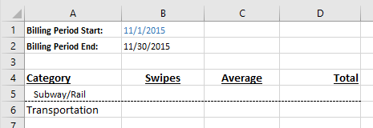
COUNTIFS
3
=CountIfs( Criteria Range, Criteria, Criteria Range , Criteria , Criteria Range , Criteria )
A5,
data[Date] ,
“>=“ & B1 ,
data[Date] ,
data[Sub-category] ,
=CountIfs( )
“<=“ & B2 )

Slide 9
AVERAGEIFS
2.75
Numeric Range
=AverageIfs( Numeric Range , Criteria Range, Criteria, Criteria Range , Criteria , Criteria Range , Criteria )
data[Amount] ,
data[Sub-category] ,
A5,
data[Date] ,
“>=“ & B1 ,
data[Date] ,
=AverageIfs( )
“<=“ & B2 )

