Slide 1
Web Design

Slide 2
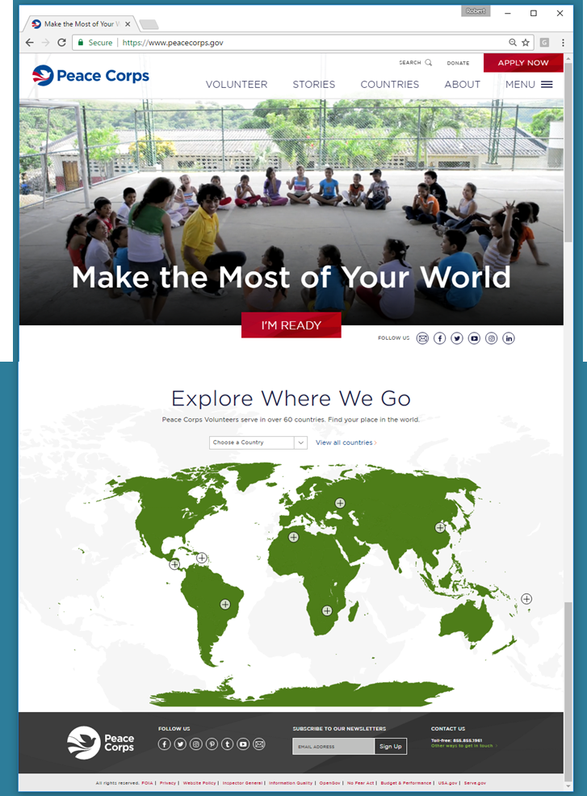
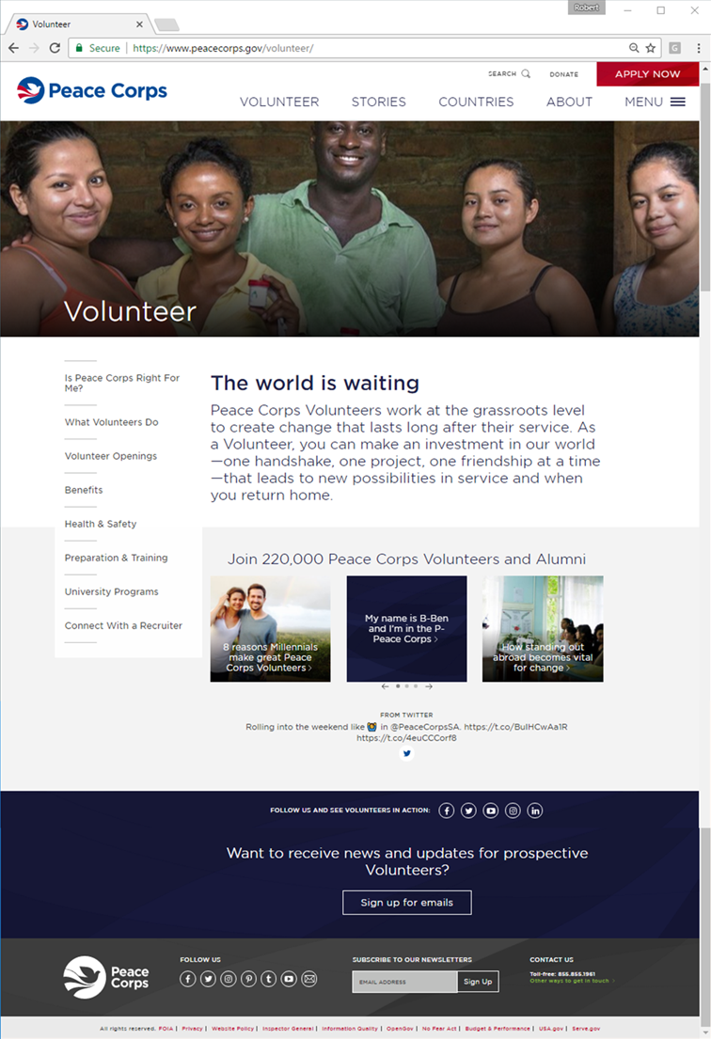
Basic Layout Elements
Header
Slider
OR
Hero
Social Bar
Sidebar
OR
Side Navigation
Content
Social Bar
Footer
Social Bar
Social Bar

Slide 3
Navigation
Header
Header
Logo
Home Link
Top Nav OR Menu
Sub-Nav
Redundancy
Sidebar
OR
Side Navigation

Slide 4
The Fold

Slide 5
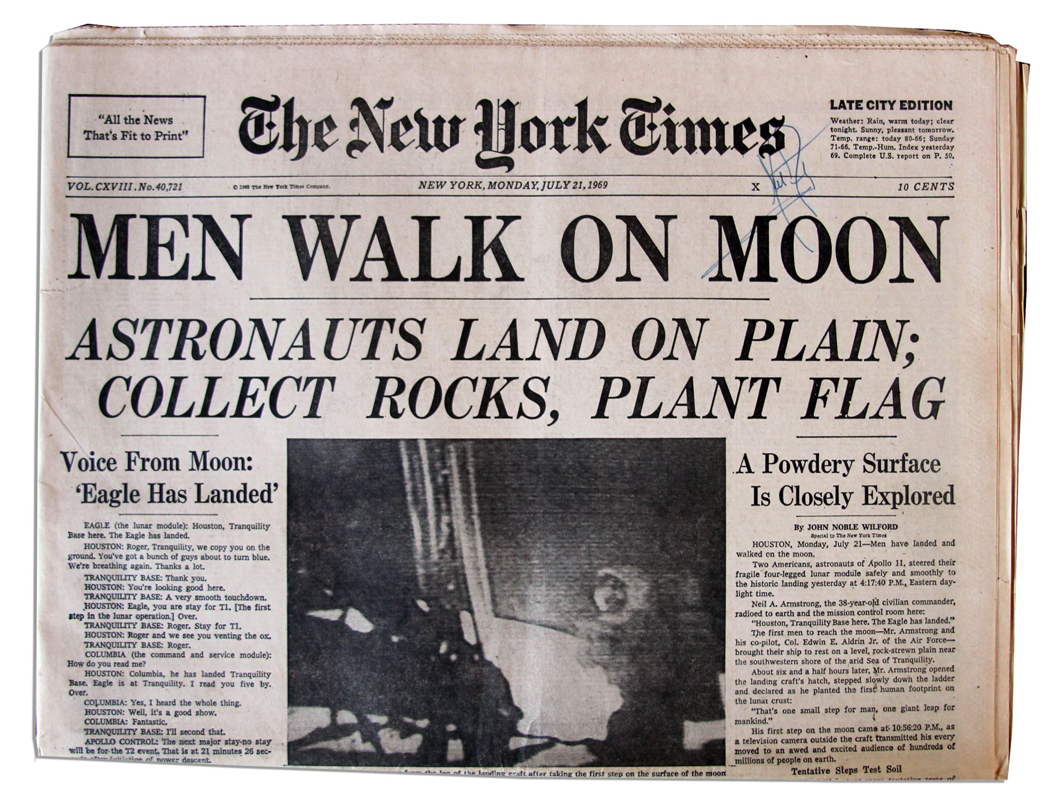
The Fold
Above the Fold
Above the Fold
Below the Fold
Below the Fold

Slide 6
Above the Fold
Header
Logo
Home Link
Top Nav OR Menu
Slider
OR
Hero
Call to Action
Social Bar

Slide 7
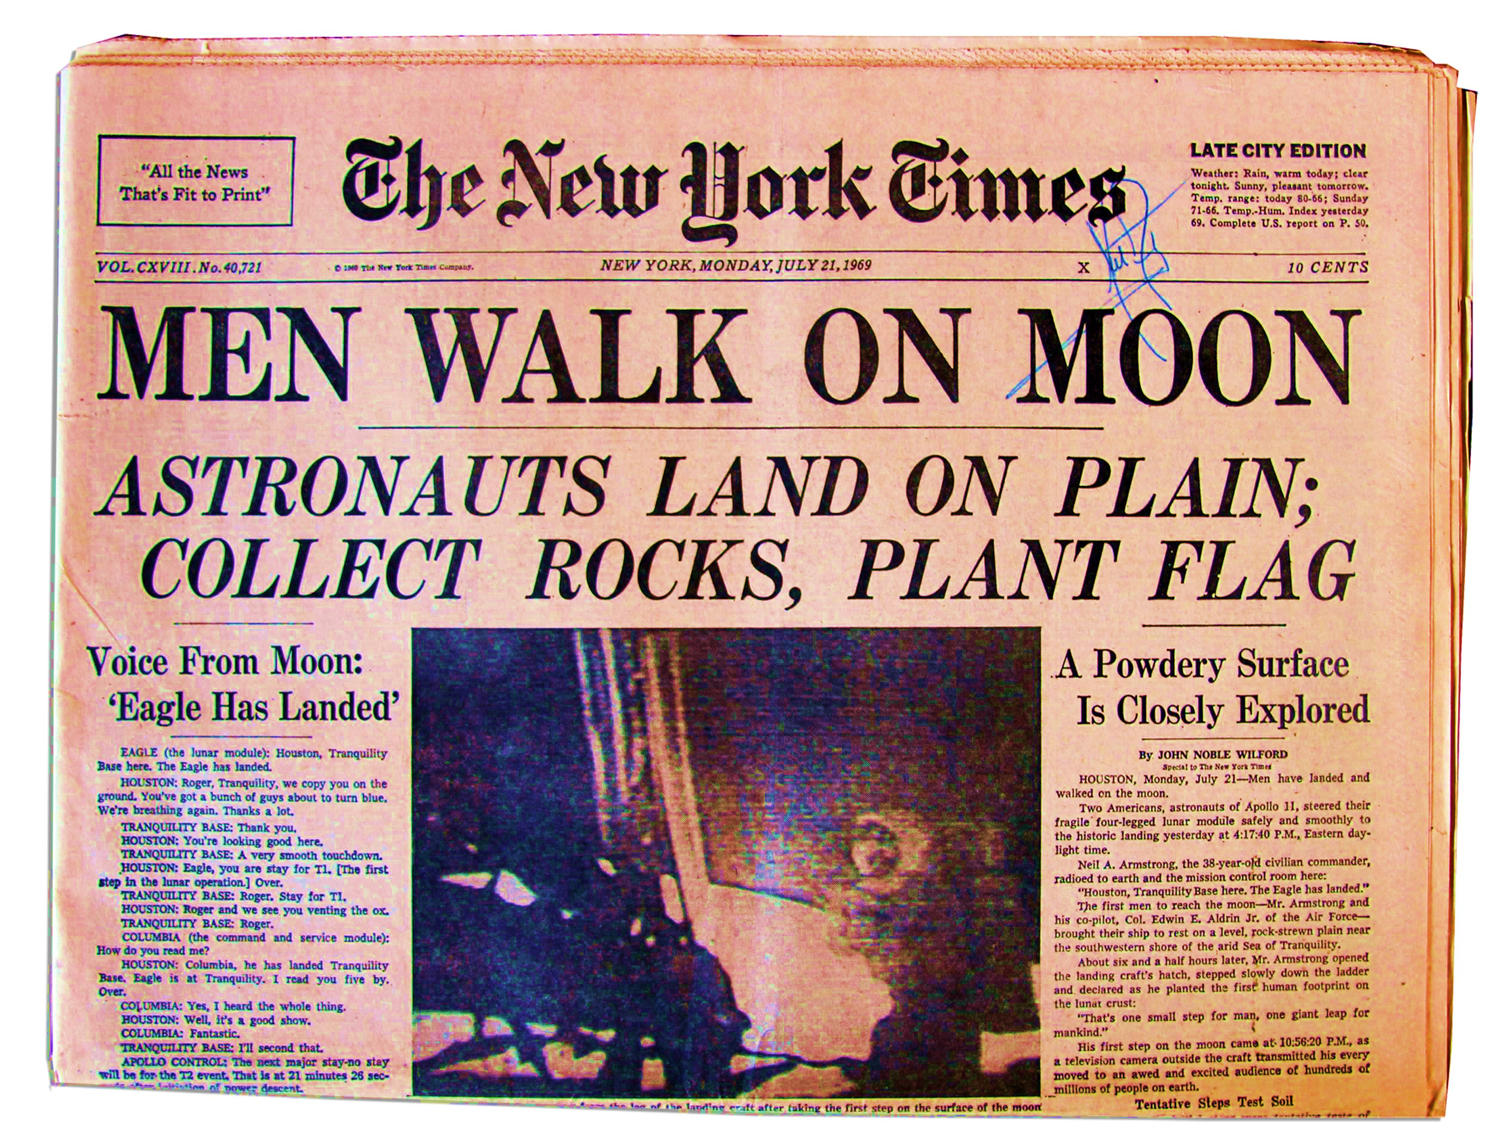
Headings
<H1>
</H1>
<H2>
</H2>
<H3>
</H3>
<H3>
</H3>
<p>
</p>
<p>
</p>

Slide 8
Wireframes

Slide 9
Quick Sketch

Slide 10
Using a Tool for a Website Mockup

Slide 11
Complicated User Workflows

Slide 12
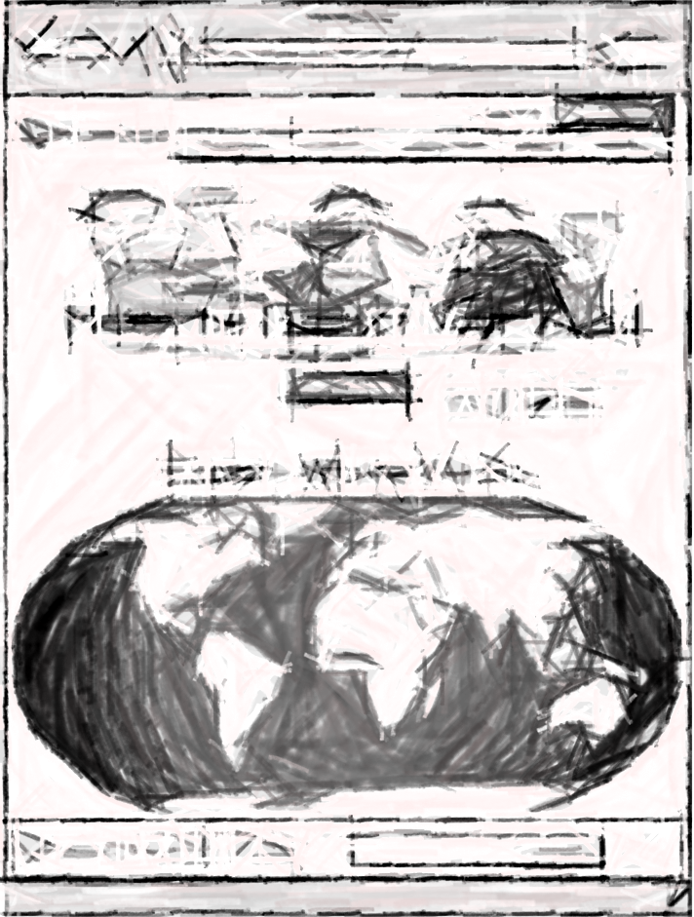
Evolution

Slide 13
Evolution

Slide 14
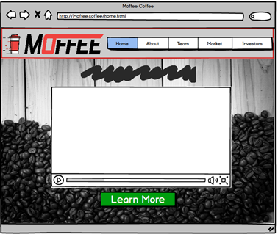
Group Project Website
Header
Logo
Home Link
Top Nav /Menu
Slider
OR
Hero
Call to Action

Slide 15
Group Project Website

Slide 16
Mobile App

Slide 17
Present a User Workflow

Slide 18
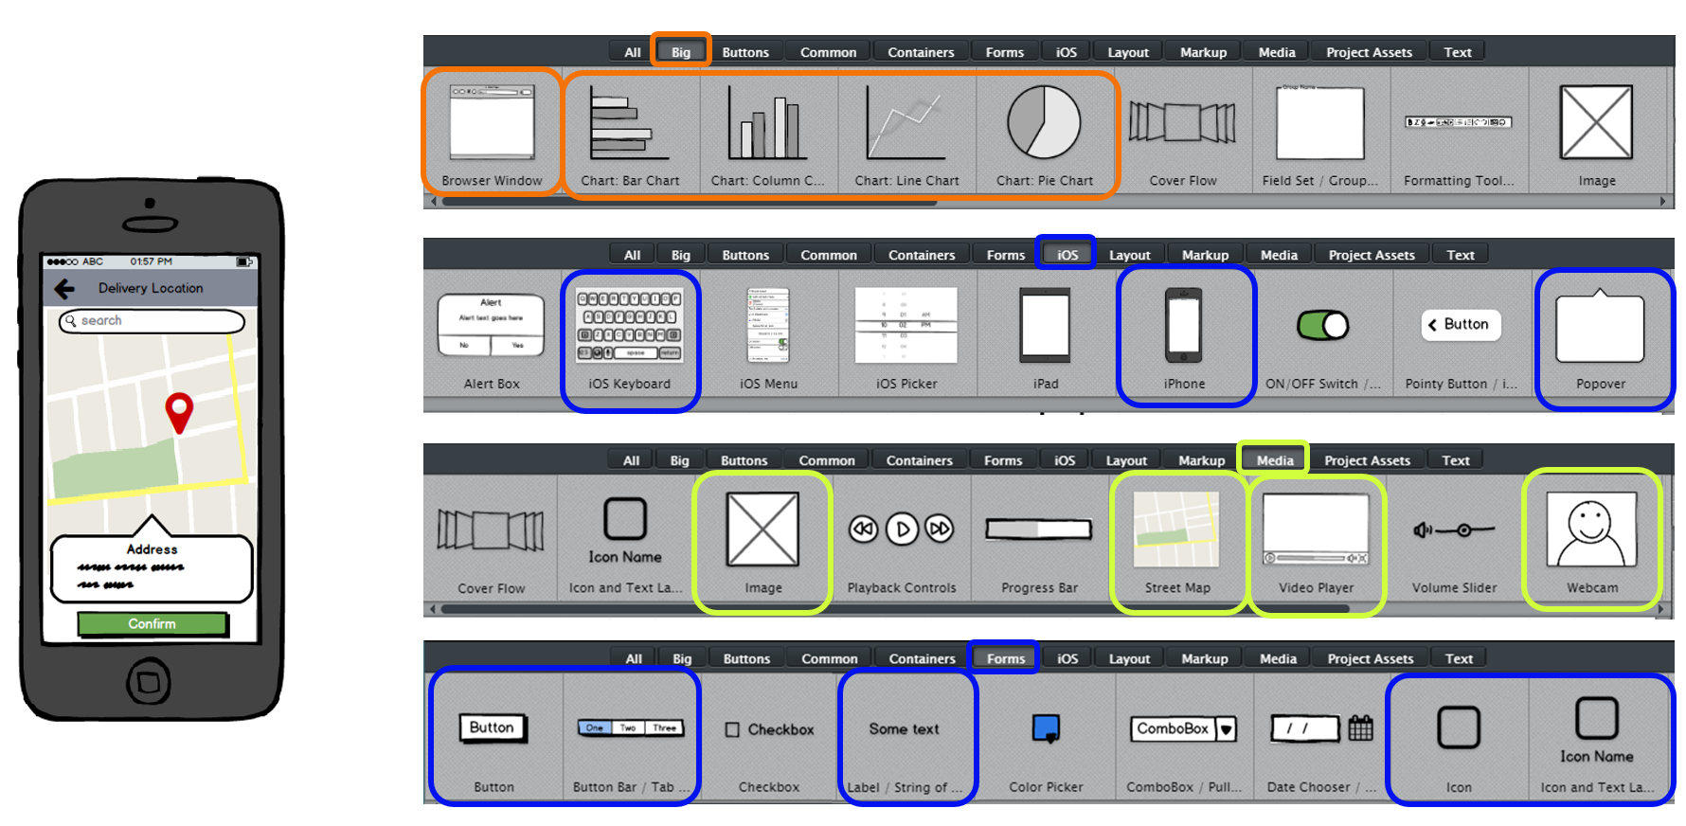
Using Balsamiq

Slide 19
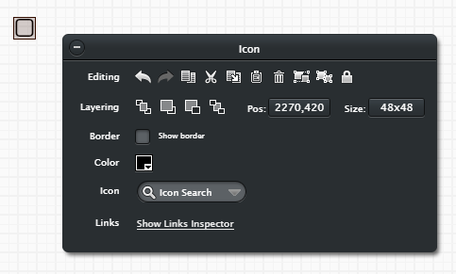
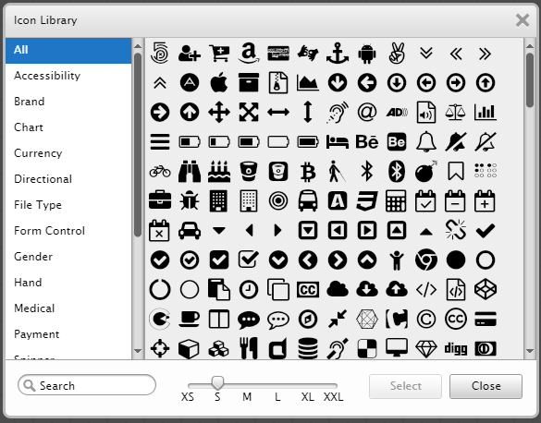
Icons Make the Difference

Slide 20
Before Starting Your Group Project

Slide 21
Who Will Use Your App?
Mobile App Concepts to Consider:
Location Based Service: Identify all of the ___ in the area to make ____ easier
Data Aggregation: Multiple sites/services have similar data, put it all in one place to make _____ easier
Augmented Reality: While looking a mobile device's screen I see the real world combined with information to make _____ easier
Service Provider Coordination: Enable user to easily order from/connect with providers of a desired service
Recommendation Engine: Based on the information that is known about a user, recommend they evaluate similar options
What problem does your app hope to solve?
Do you have multiple user types, i.e. Merchants & Customers?
What specific actions will each user need to perform to receive the full benefit of you app?
Where does your company’s revenue come from?

Slide 22
Design Thinking

