Slide 1

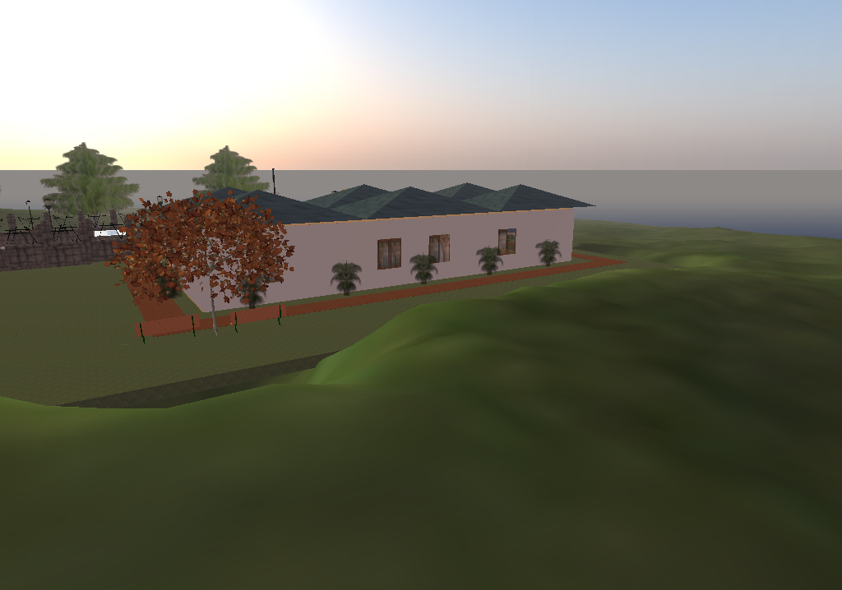
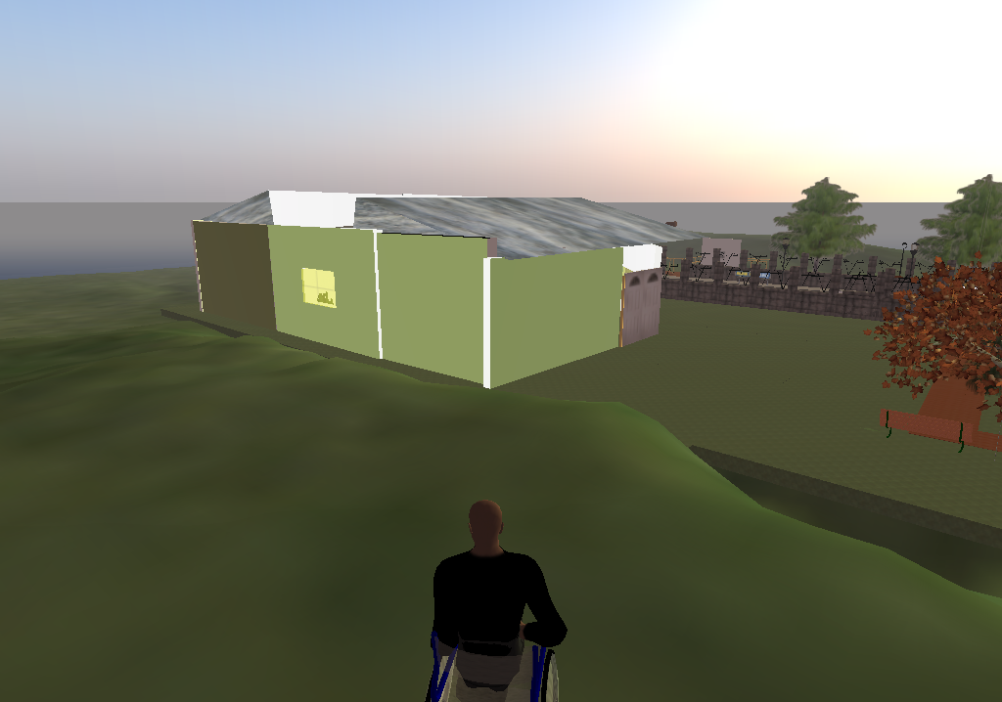
The Pace University Second Life Team Project

Slide 2
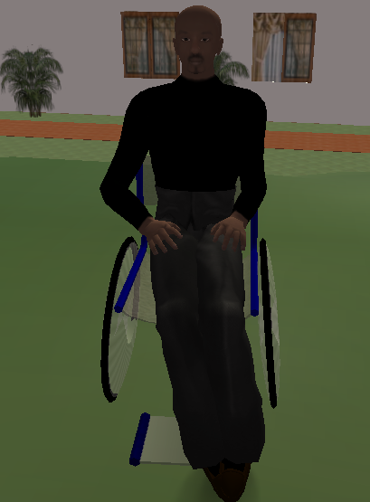
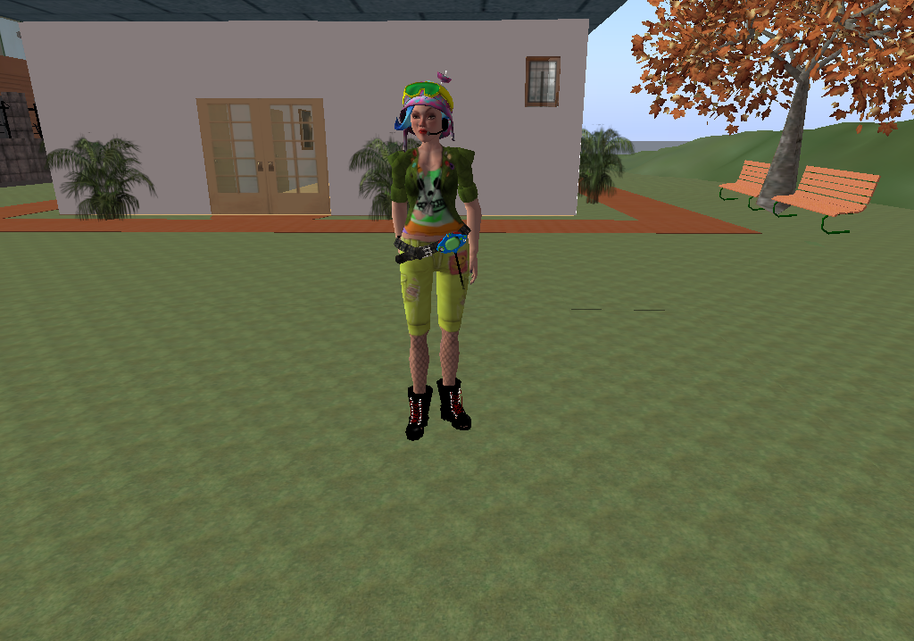
Meet The Team
Lloyd Duberry Jr.
Major: Finance
Avatar: Lloyd Adamski
Luisa Morales
Major: Business Economics
Avatar: Lu15a Parx

Slide 3
Second Life Objective:
Constructing A Comfortable Home for a senior citizen confined to a wheelchair.

Slide 4
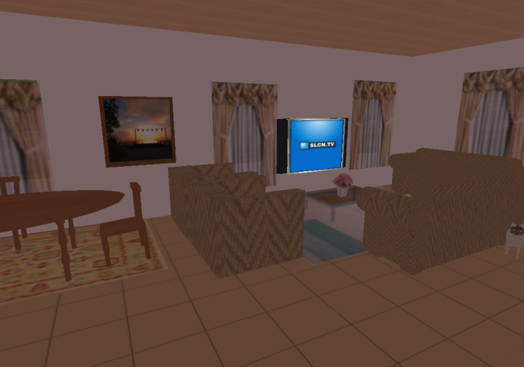
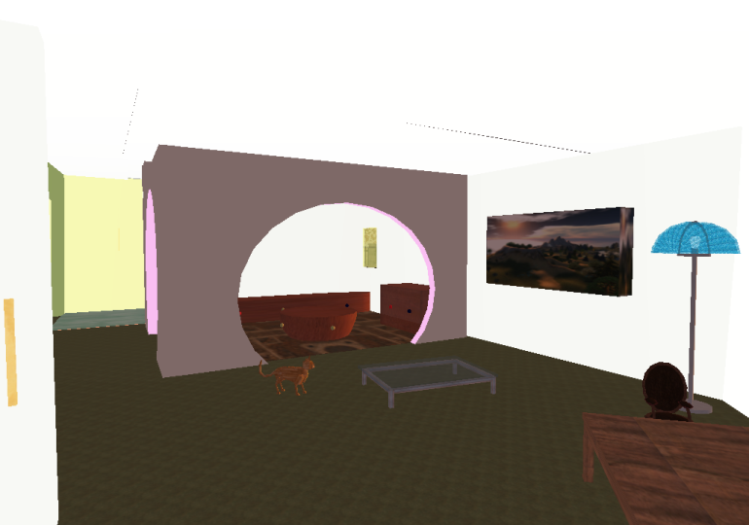
What We Built
House 1:
House 2:
Two homes were custom built for a senior citizen in a wheelchair with considerations such as:
- Spacing
- Height of furniture and appliances
- Size of windows
- Width of door entrances.
- Master bedroom and adjoining rooms
- Accessibility of kitchen
- Room arrangement
- No stairs

Slide 5
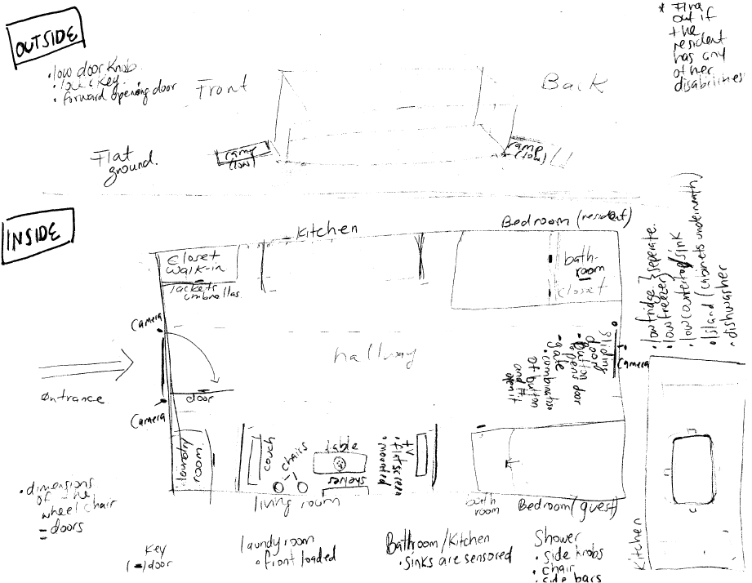
What We Did

Slide 6
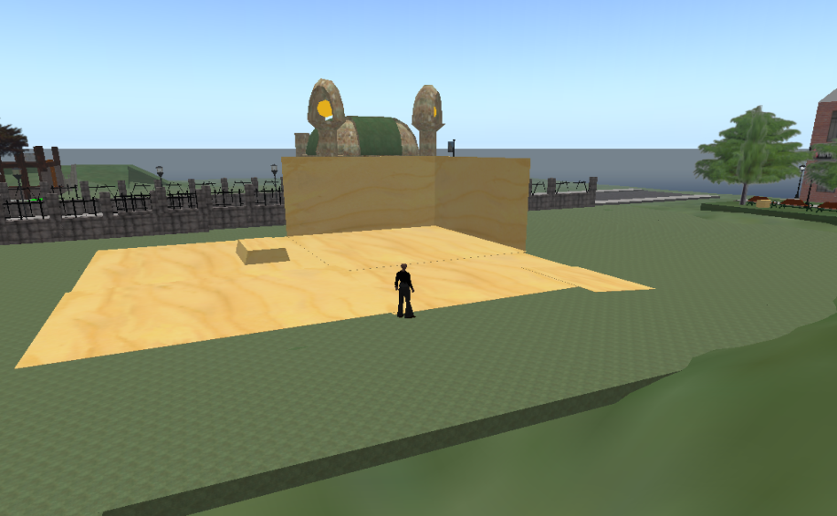
What We Did
- Brainstormed to develop a floor plan.
- Imagined ourselves in a wheelchair to determine what we may like and received input from persons with relatives in wheelchairs.
- Built our houses with the floor plan as a general guide.
- Made the houses as user friendly as possible.
- Incorporated the general considerations such as height and spacing into construction.

Slide 7
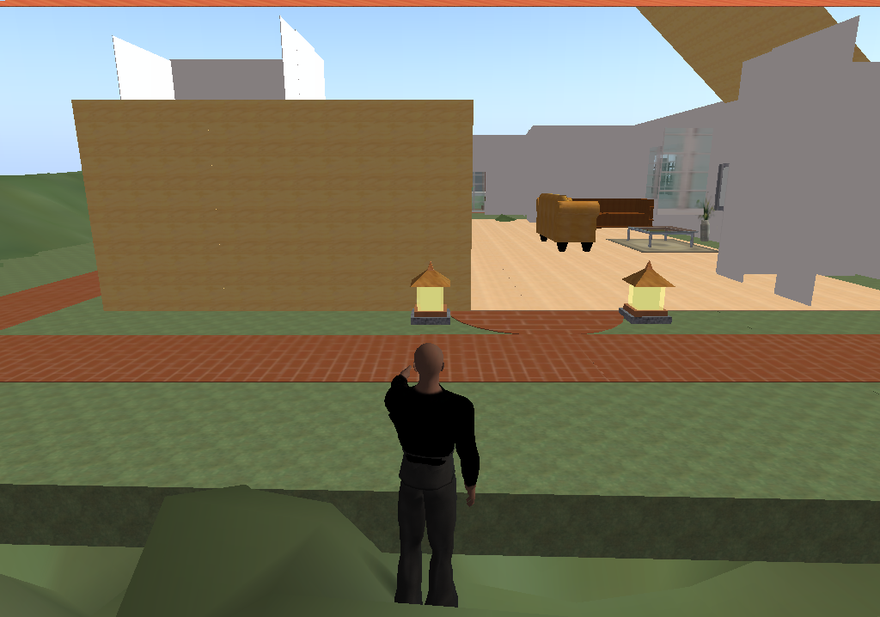
What We Did Ctd.
- Built two houses initially as to develop our construction skills.
- These were later demolished and two new homes were built with the experience gained from our initial attempts.
- Constructed the houses almost entirely as some objects such as furniture was purchased.

Slide 8


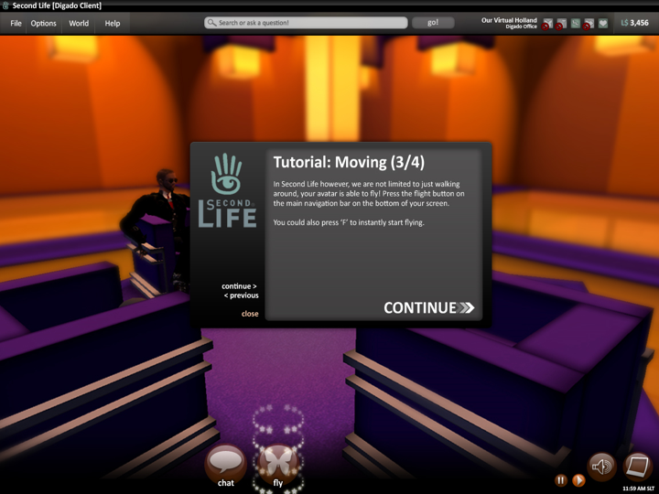
How We Did It
- Kept close communication as it was difficult to physically meet because of the distance between the two campuses.
- Working according to the floor plan was essential.
- We checked and studied tutorials on building within Second Life.
- Built majority of the house through the manipulation of prims

Slide 9
What Would Have Been Done Sooner?
.
- Second Life building tutorials to learn how to manipulate prims in second life.
- Commence construction a little earlier.
- Gain a little more insight into Linden Script Language (LSL) so that it could have been utilized more in our home.

Slide 10
What Would Have You Done Differently?
.
- Taking exact measurements so that the houses could have been built to scale.
- Obtained input from more seniors in wheelchairs in terms of their preferences for a an ideal home.
- Started construction earlier.
- Construct a one floor and a two floor house.

Slide 11
The Future: Things We Would Have Done.
- Taking exact measurements so that the houses could have been built to scale.
- Obtained input from seniors in wheelchairs in terms of their preferences for a an ideal home.

Slide 12
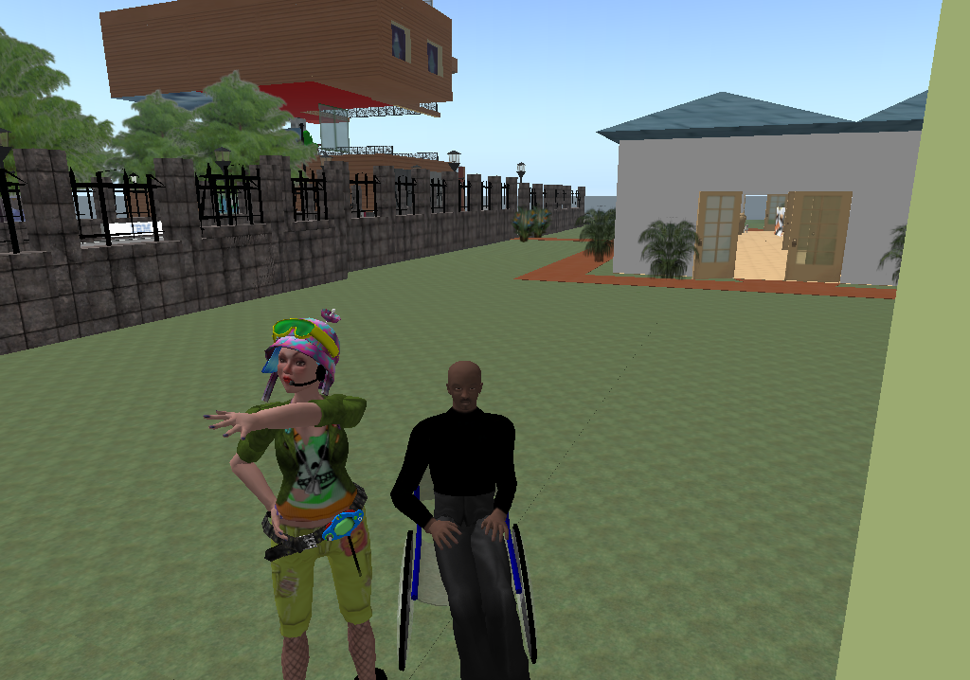
THE END

