Slide 1
Improving the Coordination of the Elderly
Using Nintendo Wii Bowling and Telikin’s Memory Game
Gina Strahl
Stephanie Catania
Our Website

Slide 2
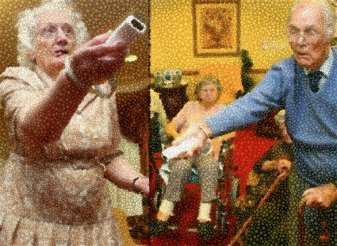
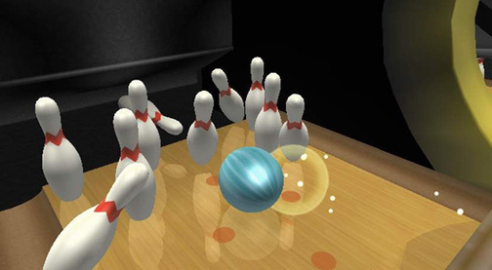
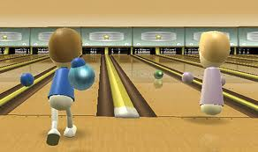
Wii Bowling Keeping the “Young at Heart” Young!

Slide 3
Research states…..
“It is a complex physiological sense that requires the input and full coordination of many systems in the body, including the input from the vestibular, visual, and somatosensory systems, and output from the motor system.” (Cavanagh, 1995).
“Balance, defined in biomechanical terms, is the maintenance of upright posture with minimal deviation from the center of gravity and vertical axis.” (Winter, 1995)
“Although balance is a critical element of daily life for all dynamic beings, the ability to maintain upright posture becomes of particular concern in aging human populations, when the deterioration of the sensory and motor systems becomes common. Decline in balance ability can be caused by both aging and injury to any of the input systems used to properly integrate balance information. Deterioration of the vestibular, visual and somatosensory systems is common with aging. Any injury to any of these systems also has an impact in the ability to integrate balance input.” (Berg, 1989)
The Wii allows elderly participants to exercise which improves balance ability, coordination and helps their postures.
Movement is key to a healthier body.

Slide 4
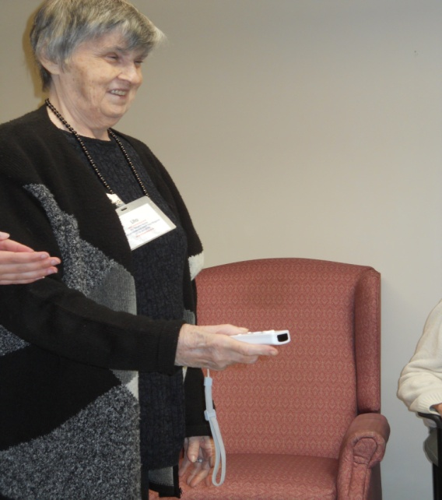
Background and Purpose
Our purpose was to prove that Nintendo Wii bowling helps improve coordination, especially with patients that have arthritis, diabetes, and multiple sclerosis by assessing their progress using a heel to knee test every session for five weeks.
Proposal

Slide 5
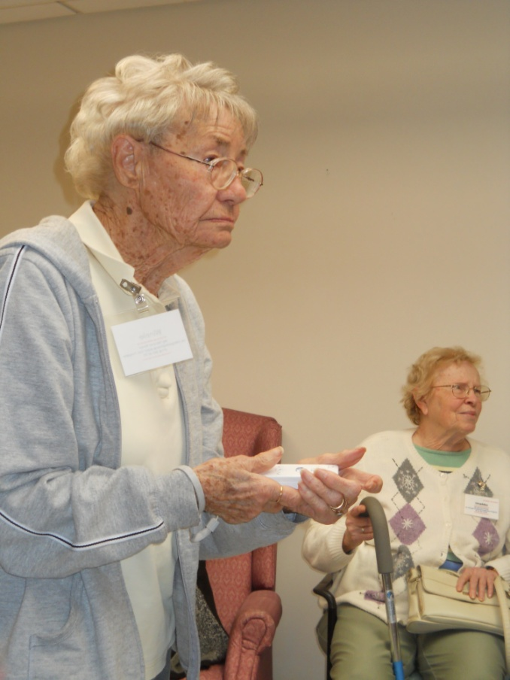
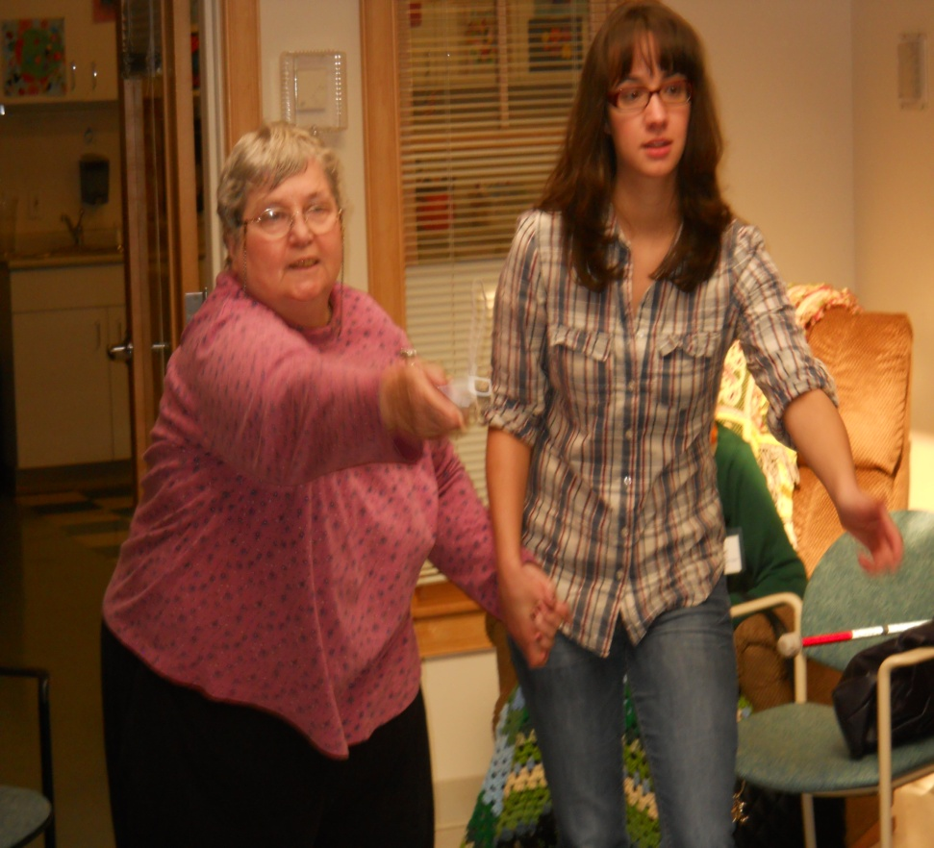
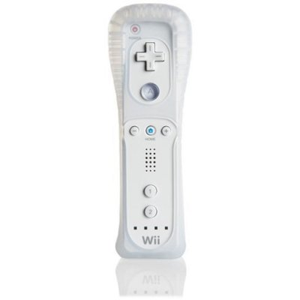
Participants and Setting My Second Home, Mount Kisco, NY
“Family Services of Westchester makes a difference in the lives of families through a broad range of services that strengthen and support parents, children and individuals of every stage of life.” The patients were between the ages of 70-86 years old at My Second Home in Mount Kisco.

Slide 6
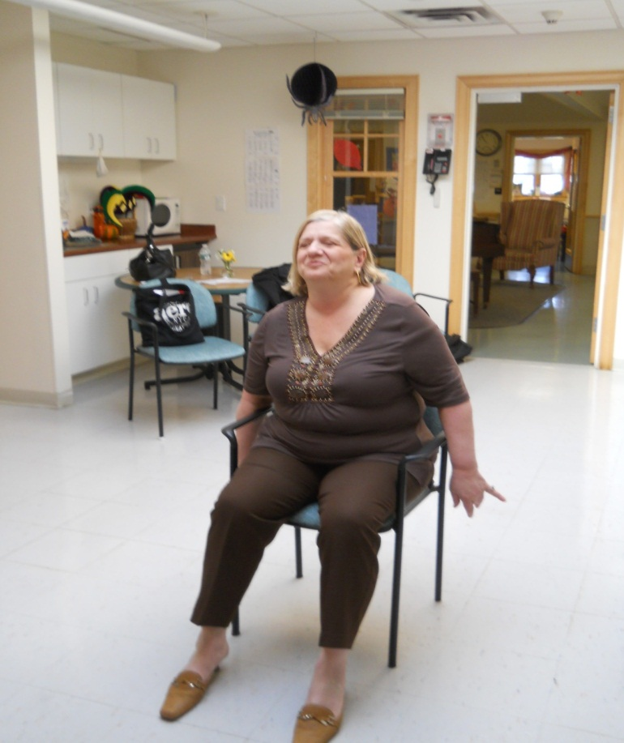
Intervention
Ten patients participated in five weekly sixty minutes intensive sessions.
Participants each were taught how to use the Wii Remote and game.
For the first two weeks we had everyone practice until they felt comfortable using the Wii remote.
We trained in both standing and sitting positions.
Eventually on the third week, we had participants start a bowling tournament.

Slide 7
Bowling Tournament
When we first met our participants we wanted them to have fun while improving their coordination and cogitative functions.
Tournament Scores
 | 1 | 2 | 3 | 4 | 5 | 6 | 7 | 8 | 9 | 10
TIGERS | 7/2 | -/3 | 7/- | 6/1 | 5/2 | 9/- | 3/3 | -/6 | 7/1 | 9/-
 | 9 | 12 | 19 | 26 | 33 | 42 | 48 | 54 | 62 | 72
BLUE JAYS | 7/Spare | -/6 | 7/- | 8/- | 7/2 | 8/- | 8/- | 4/ Spare | 3/5 | 7/2
 | 10 | 16 | 23 | 31 | 40 | 48 | 62 | 75 | 83 | 92

Slide 8
Tournament Clip

Slide 9
Outcomes
Heel to Knee ( 5 times)
 | Time | How far? | 5 weeks Later…. | Time | How far?
Jack | 10.06 | to her knee |  | 8.55 | to her knee
Bill ( standing up) | 5.51 | to his knee |  | 5.04 | to his knee
Rose | 8.2 | 1/4 under her knee |  | 6.02 | 1/4 under her knee
Annie | 9.09 | to her knee |  | 8.54 | to her knee
Vonnie | 5.65 | an inch up her leg |  | 5.05 | two inches up her leg
Imelda | 14.46 | ¼ under her knee |  | 10.47 | 1/4 under her knee
Patricia | 6.49 | to her knee |  | 5.55 | to her knee
Leonor | 7.75 | to her knee |  | 6.16 | to her knee
Lita ( blind) | 8.52 | to her knee |  | 6.28 | to her knee
Winnie | 7.54 | half way to her knee |  | 5.17 | half way to her knee
*Times are recorded in seconds!
This data proves coordination has improved after playing Wii bowling for 5 weeks.
Patients times have become much faster when using their foot to touch their heel to their knee.

Slide 10
Survey Measuring how our participants felt?
Participants in the beginning and end of the 5 weeks were asked a series of questions about playing Wii.
Before starting, almost all participants have not played Wii before or even knew how to use the console.
Participants, along with data, felt that their coordination and memory improved.
Many felt that the hardest thing to learn was the right movement and remembering the buttons, especially the “B” button.

Slide 11
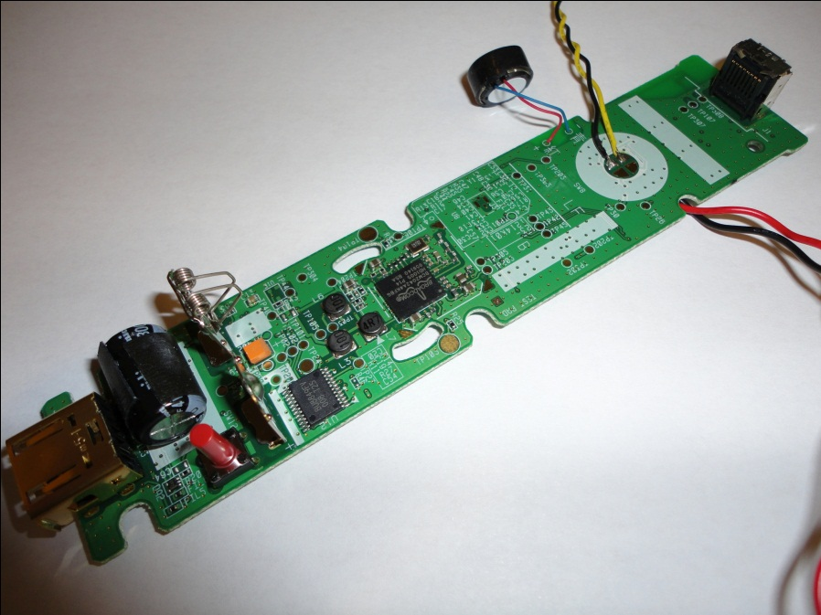
Modifying the Wii Controller
From the survey and working with the participants weekly, we had a hard time having them remember which buttons to press.
Therefore worked on trying to modify the buttons, particularly the “B” button.

Slide 12
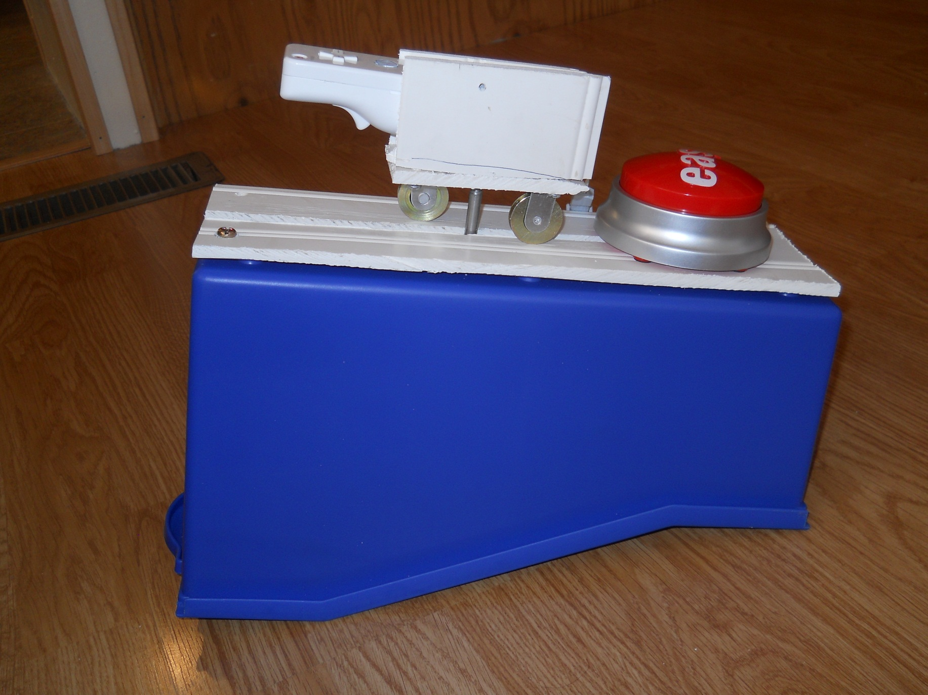

Slide 13
Wii Bowling ( Number of Pins Knocked Down)
 | 1st Week | 2nd Week | 3rd Week | 4th Week | 5th Week
Vonnie | 3 | 5 | 8 | 10 | 10
Edyie | 1 | 6 | 8 | 9 | 8
Vivian | 3 | 8 | 7 | 10 | 10
Bill | 9 | 7 | 10 | 7 | 8
Imelda | 3 | 5 | 6 | 6 | 8
Jack | 5 | 7 | 9 | 10 | 10
Winnie | 9 | 9 | 9 | 8 | 9
Lita | 1 | 7 | 7 | 8 | 9

Slide 14
Wii Bowling Conclusions
Improved coordination
Improved balance
Maintained upright postures (six participants started out playing Wii sitting in a chair, by the end of the five weeks only one participant sat while playing.)
Participants interest and excitement in Wii increased every week
Remote needs to be modified with large buttons and less buttons to press, so that they can remember

Slide 15
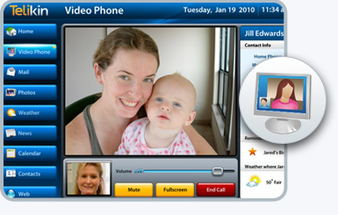
Telikin “Telikin is a simple and easy to use family computer that combines video chat, photo sharing, email and many more popular features into a sleek, touchscreen device.”
$699.99
Features: Video Chat, Mail, Photo Sharing, Weather, News, Calendar, Address Book and Web Browsing.
www.telikin.com

Slide 16
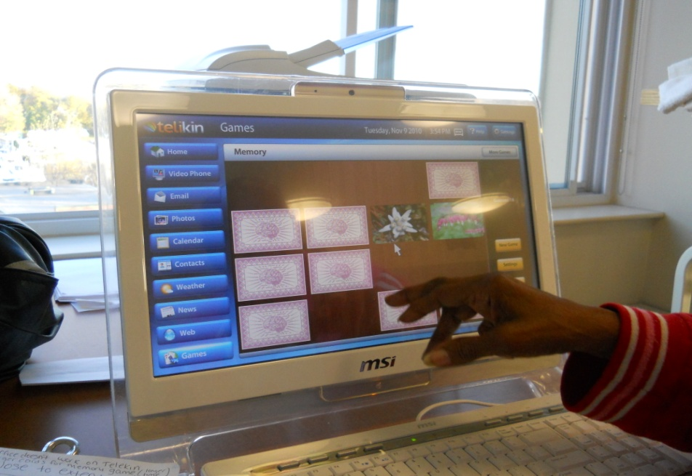
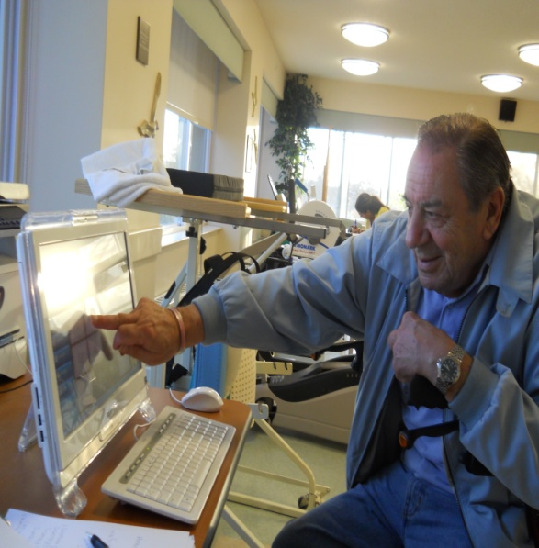
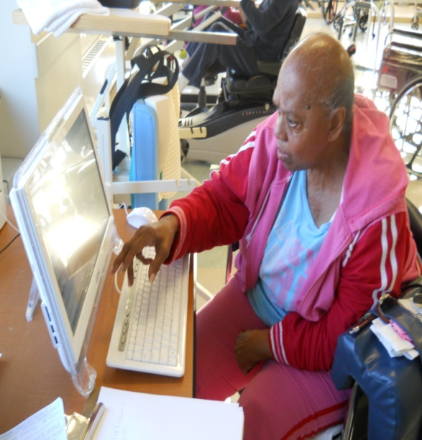
Background and Purpose
Our purpose was to prove that the Telikin helps improve coordination while assessing their progress using a finger to nose test.

Slide 17
Patients and Setting
The patients were between the ages of 70-86 years old at United Hebrew in New Rochelle.

Slide 18
In United Hebrew the Telikin is used for….
Patients to listened and watched youtube videos while exercising.
Read the news and check the weather, which allows them to use touch screen for fine motor skills.
Type information to improve motor skills.
Games they play: Memory, Blackjack, and Photo Scramble. Did not play FreeCell or Mahjong.
Use the calendar to record certain information.

Slide 19
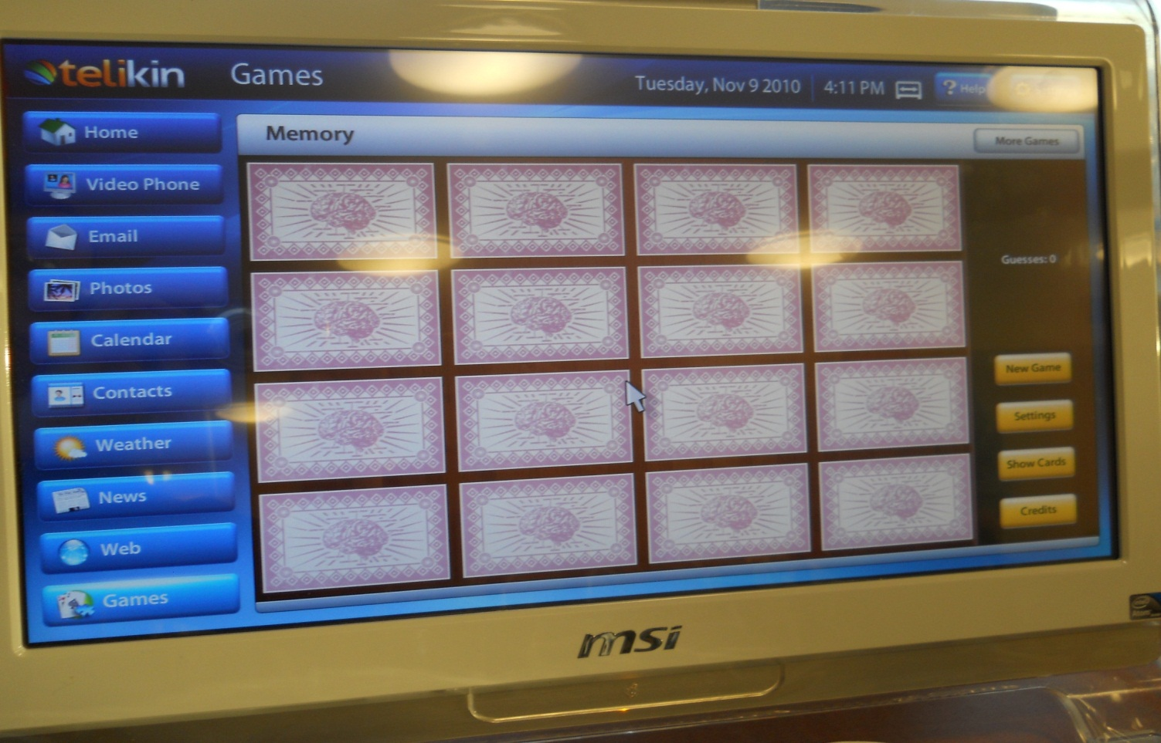
Intervention
Three patients participated in five weekly sessions for sixty minutes. Training was performed using the Telikin’s memory game. We trained in sitting positions.

Slide 20
Outcomes
 | Finger to Nose Pre-test | 5 weeks later…. | Finger to Nose Post-test
Lizzy | 5.30 |  | 5.10
Al | 6.91 |  | 6.01
Pam | 4.11 |  | 2.37
*Times are recorded in seconds
* Right hand was during assessments
The post test proves that the Telikin memory game has improved coordination and memory.

Slide 21
Telikin Conclusions
Improved coordination
Improved memory
Stroke victim (Lizzie) improved greatly and could easily speed through the memory game
Inspired confidence to explore the operating system to gain a better understanding of the technology
Provided more opportunities to be more social, including signing up on facebook and posting pictures
Offered suggestions to Telikin to improve software to better fit the needs of elderly customers

Slide 22
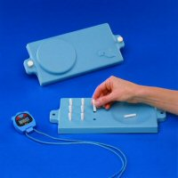
9 Hole Peg Test
The nine hole peg test is a simple test used to determine fine motor control and coordination. The test consists of a block with nine holes into which the patient has to place nine accompanying pegs. The subject is scored based on the amount of time spent in placing and removing all nine pegs.
We plan on working with the patients next semester to continue proving that the Telekin does help elderly with fine motor skills and coordination.
We gave the patients a pre-test using this test and look forward to seeing the results. Pam
Right hand- 35.72 seconds
Left hand- 36.16
Lizzy
33.44 seconds
( right hand only)

