Slide 1
STUDENT ASSESSMENT IN A CAPSTONE COMPUTING COURSE
Charles C. Tappert, Avery M. Leider, and Sukun Li
Seidenberg School of CSIS, Pace University, New York

Slide 2
Real-World Student Projects
Conducted in capstone courses for 19 years
Hallmark of the capstone courses
Student teams build real-world computer information systems for actual customers
Projects primarily serve the community
Internal university community at Pace
Greater university community
External non-profit local community
Occasional external for-profit companies
SEDSI 2019

Slide 3
Real-World Student Projects (cont)
Real-world projects are a stellar learning experience for the students
Win-win situation for all
Students
Customers
Instructors and other involved faculty
School of CSIS
University
SEDSI 2019

Slide 4
Migrate to Web-assisted Format
Migrated from traditional face-to-face format to Web-assisted format in Fall 2006
To be progressive
Technology for Web-assisted courses adequate
Web-assisted preferred by employed students – no scheduling conflicts & less commuting
To expand the population of students beyond the greater NYC area
SEDSI 2019

Slide 5
Challenges of Web-assisted Format
Uncertainties of how traditional course methods port to the Web-assisted environment and what new methods might be required
Teams lacking co-presence require higher level of organizational and process skills
No weekly classroom meetings as safety net for teams’ interaction and functioning
SEDSI 2019

Slide 6
Real-World Student Projects
Some of the information in the following slides was presented at an earlier conference, but repeated here to provide appropriate background information
The new work is related to student assessment and will come shortly
SEDSI 2019

Slide 7
Survey of Capstone Courses
We sent a survey to 84 universities having capstone courses in computing or engineering
34 universities responded
Including CMU, U. Cal, U. Maryland, NYU Wagner, U.S. Air Force Academy, U.S. Naval Academy
For some of the non-responding universities, a portion of the information was obtained from the internet
SEDSI 2019

Slide 8
Survey of Capstone Courses Project/Customer Determination
By project customers alone – often
By students alone – rarely
By instructor alone – rarely
By customers and instructor – most often
Either working together
Or customer-determined but approved by instructor
SEDSI 2019

Slide 9
Survey of Capstone Courses Student Team Selection
Students form their own teams
May get cliques of students with little diversity
Students randomly assigned to teams
iOS app called Team Shake
Instructor forms the teams – most common
Usually based on student project preferences, technical skills, and geographic location
Can ensure diversity in academics, gender, etc.
Research says best method (Nilson, 2010)
SEDSI 2019

Slide 10
Survey of Capstone Courses Dispersed Teams
Three common course offerings
Face-to-face
Dispersed Hybrid (Web-assisted)
Online with occasional face-to-face meetings
Dispersed entirely online – 20% (survey)
SEDSI 2019

Slide 11
Survey of Capstone Courses Student Assessment
Project team progress reports
Weekly – most common 48%
Bi-weekly 17%
Less often 9%
No report 26% – surprisingly!
Time management responsibility of student team
Peer reviews – most schools
Team members rate themselves and others
Weekly time expected of students
Varied from 2-40 hours/week
Majority (60%) expected 10-20 hours/week
SEDSI 2019

Slide 12
Pace University Capstone Experience 19 year history of real-world projects
2001-2005: Traditional face-to-face format
Two-semester course
2006-2019: Hybrid format
One-semester course
Web-assisted
Pedagogical mechanisms available
Three face-to-face meetings per semester
Pure online format
Only for students outside greater NYC area and unable to attend face-to-face meetings – currently about 30%
SEDSI 2019

Slide 13
Pace University Capstone Experience Project and Research Interplay
In recent years, more and more projects have supported research
Project customers – faculty and doctoral students
Projects build supporting software infrastructures
Interplay between research and project activities
Research problems provide projects
Increases faculty research productivity
Facilitates completion of doctoral dissertations
We find this interplay exciting and productive
And it is becoming a signature of the course
SEDSI 2019

Slide 14
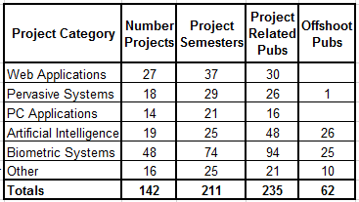
Pace University Capstone Experience Projects and Publications 2001-2015
SEDSI 2019

Slide 15
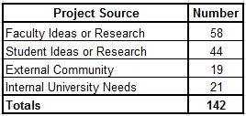
Pace University Capstone Experience Project Sources 2001-2015
SEDSI 2019

Slide 16
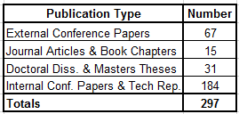
Pace University Capstone Experience Publication Types 2001-2015
SEDSI 2019

Slide 17
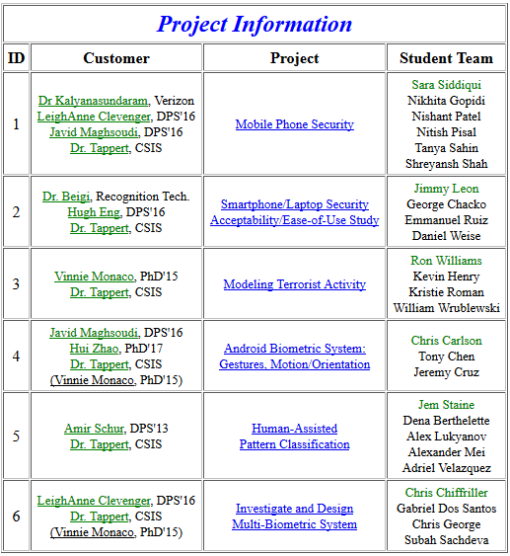
Pace University Capstone Experience Project Examples
Partial Project Information
from Course Website
SEDSI 2019

Slide 18
Pace University Capstone Experience Example Project System
Rare Coin Grading System
SEDSI 2019

Slide 19
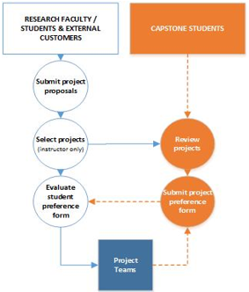
Pace University Capstone Experience Project and Team Selection
SEDSI 2019

Slide 20
Pace University Capstone Experience Teams, Roles, and Methods of Work
A team is a group of individuals having the responsibility to jointly accomplish a task
In this case, the task is the computing project
Teamwork enhances learning by creating an
“active learning process” (Bonwell, 1991)
Student teams found particularly effective when students need each other to complete the project
Team projects are the norm in industry, academia, and government
SEDSI 2019

Slide 21
Pace University Capstone Experience Teams, Roles, and Methods of Work
Effective teamwork requires
Division of responsibility
Coordination of efforts
Communication to expedite coordination
Group governance for collective decision making
Conflict resolution
Control of deviance
Group dynamics found to be particularly important in software development
Long history of failure (Denning & Reihle, 2009)
SEDSI 2019

Slide 22
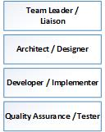
Pace University Capstone Experience Teams, Roles, and Methods of Work
Most teams involve one or more of following
Programming
Database
Computer network
Web interface
Team roles =>
3-6 members
SEDSI 2019

Slide 23
Pace University Capstone Experience Course Management
Pace University has campuses in New York City and Westchester (30 miles north of NYC)
Currently two-thirds of the students live or work in the greater NYC area
The remaining third are
Mostly from other regions of the East Coast
Some as far away as California and foreign countries
SEDSI 2019

Slide 24
Pace University Capstone Experience Scattered Team Issues/Solutions
Project stakeholder communication
Issue – communication gets difficult
For example, scattered team members more likely to feel isolated and want to communicate directly with instructor or customer
Solution
Communication between team and instructor/customer must be through team leader
Email distribution lists for whole class and for each team
Project team leaders must be local (greater NYC area) to facilitate communication/meetings with instructor and customers
Course website provides central source of course information
Blackboard discussion forum for each project (see below)
SEDSI 2019

Slide 25
Pace University Capstone Experience Scattered Team Issues/Solutions (cont)
How to handle quizzes, deliverables, etc.
Issue – classroom meetings not available
Solution – use Blackboard educational software
Quizzes
Collecting digital deliverables
Discussion forums
Forum for archiving instructor email
Forum for student introductions
Forum for textbook and other course material questions
Forum for each team project
SEDSI 2019

Slide 26
Pace University Capstone Experience Scattered Team Issues/Solutions (cont)
Provide some face-to-face interaction
Issue – no weekly classroom meetings
Solution – three classroom meetings, 3 hours each, for local students/customers
Near beginning of course semester
Face-to-face introductions, nature of course, specifics of course, remaining time for student team project meetings
Midterm
Project status presentations
End of semester
Final project presentations
SEDSI 2019

Slide 27
Student Assessment Grading Overview
Team project quarter 1 (Q1) = 10%
Team project quarter 2 (Q2) = 20%
Team project quarter 3 (Q3) = 20%
Team project quarter 4 (Q4) = 30%
Individual quizzes (20%)
Using Blackboard educational software system
Strong emphasis on project work (80%)
No midterm/final exams (as used in two-semester course)
SEDSI 2019

Slide 28
Student Assessment Grading Overview
Project work grades assigned each quarter
With increasing points as semester progresses
Project work grades assigned to students are determined by
A team assessment relative to other teams
Individual team member assessment within team
Current grades posted on course website indexed by last four digits of student ID for anonymity
SEDSI 2019

Slide 29
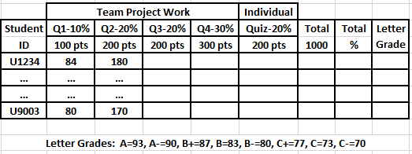
Student Assessment Grade Spreadsheet
SEDSI 2019

Slide 30
Student Assessment Team Project Technical Paper
Quarter 1 (Q1)
IEEE format, title, abstract, introduction, project requirements, literature review citing references
Quarter 2 (Q2)
IEEE format, key terms, finalized literature review, methodology, preliminary findings/results
Quarter 3 (Q3)
All sections complete except for final updates
Quarter 4 (Q4)
In final form for the conference proceedings
SEDSI 2019

Slide 31
Student Assessment Team Project Work Assessment
Instructor Team Project Work Assessment
Based primarily on technical paper quality
GA Team Project Work Assessment
Based on quality of weekly team status reports and spot checking of quality of team meetings
Project Technical Paper Format
GA measures degree of IEEE format correctness
Less emphasis as semester progresses
Project Technical Paper Turnitin Score
Degree of potential plagiarism
SEDSI 2019

Slide 32
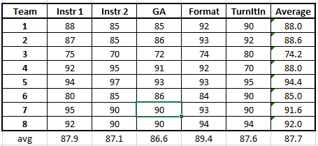
Student Assessment Team Project Work Assessment
Team Assessment Performed Each Quarter
SEDSI 2019

Slide 33
Student Assessment Peer Evaluation
Issue – lack of classroom meetings makes it difficult to determine individual team members’ contribution to the project work
Peer evaluations critical for distributed teams
Possibly little team member/customer contact
Possibly little team member/instructor contact
Literature indicates
Various granularity levels in peer evaluations
Some automated systems reported
SEDSI 2019

Slide 34
Student Assessment Individual Student Evaluations
Individual student evaluations by peers, customer, instructors, and GA occurs 4 times
At each quarterly checkpoint: Q1, Q2, Q3, Q4
Grading process for a graded team event
First assign a team grade
Then adjust individual grades up/down based on peer, customer, instructor and GA evaluations
SEDSI 2019

Slide 35
Student Assessment Individual Student Assessment
Example of 4-member Team Summary Chart
Peer, Customer, Instructor, and GA Evaluations
Newly added evaluations by customer, instructor and GA in yellow
Team grade highlighted in red in lower right-hand corner
Team member 1 received high and team member 3 low evaluations
SEDSI 2019

Slide 36
Student Assessment Individual Student Assessment
The spreadsheet for individual team member grades is designed so the sum of the evaluations is automatically computed
Student grades are then automatically computed once the team grade is entered in lower right-hand corner
SEDSI 2019

Slide 37
Other Assessments Pedagogical Course Evaluations
Issue – lack of classroom meetings makes it difficult for instructor to determine relative value of the course methodologies
Solution – semester-end student survey
Procedures/methods that worked well, or did not work well, and why
SEDSI 2019

Slide 38
Other Assessments Pedagogical Customer Evaluations
Issue – instructor is often not aware of the quality of team-customer interactions
Solution – semester-end survey
Obtain student feedback on customer interaction
Were customer requirements clear?
Was amount of contact/interaction adequate?
Was help on the project work appropriate?
SEDSI 2019

Slide 39
Pace University Capstone Experience Student Satisfaction High
On 5-point Likert scale, agree = strongly agree/agree
93% agree
working on real-word projects for actual customers was a good learning experience
86% agree
writing a technical paper for the Pace Univ. yearly internal conference was a good learning experience
86% agree
Projects in Computing and Information Systems by Dawson was a good textbook for the course
82% agree
quizzes were an appropriate individual evaluation method for the readings of the course
79% agree
peer evaluations were an appropriate method of determining individual contributions
43% agree
the three optional in-class meetings were useful for the course, while another 43% were neutral
SEDSI 2019

Slide 40
Conclusions
Capstone courses are particularly important to computing and information systems education
Students develop hard and soft skills, are exposed to a wide range of topics, and foster interdisciplinary collaboration
The project deliverables provide valuable systems for the customers and support student/faculty research
With Pace University’s five year’s experience in face-to-face mode and 14 year’s in Web-assisted mode
Techniques for managing and assessing distributed teams have been successful and they continue to evolve
SEDSI 2019

