Slide 1
CS691-CS692-IT691 Capstone Projects Course
Dr. Charles Tappert
LTC Avery Leider
Seidenberg School of CSIS, Pace University

Slide 2
Agenda
Course Overview
Introductions – Instructor and Students
Handout attendance sheet
Job title, what you do, #years work experience
Review Course Website
Preliminary projects page
Review Capstone Projects Journal Paper
Discuss Hacker Rank
If Time, Review Machine Learning Basics

Slide 3
Seidenberg Areas of Expertise
Cybersecurity
Artificial Intelligence, Machine Learning, Deep Learning, Data Mining, Big Data Analytics
Biometrics, especially those not-well-studied
Quantum Computing

Slide 4
Seidenberg Areas of Expertise Cybersecurity
Pace University is NSA and DHS designated National Center of Academic Excellence in Cyber Defense Educ.
NSA & NSF: Conduct Summer Cybersecurity Workshops for High School Teachers 2015-2017
DoD Info. Assurance Scholarships 2006–2016
DoD: Data Analytics in Cybersecurity 2017-2018
Nat. Crime Agency, Mobile App Research 2016-2017
Run a Computer Forensics Lab NYC

Slide 5
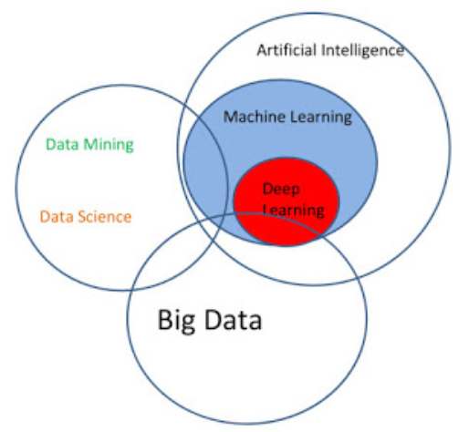
Seidenberg Areas of Expertise AI, Machine Learning, Data Mining, Big Data

Slide 6
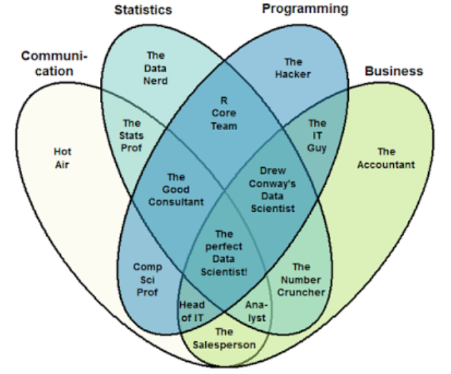
Seidenberg Areas of Expertise The Data Scientist Venn Diagram

Slide 7
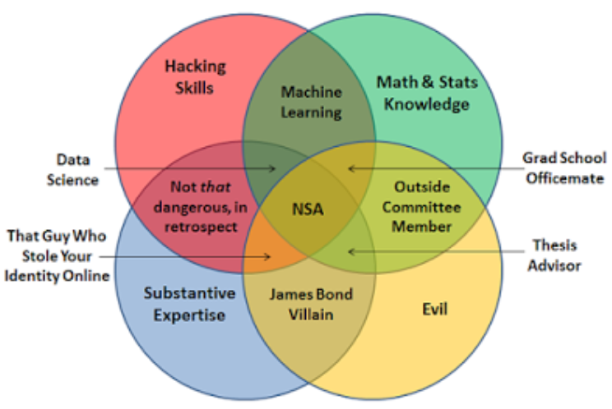
Seidenberg Areas of Expertise Evil Component

Slide 8
Seidenberg Areas of Expertise Biometrics
We focus on the not-well-studied biometrics because it is easier to do original research and publish results – hard to compete with companies specializing in the established biometrics, such as fingerprint, face, iris, voice
Pace University currently has the world’s best keystroke biometric system
Dr. Vinnie Monaco, U.S. Army Research Laboratory
Keystroke Biometrics Ongoing Competition (KBOC)

Slide 9
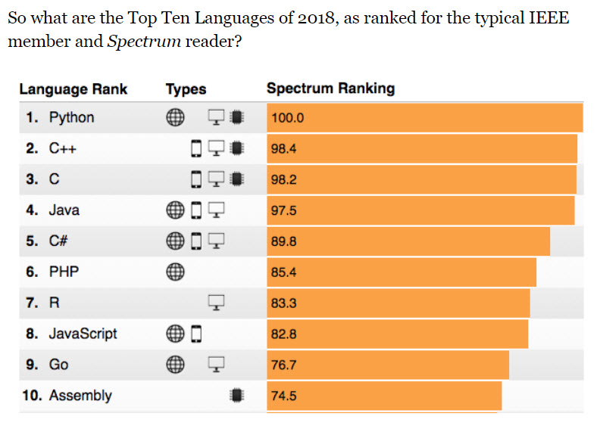
Top Programming Languages in 2018

Slide 10
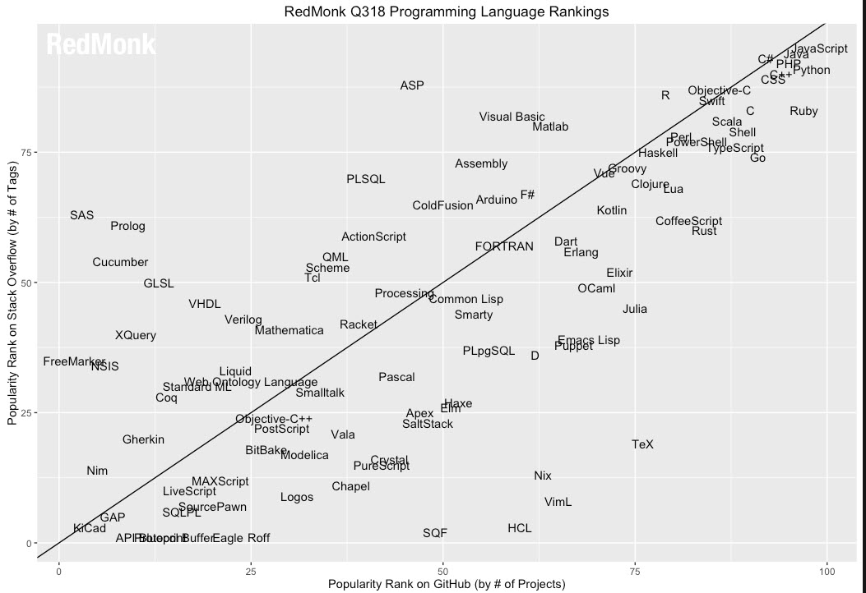
2018 RedMonk rating of Programming Language popularity using
Stack Overflow and GitHub

