Slide 1
Tutorial 1 Using HTML to Create Web Pages

Slide 2
Objectives 1.1
Explore the history of the Internet and the World Wide Web
Study the differences between HTML, XHTML, and CSS
Create a Web page with basic HTML tags
Apply formatting tags to affect text on a Web page

Slide 3
Objectives 1.2
Understand image files and file types
Add an image to a Web page
Create ordered, unordered, and description lists
Create nested lists
Validate a Web page

Slide 4
Learning About the Internet and the World Wide Web
The Internet is a global internetwork that includes communication technologies such as email, file transfers, and other data transfers.
The World Wide Web (simply the Web) is the Internet technology that provides the ability to download Web pages.

Slide 5
The Internet and the World Wide Web
The software used to download and view Web pages is called a Web browser.
Current Web browsers:
Microsoft Internet Explorer
Apple Safari
Google Chrome
Mozilla Firefox

Slide 6
HTML, XHTML, and CSS
Hypertext Markup Language (HTML) is a set of instructions that identify sections of a Web page and may specify layout placement or formatting.
Extensible Hypertext Markup Language (XHTML) is a set of rules applied to HTML to ensure the code conforms to standards.
Cascading Style Sheets (CSS) specifies formatting and placement.

Slide 7
Hypertext and Markup
Rendering a Web page is the process of interpreting a file that contains HTML and CSS, and displaying the resulting Web page.
Hypertext is a technology that allows you to click a link that points to a file.
Markup language is a system of codes that describes something about the content.
The standards for HTML are set by the World Wide Web Consortium (W3C).

Slide 8
Basic HTML Tags
Every HTML document should start with a DOCTYPE tag that identifies the version of HTML used in the document.
HTML5 simplified that tag to the following: <!DOCTYPE html>

Slide 9
The html, head, and body Elements
The html element is the root element of a Web document; it is the container for all other elements on the Web page.
The head section contains HTML code that does not appear in the browser; it is a container for information about the document.
A head section contains metadata—a document’s keywords, information about its author, and a description of the document.

Slide 10
The html, head, and body Elements
The body element is the container for all of the page content that will be rendered in the document window.

Slide 11
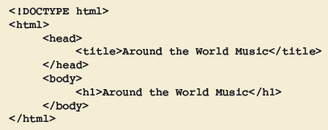
Typing the Code
The file that contains HTML and CSS code can be written and saved using:
Notepad (Microsoft Windows)
TextEdit (Apple OS X)
Elements that are contained inside other elements are indented.

Slide 12
Typing the Code
An HTML element includes an opening tag, the text content, and the closing tag using the following format: <tag>content</tag>
Tags that are not paired are called empty elements, and their format is: <tag />

Slide 13
Commenting Code
Comments can be used to identify sections of the code.
The comment tag is entered as follows: <!-- comments inserted here -->

Slide 14
Creating Headings
The heading elements are used to mark the importance of content.
There are six heading elements: h1, h2, h3, h4, h5, and h6: <hn>content</hn>
Font sizes can be measured in points (pt).

Slide 15
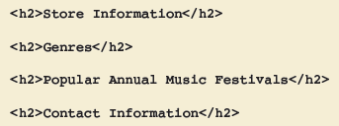
Creating Headings

Slide 16
The Paragraph Element
The paragraph element is used to identify a paragraph of text: <p>content</p>

Slide 17
Text Formatting Tags
The strong element renders text in bold.
The em element renders text in italic.
For applying two or more effects, nested tags are used: <tag1><tag2>content</tag2><tag1>

Slide 18
Inserting Special Characters
Special characters cannot be created by using the keyboard.
A named character reference has the following form: &name;
A numeric character reference has the following form: &#number;

Slide 19
Using Images on a Web Page
Image file formats are GIF, JPEG, and PNG.
The image element is used to insert an image on a Web page: <img />
An attribute specifies the name of a property related to a Web page element and the value for that property.
The image tag contains a source property: src src = "images/logo.jpg"

Slide 20
Using the img Element
filename – the filename of the image
alternate_text – a description of the image
widthvalue – the width of the image in pixels
heightvalue – the height of the image in pixels

Slide 21
Attributes Used with Images
alt – provides a brief description of the image, and is used as a ScreenTip or ToolTip
title – provides some information about the element in which it is included
width and height – specify the dimensions of the area of the Web page where the image will be rendered

Slide 22
Attributes Used with Images

Slide 23
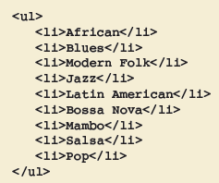
Creating Lists
You can use HTML to create an unordered list (a bulleted list), an ordered list (a list with numbers or letters), and a definition list (a list with a hanging indent format).

Slide 24
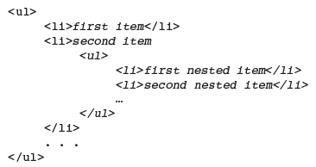
Nested Lists
A nested element is an element that is inside of another element.
A sublist is a list that is nested inside a list item of another list.
The general structure of a nested list:

Slide 25
Nested Lists

Slide 26
Ordered List
An ordered list structure:

Slide 27
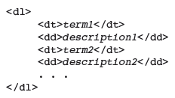
The Description List
A use of the description list is to create:
chronology – list of events in time order
glossary – alphabetic list of terms and definitions
A description list structure:

Slide 28
The break Element

Slide 29
The meta Element
Metadata is data that provides information about other data.
<meta name = "name of category" content = "content data" />

Slide 30
Validating a Completed File
Validation is the process of checking the file for syntax and compliance errors.
Validation does not check for spelling, typos, or grammar errors.
In addition to the HTML and XHTML standards, there is also a Web Accessibility Initiative standard.
There are free validators available.

Slide 31
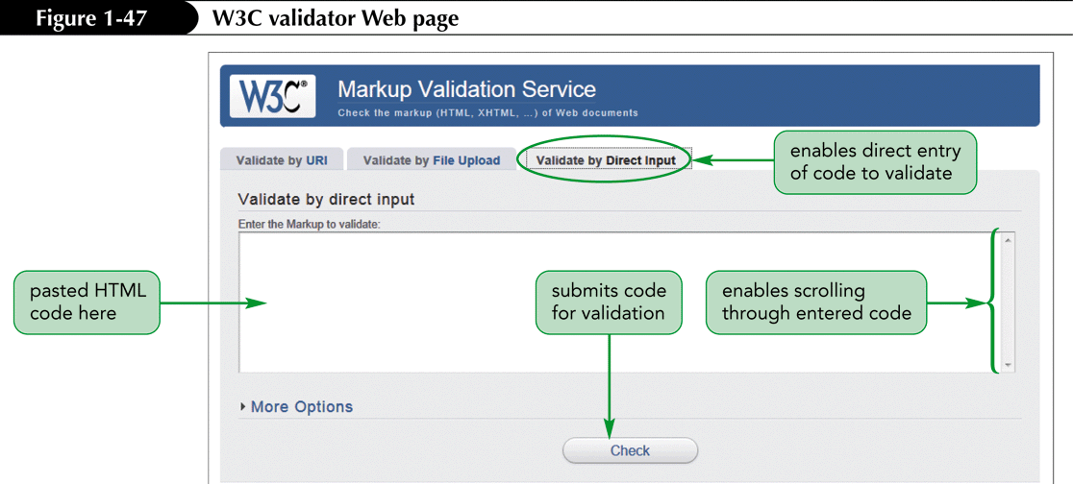
Validating a Completed File
A code validator is a Web site that provides a mechanism to submit a code, and provides an error report.

Slide 32
Validation Report

