Slide 1
Algorithms for Restricted Networks in the Internet of Things
Miguel A. Mosteiro
mmosteir@kean.edu
http://www.kean.edu/~mmosteir

Slide 2
The Internet of Things

Slide 3
This talk
Counting in
Anonymous Dynamic Networks
Alessia Milani and Miguel A. Mosteiro.
“A Faster Counting Protocol for Anonymous Dynamic Networks”
In 19th Intl. Conf. On Principles Of Distributed Systems (OPODIS), 2015.
Maitri Chakraborty, Alessia Milani, and Miguel A. Mosteiro.
“Counting in Practical Anonymous Dynamic Networks is Polynomial”
In 4th Intl. Conf. On Networked Systems (NETYS), 2016.

Slide 4
The Counting Problem
How do you count the size of your group,
if the members are all identical and move?
I don’t know!
You also look the same as
everyone else!!
You all look the same,
did I already count you?

Slide 5
Why do we care?
The problem is clean, but why do we care?
Distributed computation: how do you know when to stop?
Distributed protocols:
need the number of processors to decide termination.

Slide 6
Distributed Counting Protocol
We need a
Distributed Counting Protocol:
« Given a system of n nodes,
all nodes eventually terminate knowing n »

Slide 7
Anonymous Dynamic Networks
Fixed set of n nodes
No identifiers or labels
A special node, called the leader [1]
Synchronous communication : At each round
a node broadcasts a message to its neighbors
receives the messages of its neighbors
executes some local computation
1-interval connectivity [2]
communication links may change from round to round, but
at each round the network is connected
An upper bound Δ on the maximum degree is known by all nodes
[1] O. Michail, I. Chatzigiannakis, and P. G. Spirakis. Naming and counting in anonymous unknown dynamic networks. SSS 2013
[2] Fabian Kuhn, Nancy A. Lynch, Rotem Oshman. Distributed computation in dynamic networks. STOC 2010

Slide 8
Previous work
Previous Counting Protocols
Guarantee only an exponential upper bound on the network size [1] or
They guarantee the exact size but
Take double-exponential number of rounds [2] or
Take exponential number of rounds, but do not terminate [2] or
Terminate but no running-time guarantees [3]
Lower bound on the time complexity
Ω(D) where D is the dynamic diameter and
Ω(logn) even if D is constant [4]
Not practical
Huge gap
[1] O. Michail, I. Chatzigiannakis, and P. G. Spirakis. Naming and counting in anonymous unknown dynamic networks. SSS 2013
[2] G. A. Di Luna, R. Baldoni, S. Bonomi, and I. Chatzigiannakis. Conscious and unconscious counting on anonymous dynamic networks. ICDCN 2014
[3] G. A. Di Luna, R. Baldoni, S. Bonomi, and I. Chatzigiannakis. Counting in anonymous dynamic networks under worst-case adversary. ICDCS 2014
[4] G. A. Di Luna and R.Baldoni. Investigating the cost of anonymity on dynamic networks. 2015.

Slide 9
Our contributions
Incremental Counting (IC) algorithm:
computes the exact size of the network
exponentially faster than best previous algorithm [1]
tolerates worst-case changes of topology
Theoretical analysis:
correctness and running time
identified speed-up bottleneck for counting with gossip-based protocols
Experimental evaluation:
Incremental Counting is polynomial (and practical)
variety of input network topologies that may appear in practice
insight on network dynamics impact on dissemination
[1] G. A. Di Luna, R. Baldoni, S. Bonomi, and I. Chatzigiannakis. Conscious and unconscious counting on anonymous dynamic networks. ICDCN 2014

Slide 10
Incremental Counting:
Our protocol
Initially, each non-leader has “energy” 1
1. Guess a size k of the system
start from k=2
k?
2. Collection phase:
to let the leader collect “enough” energy
k?
k?
k?
k?
k?
k?
Notes:
Used to compute the time of the collection phase
« Using that k/(k^{c} − 1) < 1/k for any c > log 5 and k ≥ 2

Slide 11
IC Collection Phase:
Protocol Details
Initially, each non leader node has energy 1, the leader has no energy
The total energy is n-1 during all the execution.
# rounds for the leader to collect
at least k-1-1/k^{c} energy
Collection at the leader node
Collection at non-leader node
Upper bound on the
maximum dynamic degree

Slide 12
IC Collection Phase example
End of round 1
Round 1
The collection continues for a fixed number of rounds Τ
that depends on the estimate k.
Τ(n) is large enough to drain all the energy in the network.
Round 2
End of round 2

Slide 13
Incremental Counting:
Our protocol
Initially, each non-leader has “energy” 1
1. Guess a size k of the system
start from k=2
k?
2. Collection phase:
to let the leader collect “enough” energy
k?
k?
3. Verification phase:
to check whether the guess k is correct
k?
k?
k?
k?
Notes:
Used to compute the time of the collection phase
« Using that k/(k^{c} − 1) < 1/k for any c > log 5 and k ≥ 2

Slide 14
IC Verification Phase:
Challenges for Verification
If e_{leader} > k-1 k < n
But,
if k-1-1/k^{c} ≤ e_{leader} ≤ k-1 ???
Need to check if some non-leader has more than
1/k^{c} energy left.

Slide 15
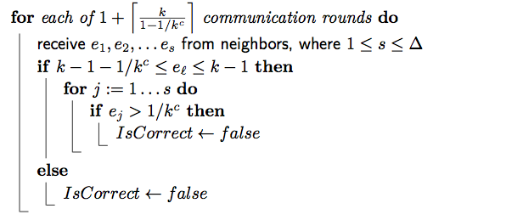
IC Verification Phase:
Protocol Details
Search for a node p with more than 1/kc energy left
Verification at the leader node
Execute this phase long enough to hear about p if it exists
All non-leader disseminate max energy heard
Verification at non-leader node

Slide 16
Incremental Counting:
Our protocol
Initially, each non-leader has “energy” 1
1. Guess a size k of the system
start from k=2
k?
2. Collection phase:
to let the leader collect “enough” energy
k?
k?
3. Verification phase:
to check whether the guess k is correct
k?
k?
k?
k?
4. Notification phase:
k=n : let all nodes know that k is the size
k<n : wait and go to step 2, guessing k+1
Notes:
Used to compute the time of the collection phase
« Using that k/(k^{c} − 1) < 1/k for any c > log 5 and k ≥ 2

Slide 17
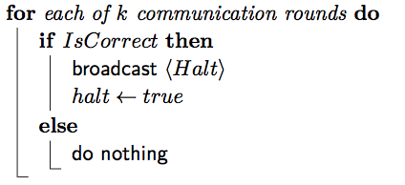
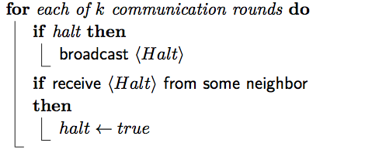
IC Notification Phase:
Protocol Details
Disseminate whether current estimate is correct or not.
Notification at the leader node
…
Execute this phase long
enough for all hear
Notification at non-leader node
All non-leader disseminate
“halt” if ever received
…

Slide 18
Incremental Counting:
Our protocol
Worst-case analysis:
IC computes exact size
in less than
(2Δ)^{n+1}(n+1)ln(n+1)/ln(2Δ)
comm rounds.
Initially, each non-leader has “energy” 1
1. Guess a size k of the system
start from k=2
k?
n!
2. Collection phase:
to let the leader collect “enough” energy
k?
n!
k?
n!
BUT! Simulations:
showed that in practice is less than Δn³ comm rounds!
Exponential improvement but still exponential upper bound => not enough for practical guarantees
3. Verification phase:
to check whether the guess k is correct
k?
n!
k?
n!
k?
n!
k?
n!
4. Notification phase:
k=n : let all nodes know that k is the size
k<n : wait and go to step 2, guessing k+1
Practical for IoT subnetworks!!
Notes:
Used to compute the time of the collection phase
« Using that k/(k^{c} − 1) < 1/k for any c > log 5 and k ≥ 2

Slide 19
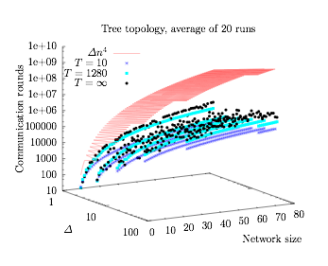
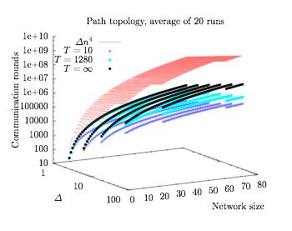
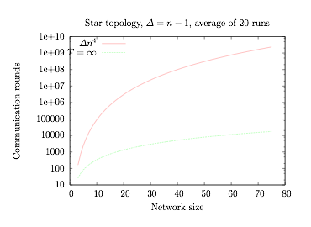
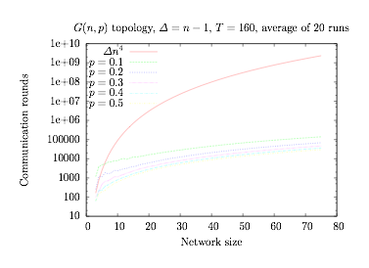
Our simulations
Random Rooted Unlabeled Trees
All of them below Δn⁴ !!!
(actually Δn³)
Extremal
topologies
log scale!
Random Networks
Centralized simulator provides upper bound for distributed implementation.

Slide 20
Future and Ongoing Work
Improve lower bound.
Distributed implementation that does not require synchronization.
Other computations in ADNs.

Slide 21
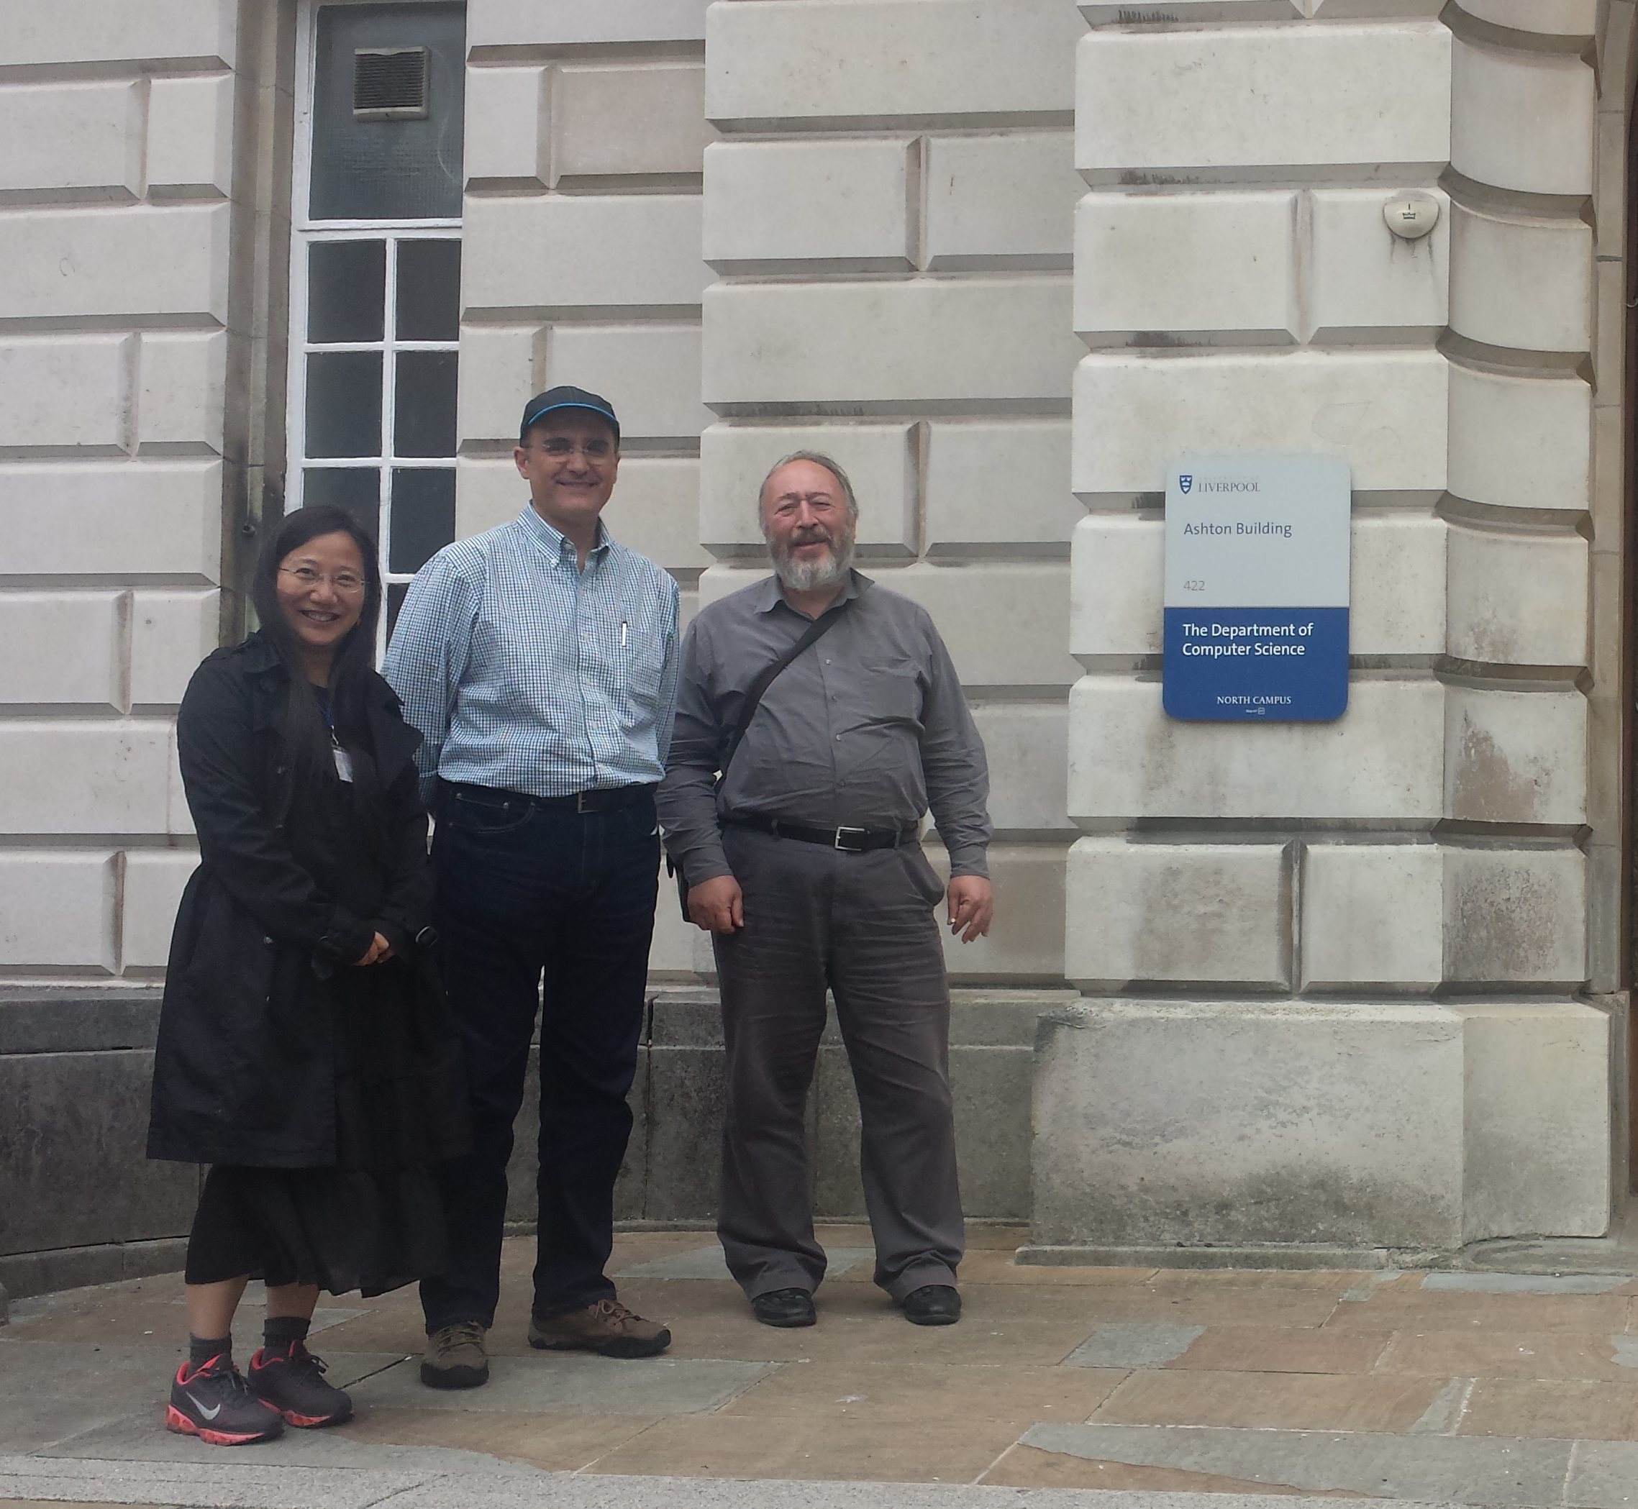
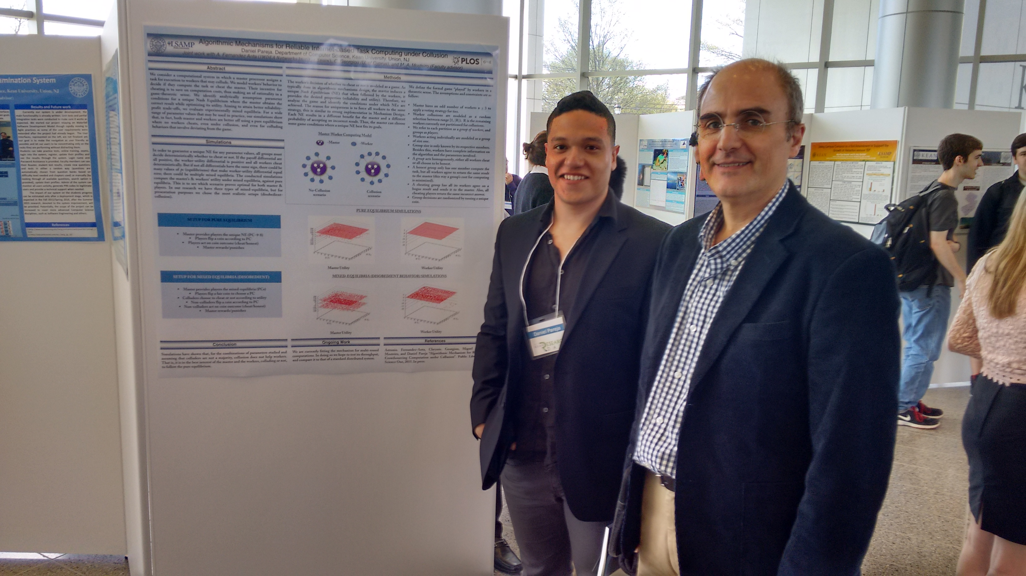
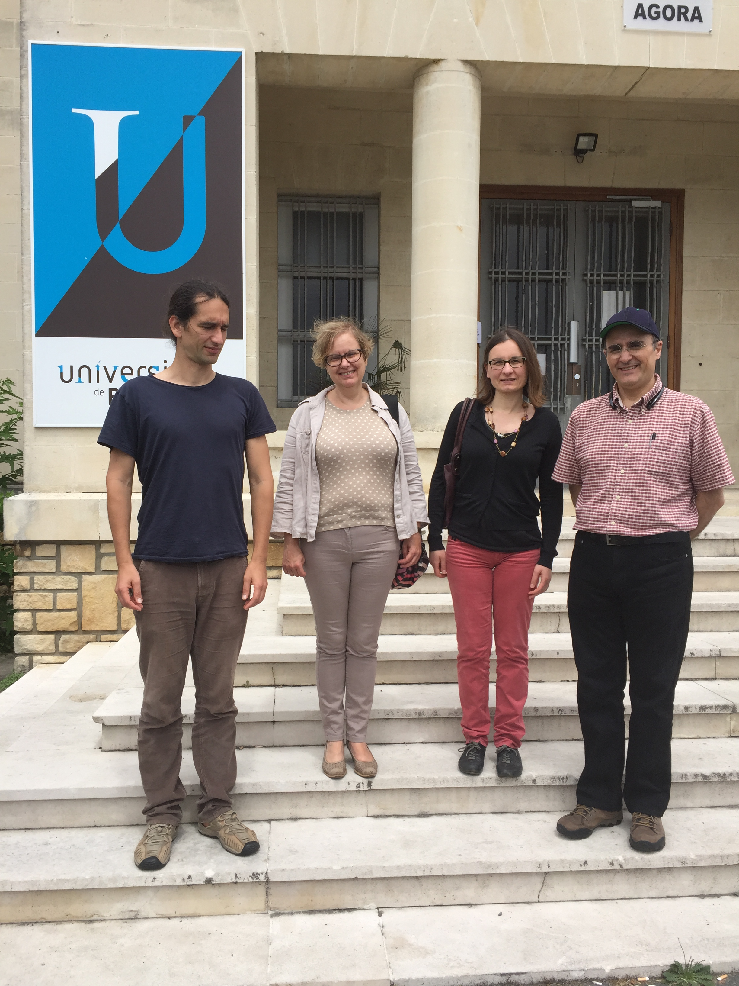
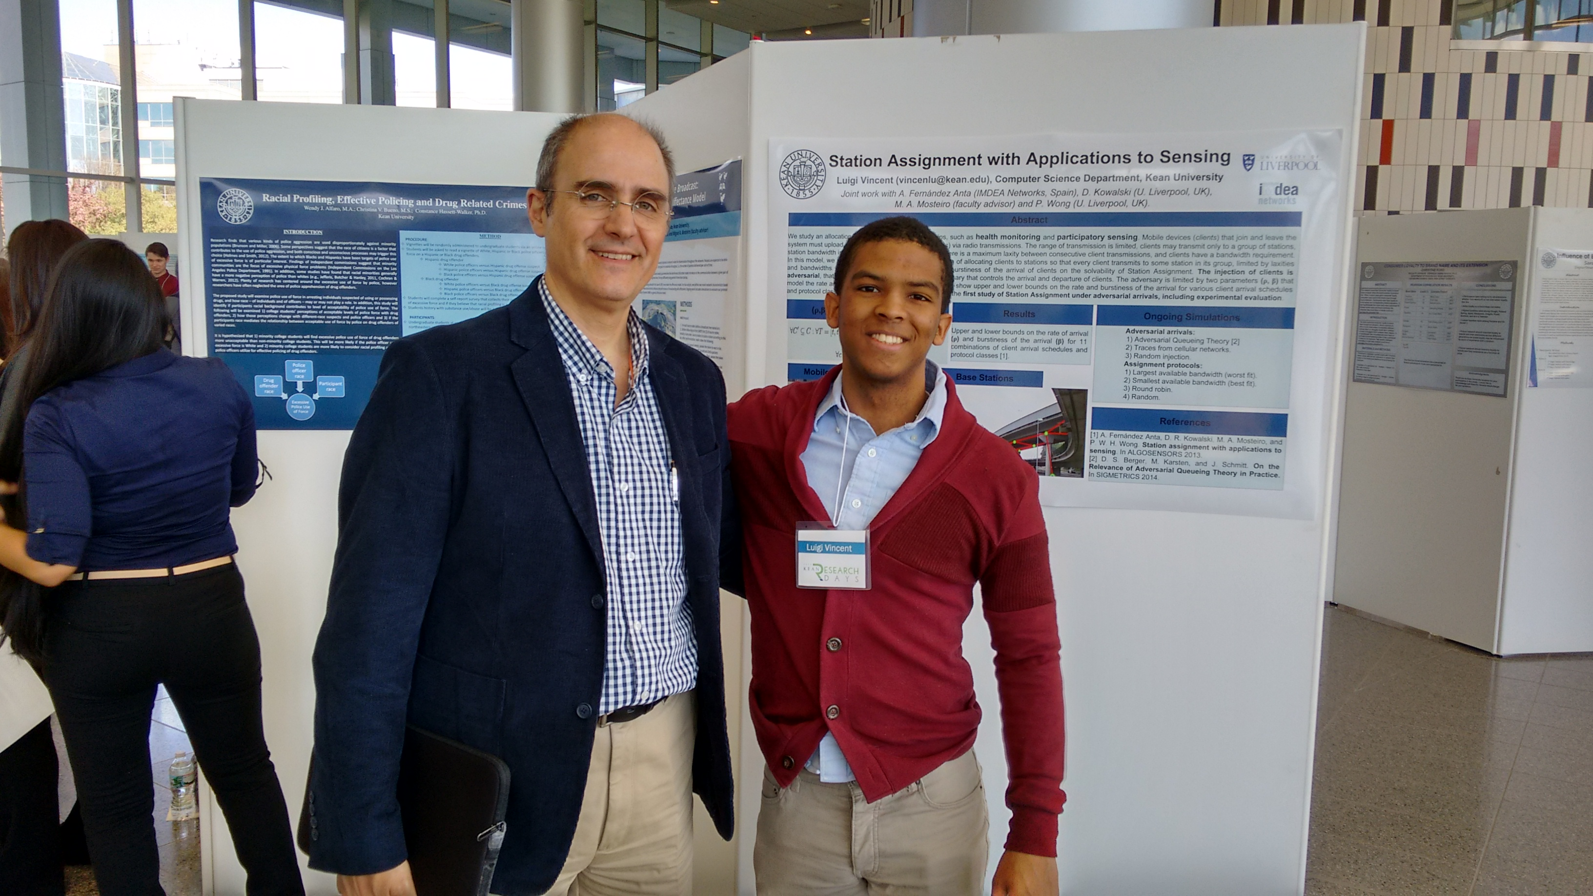
Undergraduate Research at Kean
Kean undergrads
International collaborations
Papers
D. Kowalski, M. A. Mosteiro and T. Rouse. “Dynamic Multiple-message Broadcast: Bounding Throughput in the Affectance Model”. In ACM FOMC at MobiHoc 2014.
A. Fernandez-Anta, C. Georgiou, D. Pareja, and M. A. Mosteiro. “Algorithmic Mechanisms for Reliable Crowdsourcing Computation under Collusion”. In PLoS ONE, 2015.
M. A. Mosteiro, Y. Rossikova, and P. Wong. “Station Assignment with Reallocation”. In SEA 2015.
M. Chakraborty, A. Milani, and M. A. Mosteiro. “Counting in Practical Anonymous Dynamic Networks is Polynomial”. In NETYS 2016.
A. Fernandez-Anta, C. Georgiou, D. Pareja, and M. A. Mosteiro. “Multi-round Master-worker Computing: A Repeated Game Approach”. Under review in SRDS 2016.
D. Kowalski, M. A. Mosteiro, and K. Zaki. “Dynamic Multiple-message Broadcast: Bounding Throughput in the Affectance Model”. Under review in Algorithmica.
A. Fernandez-Anta, D. Kowalski, M. A. Mosteiro, P. Wong, and L. Vincent. “Dynamic Station Assignment”. Under review in Algorithmica.
2014 John Dobosiewicz Research Days Interdisciplinary Award
Joint work with Maitri Chakraborty (CS’16).
2016 Undergraduate Researcher of the Year Award
(university wide).
2015 Undergraduate Research Days Project Award

Slide 22
Thank you!
Miguel A. Mosteiro
mmosteir@kean.edu
http://www.kean.edu/~mmosteir

