Slide 1
Adaptive Scheduling over a Wireless Channel under Jamming
Antonio Fernández Anta,
Joint work with C.Georgiou, D.Kowalski, and E.Zavou
TexPoint fonts used in EMF.
Read the TexPoint manual before you delete this box.:

Slide 2
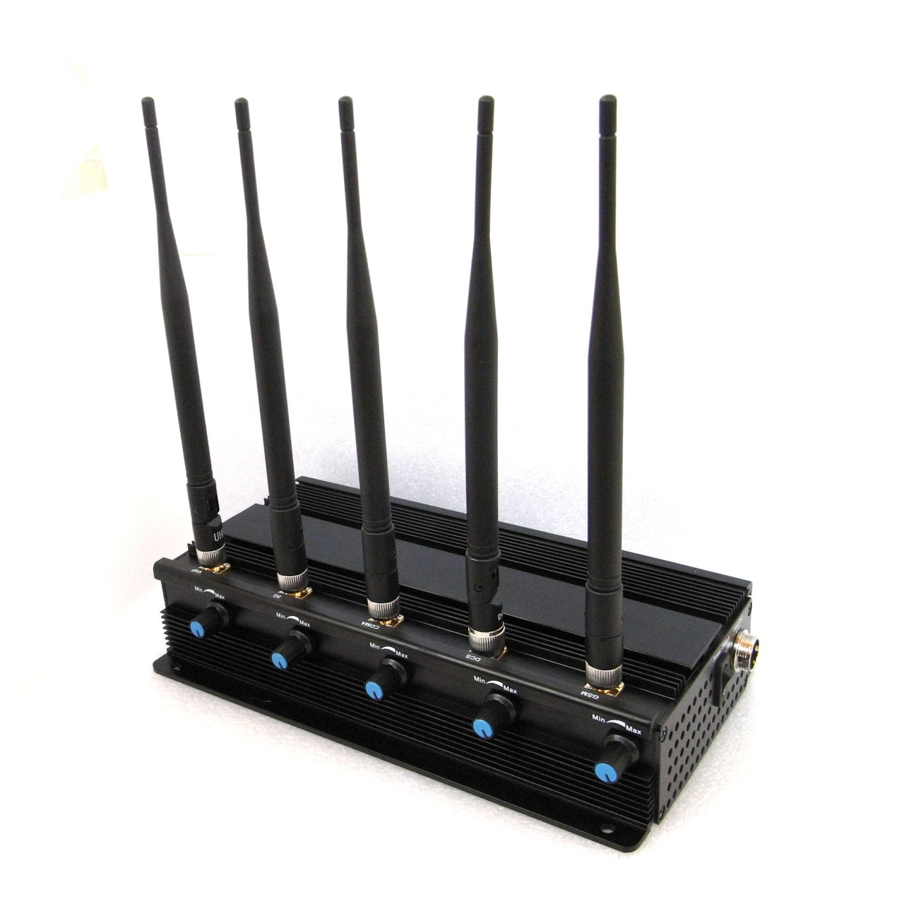
Motivation
Wireless channels
Fast communication, maximize throughput
Channel jamming
Malicious or not

Slide 3
Related Work
[MILCOM ‘06] D. Thuente, and M. Acharya.
Intelligent jamming in wireless networks with applications to 802.11 b and other networks.
Survey: several jamming techniques and analysis of their effects on the different networks
[TCS ‘09] S. Gilbert, R. Guerraoui, and C. Newport.
Two-node communication of one message / a third node disrupts to delay the communication
Constrained, up to β messages can be jammed
[ICDCS ‘11] A. Richa, C. Scheideler, S. Schmid, and J. Zhang.
Competitive and fair medium access despite reactive jamming.
Reactive jamming in MAC layer
Constrained jamming: (1-ε)T time steps (slotted time)
n nodes, must deal with collisions
Competitive analysis to guarantee a c-fraction of successful time steps

Slide 4
Problem & Continuous Model (AQT-based)
3
2
1
Adversary (ρ,σ)-A (AQT-like [Andrews el at 2001])
ρ: ‘error token’ availability rate (recharging)
New error tokens
σ: maximum error tokens in adversary’s bucket (battery capacity)
Fixed amount of data to be transmitted, P
Large amount of data to be transmitted
Packets of length p = h + l = 1 + l, (header + payload)
Continuous time / NOT slotted
X
X
P
1/ρ
0

Slide 5
Problem & Continuous Model (AQT-based)
2
Efficiency Measures:
Total transmission time, Tr
Goodput, G
Useful Payload / time, UP/Tr
NOT competitive analysis
Instantaneous feedback
X
X
P
1/ρ
0

Slide 6
Uniform Packet Length
Communication restrictions, or sender specifications
X
X
X
X
0
r : jammed packets
Theorem 1:
Using uniform packets of length
we find the maximum goodput
Then, as P grows to infinity, the goodput increases, with its limit becoming

Slide 7
Adaptive Packet Length
Can we achieve a better goodput than the uniform case?
Under which circumstances?
Case σ =1:
X
0
1/ρ
2/ρ
1
1
0
1

Slide 8
Adaptive Packet Length (σ = 1)
No jam: p_{k} last packet sent
- Total packet lengths = interval length
Jam: j packets sent
Algorithm ADP-1:
Send packets of decreasing length p_{i} = Z – i, for i: 0,1,2…
If packet p_{i} is jammed, then send one more packet of length equal to the rest of the interval
0
1/ρ
X
0
1/ρ

Slide 9
Adaptive Packet Length (σ = 1)
Algorithm ADP-1:
Send packets of length p_{i} = Z – i, for i: 0,1,2…k
If packet p_{i} is jammed, then send one more packet of length equal to the rest of the interval
Theorem 2:
The goodput achieved by Algorithm ADP-1 is
which is at least equal to the optimal goodput G* of the uniform case, for hence

Slide 10
Building Block/ Static Model
f
Adversary (T, f)-A
T: fixed interval of interest
f: maximum error tokens in interval T
Efficiency measures
Optimal useful payload for T, UP(T, f)
Goodput,
Useful payload / time, G(T, f)=UP(T, f)/T
X
X
P
1/ρ
0

Slide 11
From Static to Continuous…
Divide time into 1/ρ-intervals
1 new error token, every 1/ρ time
X
σ = 1
0
1/ρ
2/ρ
1
1
0
1
X
X
σ > 1
0
1/ρ
2/ρ
σ
σ-1
σ

Slide 12
Uniform Packet Length (static model (T,f))
Communication restrictions, or sender specifications
X
X
X
X
0
T
≤ f : jammed packets
n : total packets sent
Theorem 1:
Using uniform packets of length
achieves useful payload
and when no packets are jammed
Then, the optimal achievable goodput rate is

Slide 13
Adaptive Packet Length (f =1) (static model)
Algorithm ADP(T, 1):
If T ϵ [1,2) then
Send packet of length p = T
else
Find i s.t. T ϵ [ i(i-1)/2 + 1, i(i+1)/2 + 1 )
Send packet of length p = (T-1)/i + (i-1)/2
If packet is jammed then
Send a second packet of length p’ = T - p
else
Call ADP(T - p, 1)
X
0
T
T – p₁
T – p₁ – p₂
T – p₁ – p₂ – p₃
1
0

Slide 14
Adaptive Packet Length (f =1) (static model)
Algorithm ADP(T, 1):
If T ϵ [1,2) then
Send packet of length p = T
else
Find i s.t. T ϵ [ i(i-1)/2 + 1, i(i+1)/2 + 1 )
Send packet of length p = (T-1)/i + (i-1)/2
If packet is jammed then
Send a second packet of length p’ = T - p
else
Call ADP(T - p, 1)
Theorem 2:
Algorithm ADP(T, 1) achieves optimal useful payload
The corresponding goodput is UP(T,1)/T

Slide 15
Adaptive Packet Length (f >1) (static model)
Algorithm ADP(T, f):
If T < f + 1 then
Send packet of length p = T
else
Send packet of length p = (αT+β)/γ \\ α, β & γ depend on T
If packet is jammed then
Call ADP(T - p, f - 1)
else
Call ADP(T - p, 1)
X
X
ADP(T’,1) …
0
T
T – p₁
T – p₁ – p₂
T – p₁ – p₂ – p₃
3
2
1

Slide 16
Adaptive Packet Length (f >1) (static model)
Theorem 3:
Algorithm ADP(T, f) achieves optimal useful payload
by choosing the smallest p that satisfies
UP(T-p, f-1) = p-1 + UP(T-p, f),
where

Slide 17
T = 1/ρ, f = 1

Slide 18
Conclusions & Future Work
Uniform Packet Length: NOT the optimal approach
Adaptive Packet Length achieved better results
Finding an optimal solution for the continuous model, even for σ = 1 is not trivial
Dividing the execution in 1/ρ intervals is not the optimal approach for the continuous model
For 1/ρ ϵ [2,4) the uniform packet scheduling is better than ADP(T,f) for f=σ=1
Need to adapt the ADP to the number of tokens at the beginning of each interval. Will this lead to optimality?

Slide 19
References
Antonio Fernández Anta, Chryssis Georgiou, Elli Zavou: Packet Scheduling over a Wireless Channel: AQT-Based Constrained Jamming. NETYS 2015: 230-245
Antonio Fernández Anta, Chryssis Georgiou, Elli Zavou: Adaptive Scheduling Over a Wireless Channel Under Constrained Jamming. COCOA 2015: 261-278

Slide 20
Thank you!
Questions?

