Slide 1
Efficient Opportunistic Relay with D2D Communication Techniques
Vincenzo Mancuso, PhD
Research Associate professor
IMDEA Networks Institute
vincenzo.mancuso@imdea.org

Slide 2
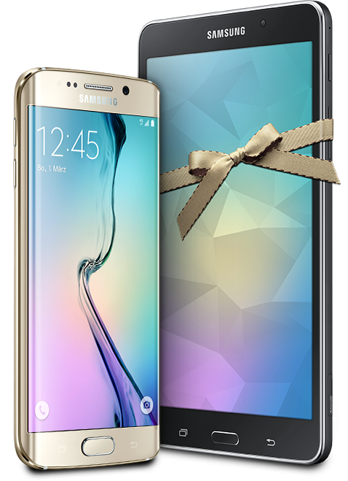
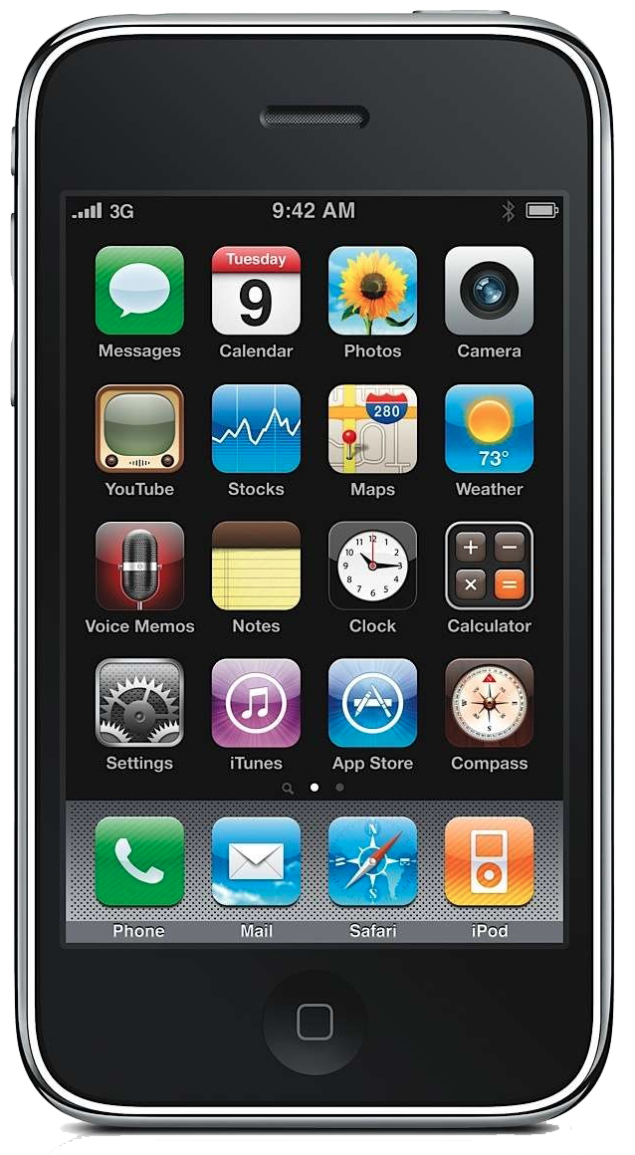
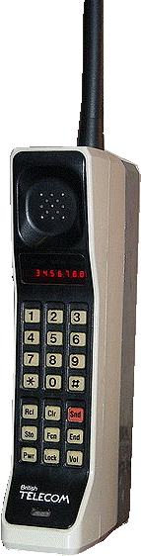
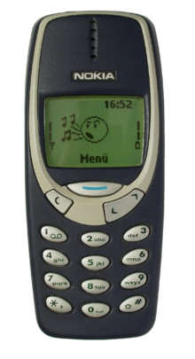



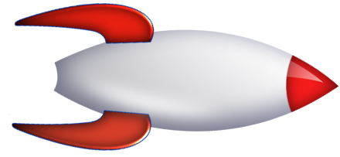
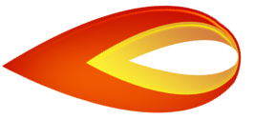
Motivation
Notes:
Since the first g we always improved
But never enough to meet user’s demand.

Slide 3
Efficiency in dense networks
Problem:
  Non-efficient use of cellular spectrum due to interference
  Too much (not real-time) traffic has to be delivered through the cellular network infrastructure
Possible solutions:
For selected services, schedule only good users (channel opportunistic scheduling)
Allow all users to exchange contents when they are in radio range (opportunistic relay/clusters)
D2D as enabling technology
Clustering
(Static/Dynamic)
Opportunistic Scheduling
(Unfairness/Complexity)

Slide 4

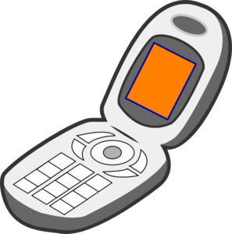
D2D Communications
Definition:
Direct communication between two mobile users without traversing the Base Station or core network (e.g., with WiFi Direct, LTE Direct, LTE-U, Bluetooth, …)
Legacy
D2D

Slide 5


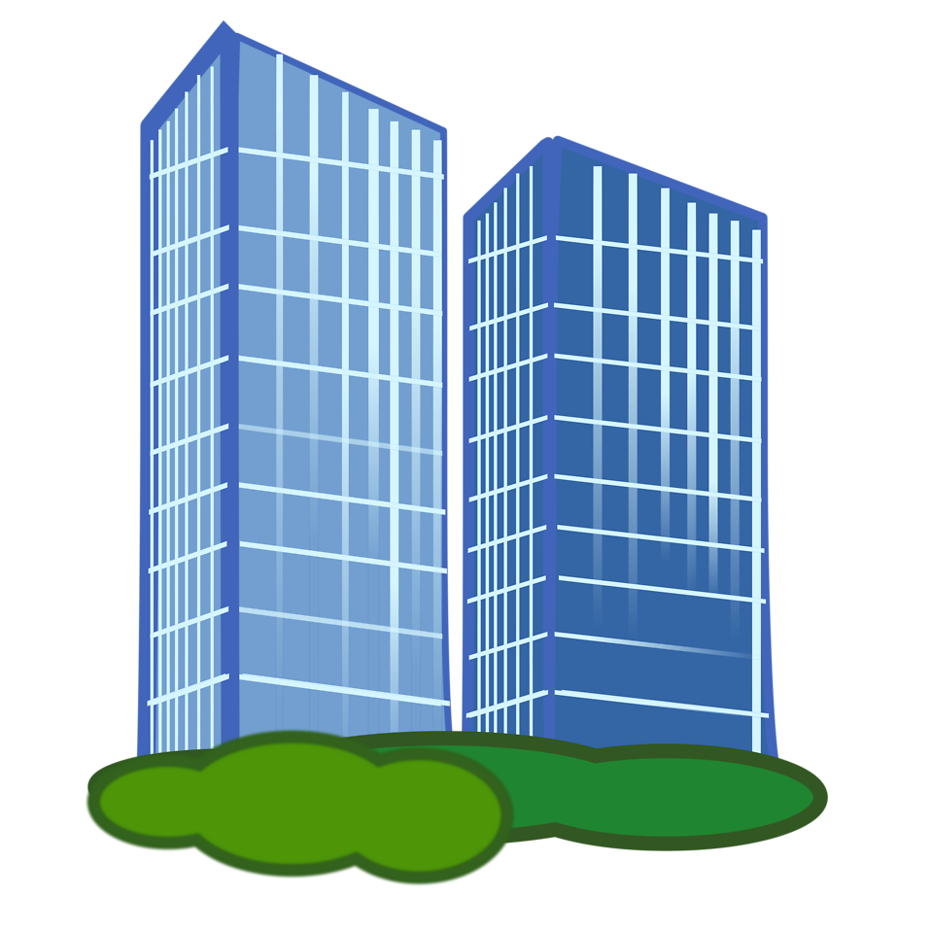

Channel Opportunistic Scheduling
Goal:
Using the channel with the highest rate to achieve higher efficiency.
Resource Blocks
16 QAM
QPSK
64 QAM

Slide 6
Clustering
Goal:
Grouping users to leverage cooperative gain.

Slide 7
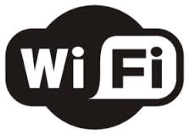
Opportunistic D2D communications
Goal:
Relay through the user with better channel quality.
Two-Tier Scheduling
WiFi (D2D) connection
Cellular connection
Cluster Client
Cluster Head

Slide 8
Theory

Slide 9
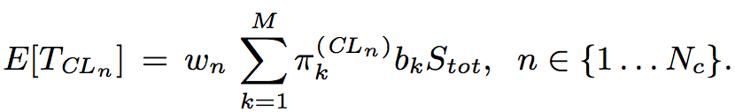


Inter-Cluster Scheduling Mechanism
CL(WRR): At each scheduling epoch, resource blocks are divided among cluster heads according to the size of their clusters.
Low Complexity
Fairness
Cluster 1
Cluster 2
RB1
RB2
RB3
Frequency
RB4
RB5
RB6
Time

Slide 10
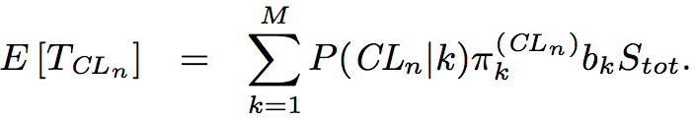


Inter-Cluster Scheduling Mechanism
CL(MR): At each scheduling epoch, resource blocks are allocated to the cluster head with the highest channel quality.
Throughput Optimal
Low Complexity
RB1
RB1
RB2
RB2
RB3
RB3
Frequency
Frequency
RB4
RB4
RB5
RB5
RB6
RB6
Time
Time
Cluster 1
Cluster 2

Slide 11
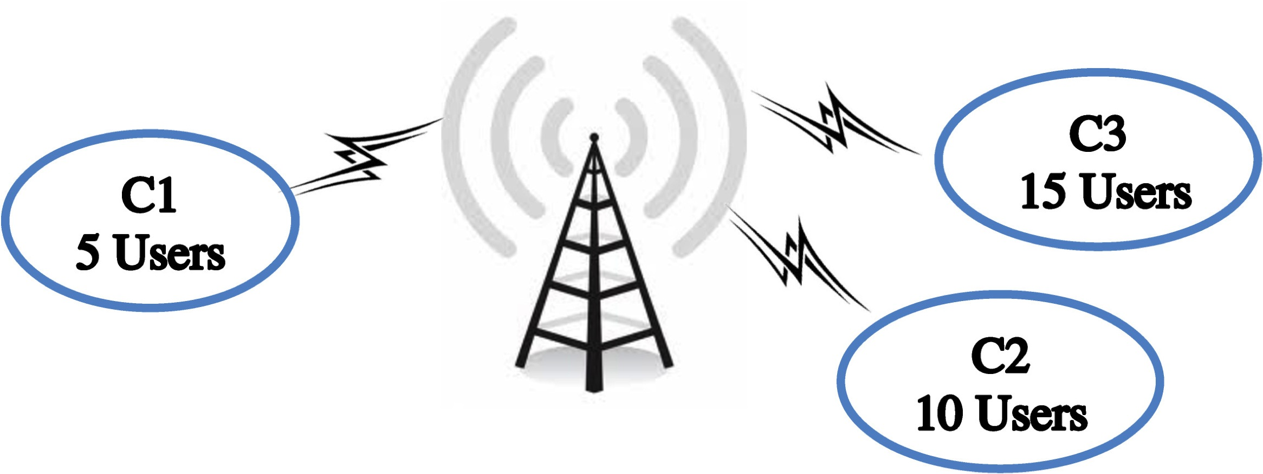
Throughput + Fairness
Good
Average
Poor
Both CL(MR) and CL(WRR) have comparable throughput gains.
CL(MR) is unfair when the number of poor users increases.
Jain’s Fairness Index

Slide 12
Throughput + Energy efficiency
Good
Average
Throughput gain up to 50%.
Energy efficiency gain up to 30%.
Poor

Slide 13
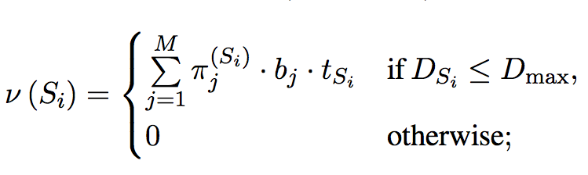
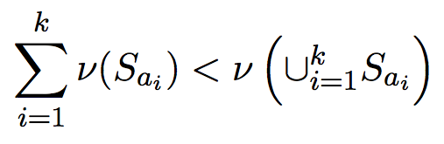
Cluster Formation & Revenue Distribution
A coalitional game:
Definition of the game:
Join if throughput is improved.
Cluster formation based on Merge & Split^{[1]} :
Merge if , otherwise split.
Several methods to share the gain inside cluster:
Equal share allocation
Weighted share allocation
Shapley value
[1] W. Saad, Z. Han, M. Debbah, A. Hjorungnes, and T. Basar. Coalitional games for distributed collaborative spectrum sensing in cognitive radio networks. In Proceedings of IEEE INFOCOM, pages 2114–2122, 2009.

Slide 14
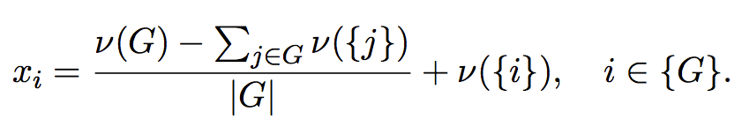
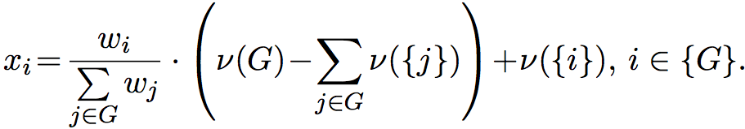



Intra-Cluster Scheduling
Equal share allocation
Weighted share allocation
Shapley …
30%
60%
10%
Gain? Just Throughput? What about energy, efficiency, etc.?

Slide 15
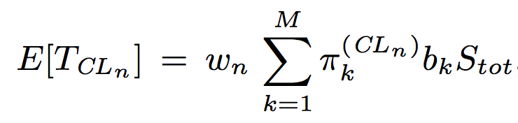
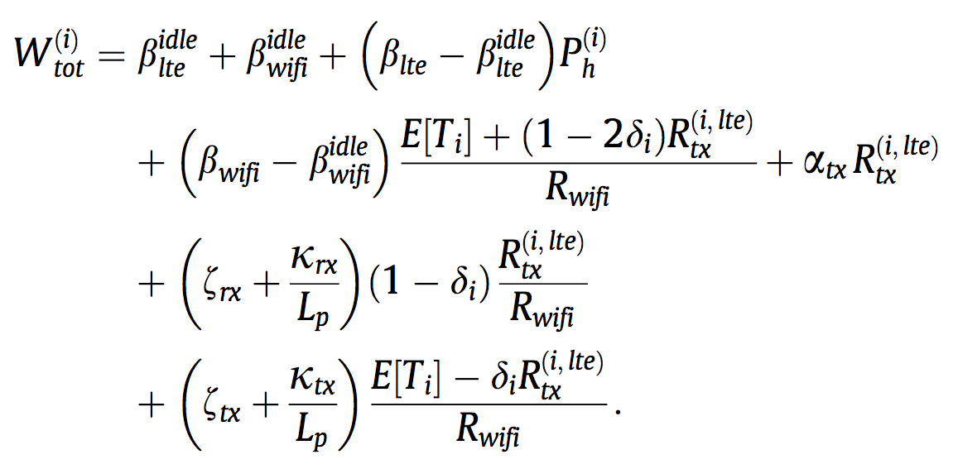
Throughput and Power Analysis
Expected achievable throughput under CL(WRR)^{[2]}:
Power consumption of a D2D user over LTE or WiFi^{[3]}:
[2] Arash Asadi and Vincenzo Mancuso, “On the compound impact of opportunistic scheduling and D2D communications in cellular networks”, in Proceeding of the ACM MSWIM, Barcelona, Spain, 2013.
[3] Arash Asadi and Vincenzo Mancuso , “DRONEE: Dual-radio Opportunistic Net- working for Energy Efficiency”, Elsevier Computer Communications, 2014.

Slide 16
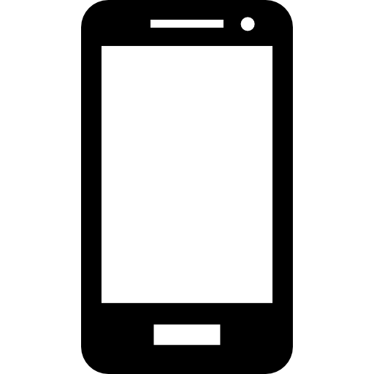


Simulation results (static nodes)
3 Classes of users
RR: $\frac{\text{Resources}}{\text{\# }\text{of} \text{users}}$
2
PF: $\frac{\text{C}\text{urrent} \text{R}\text{ate}}{\text{P}\text{ast} \text{T}\text{hroughput}}$
8
4
6
Higher Efficiency, although two interfaces are used
16.9%
86.4%

Slide 17
Simulation results with mobility
13% Gain
75% Gain
Equal Share (ES) → High fairness → low motivation
Weighted Share (WS) → Low fairness → high motivation
CL(WRR) has better fairness than PF!

Slide 18
Can D2D further enhance fairness without throughput penalty?
Leverage scheduling ties to adjust fairness
Complete analysis available, we have designed smart stochastic tie-breaking rules
Very high complexity, heuristics needed
Does D2D help? How?

Slide 19


Simple heuristics
BeLF
PIKe
The network is mapped to a binary tree. In each recursion, the WRR priority is computed between the two groups based on the maximum of the channel qualities within each group.
Drawback: It does not work well when the branches have very different channel quality.
The probability of the tie between each user n and the rest of the users is computed. The throughput hidden in the ties is distributed among users as follows:
If a user receives more than 1/N of the total throughput, it pushes the α_{n} to be negative. We propose the following transformation to preserve positive weights:
Drawback: It is not an optimal approach.
n_{(0,0)}
{U₁, U₂, U₃}
β_{(0,0)} = 1
β_{(1,0)}
n_{(1,0)}
{U₁, U₂}
n_{(1,1)}
{U₃}
β_{(1,1)} = 1 - β_{(1,0)}
α₃ = β_{(0,0)} . β_{(1,1)}
n_{(2,0)}
{U₂}
n_{(2,1)}
{U₁}
β_{(2,1)}= 1 - β_{(2,0)}
α₂ = β_{(0,0)} . β_{(1,0)} . β_{(2,1)}
β_{(2,0)}
α₁ = β_{(0,0)} . β_{(1,0)} . β_{(2,0)}

Slide 20
Measurement results I: no clustering
We recorded the SNR of 15 Android phones in our offices

Slide 21
Measurement results II: with five clusters
Using clustering techniques, we increase the ties and therefore the chance of improving fairness
So, yes, clustering helps by generating ties, and D2D is needed to manage the clusters without missing channel opportunities

Slide 22
Tie-breaking results

Slide 23
More applications
Combine ICIC and D2D opportunistic gain
Optimized D2D mode selection
  Inband, outband, …
  WiFi, LTE-U, …
Support for mobile edge computing (MEC)
  Online games
  Virtual, distributed data centers
…

Slide 24
Protocol

Slide 25

Integration into LTE-A and WiFi Direct^{[4]}
Cluster formation over WiFi Direct
Cluster registration
Bearer establishment
Mobility
Data plane operations
LTE procedure adaptation
[5] Arash Asadi and Vincenzo Mancuso, “WiFi Direct and LTE D2D in Action”, in Proceeding of the IEEE Wireless Days, Valencia, Spain, 2013.

Slide 26


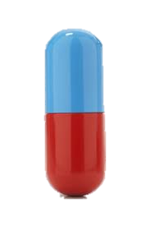
Data Flow from UE to eNB
PDCP to RLC tunneling for higher security and performance.
Platform integration with minor modifications.
Cluster head
Cluster client i
Transparent Tunnel
TCP/UDP
IP
…
…
Cluster clients’ traffic
LTE PDCP
Q_{i-1}
Q_{i}
Q_{i-1}
TCP/UDP
IP
…
…
Local traffic
LTE PDCP
Q_{i-1}
PDCP PDUs
Q_{i}
Scheduler
PDCP PDUs
Q_{i+1}
…
…
PDCP
RLC
RLC
MAC
MAC
MAC
MAC
PHY
PHY
PHY
PHY
WiFi Channel
LTE Channel

Slide 27
Experiment

Slide 28
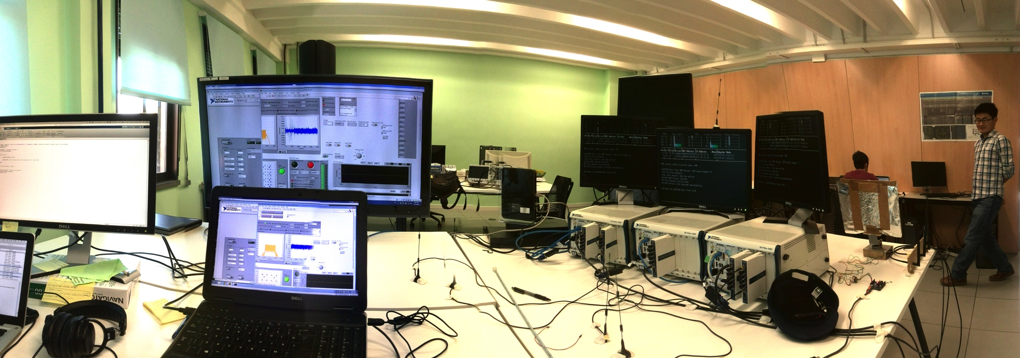
Prototyping the First SDR-based D2D Testbed^{[5]}
[5] Arash Asadi, Vincenzo Mancuso, and Rohit Gupta, “An SDR-based Experimental Study of Outband D2D Communications”, Accepted in IEEE INFOCOM, San Francisco, USA, 2016.

Slide 29
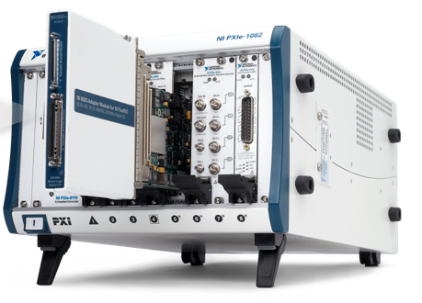
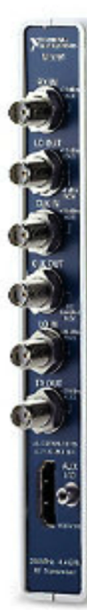
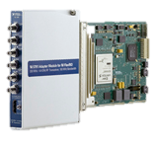
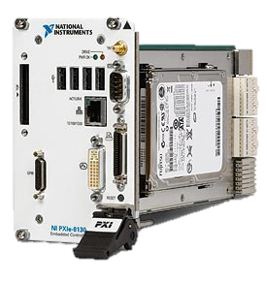
Hardware Components
Real-Time Controller
FPGA
FAM
Mac
Services
Transport Block
Generation
CCH
Convolutional
coding
Interleaving
Bit to IQ Symbol mapping
iFFT & Resampling
DAC
SCH
Scrambling
PXIe 8135
(Real-Time controller)
MUX
FlexRIO module
(RF transceiver)
D2D
Services
Resource
Mapping
PSS
Reference Sym
Null

Slide 30

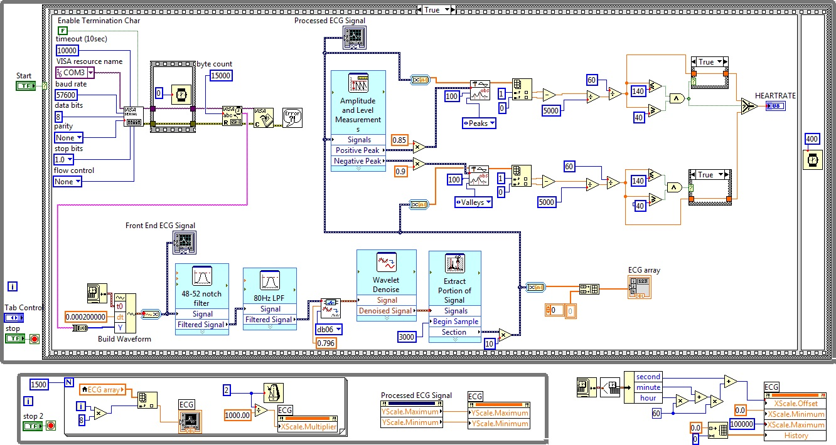
SDR Software

Slide 31
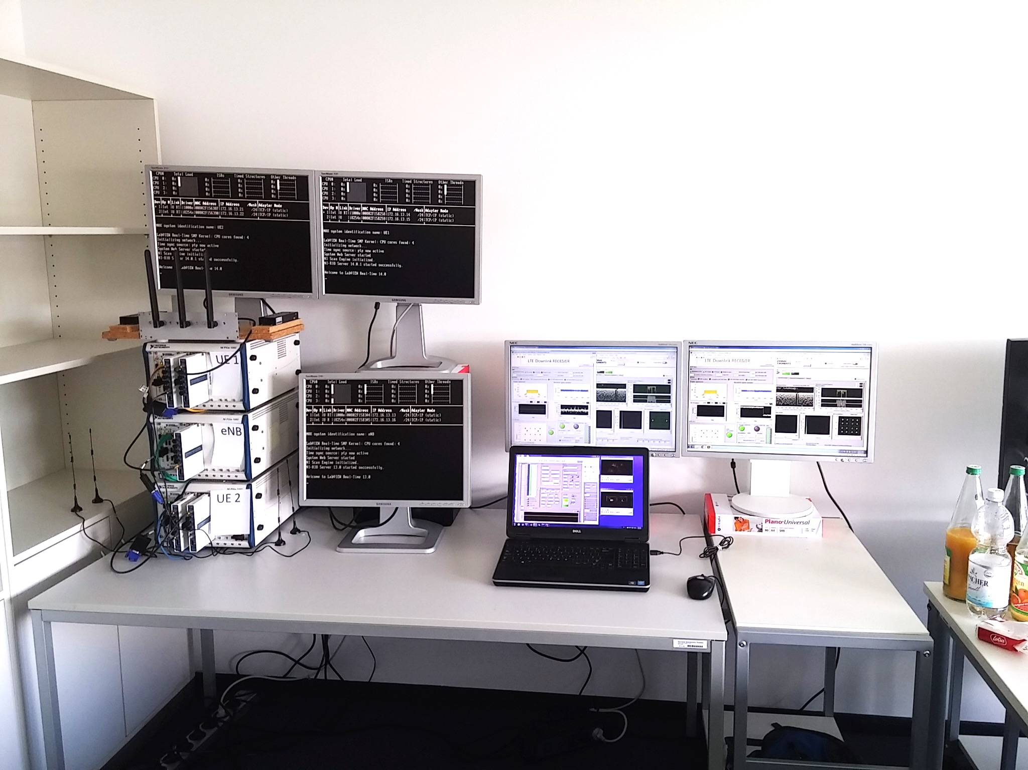
Experimental Results
Schedulers:
    Round Robin (RR)
    Proportional Fair (PF)
    Clustered RR (CL(RR))
    Clustered PF (CL(PF))
WiFi
LTE (RX)
LTE (TX)
Less than 3 ms
11%
21%

Slide 32
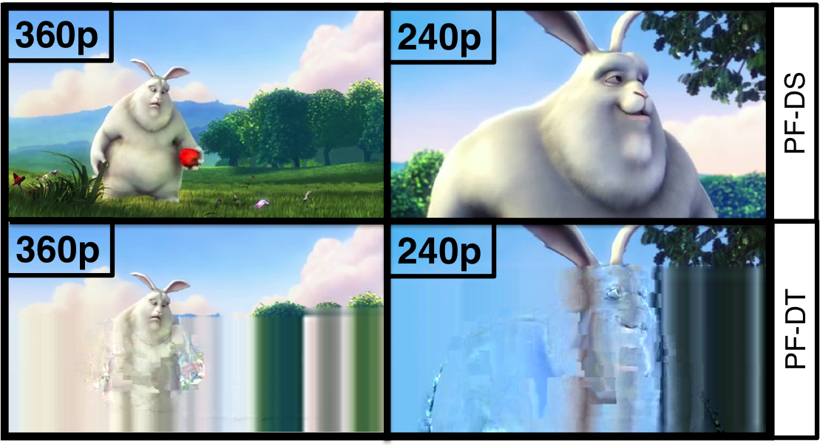


Experimental Results
Notes:
Structural similarity (SSIM). QoE metric based on the difference with the original

Slide 33
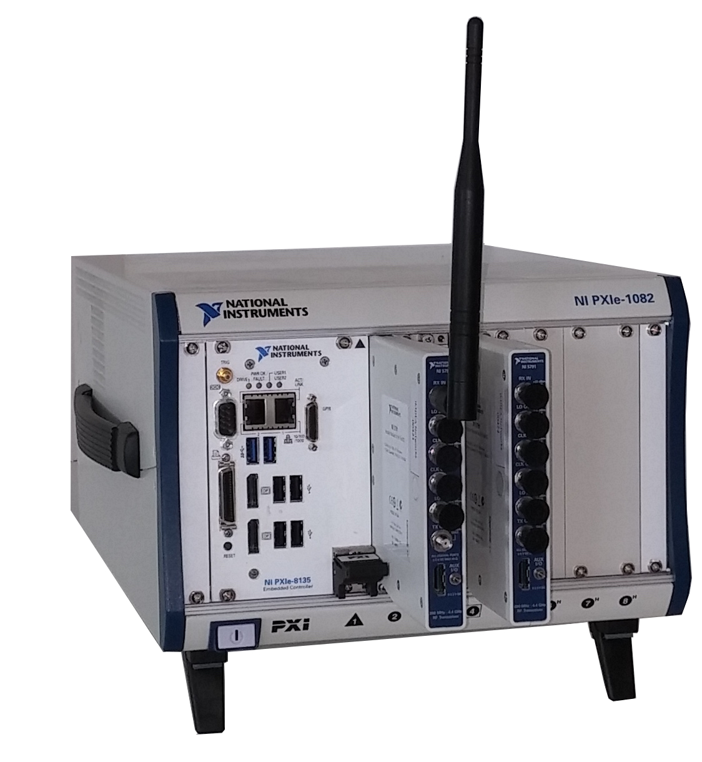
Experimental Results
CSI
CSI
CSI
71.8%

Slide 34
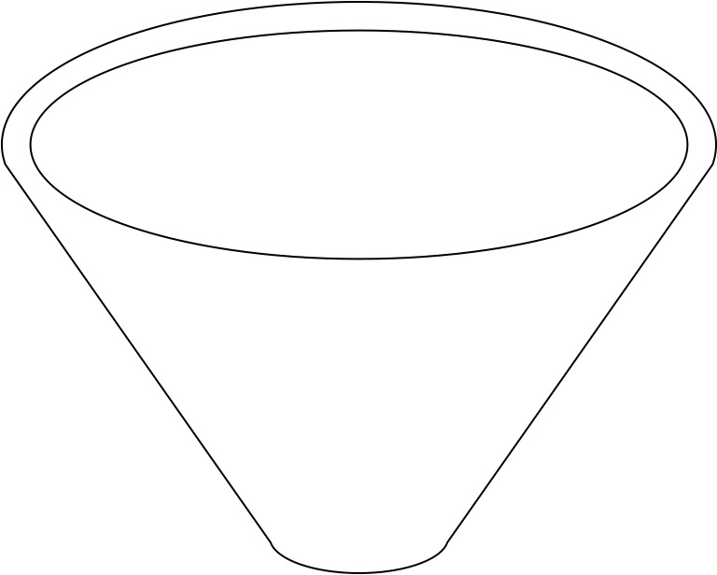

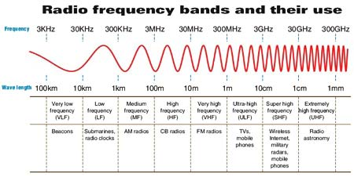

Conclusion
Densification
Theory
Simulation
Opportunistic D2D communications feeds on Density.
Experiment
Spectrum Scarcity
Analytical and experimental results illustrated higher efficiency.
Complexity
Leveraging new paradigms and existing tools.
Feasibility of Opportunistic D2D Communications

Slide 35
Future Works
Dense Scenarios

Slide 36

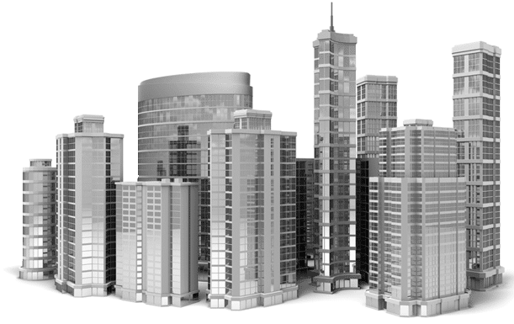
Future Works
Public Safety

Slide 37
and many thanks to Arash Asadi, PhD, who successfully defended in March with this work and a similar presentation

